Slide 1
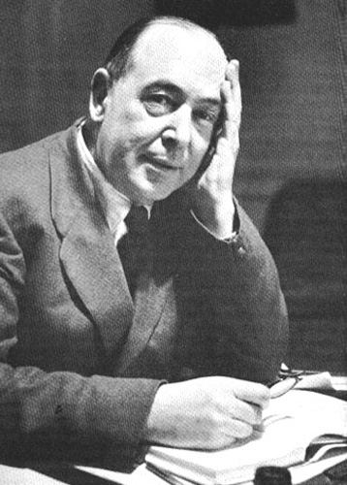
The war writings of c. s. lewis
1939--1945

Slide 2
Workshop description
This class will present the life and writings of C. S. Lewis during the Second World War, showing how his faith and imagination focused his attention on addressing, through his writings, three wars—(1) the one being fought for the future of Europe, (2) the one about the Christian faith and (3) the one that dealt with objective vs. subjective reality.

Slide 3
I. An introduction
World war i
World war ii
Though Irish (and therefore exempt from military service), he volunteered and served as a Second Lieutenant in the Army in World War I.
He was wounded in battle.
He was scarred emotionally and psychologically so that he rarely spoke or wrote about his war experiences.
In World War II he volunteered for the Oxford City Home Guard Battalion.
He lectured for the Royal Air Force on weekends.
He hosted refugee children in his home during the war.
He reflected the war in his writings without writing about his own war experiences.
His brother Warren served with the Royal Army Service Corps in both wars (Dunkirk).

Slide 4
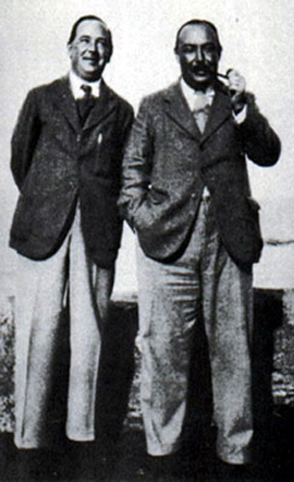
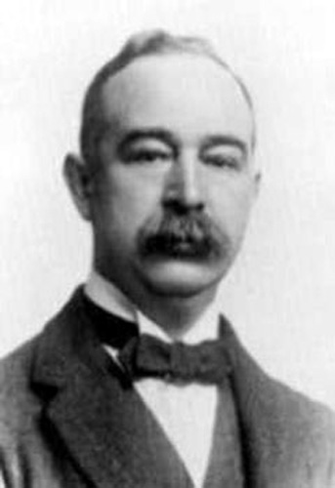
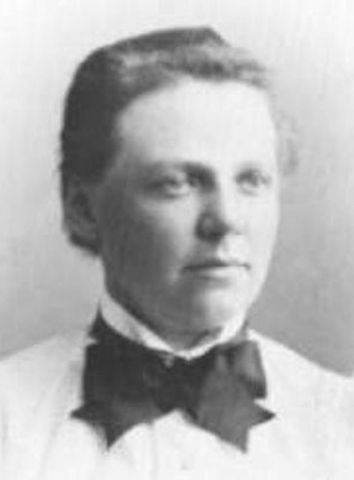
Albert & Flora
Jack & Warren

Slide 5
II. Owen Barfield’s Three Lewises
Literary Criticism
Poetry & Imaginative Fiction
Christian Apologetics & Spiritual Autobiography

Slide 6
III. An overview: 1939
“The Dark Tower” was never published during Lewis’s lifetime, undated
Rehabilitations and Other Essays on March 23
“Christianity and Literature” read to a religious society at Oxford
The Personal Heresy: A Controversy (with E. M. W. Tillyard) on April 27
Letter “The Conditions for a Just War,” Theology, Vol. XXXVII, May
Poem “To Roy Campbell,” later retitled “To the Author of ‘Flowering Rifle’,” a pro-Fascist book/poem published in 1939 in support of Franco in the Spanish Civil War. Lewis’ poem was published in The Cherwell (LVI) on May 6
“The Renaissance and Shakespeare: Imaginary Influences” was delivered in Stratford on August 30
“Learning in War-Time” was preached at St. Mary the Virgin Church, Oxford, on October 22
“The Fifteenth-Century Heroic Line” from Essays and Studies, Vol. XXIV
“High and Low Brows” read to the English Society at Oxford

Slide 7
III. An overview: 1940 (more coming)
“Dante’s Similes” was read on February 13 to the Oxford Dante Society
Poem “Break Sun, My Crusted Earth” by February 25
Poem “Arise my Body” by February 25
Poem “Essence” by February 25
Poem “The World is Round” by February 25
“Christianity and Culture” (March, Theology)
“Dangers of National Repentance” in The Guardian on March 15
“Two Ways with the Self” from The Guardian on May 3
The Problem of Pain published on Oct. 14

Slide 8
III. An overview: 1940 (completed)
Letter on “Christianity and Culture” to Theology, Vol. XL, June
“The Necessity of Chivalry” published as “Notes on the Way” in Time and Tide, Vol. XXI, on August 17
Letter “The Conflict in Anglican Theology,” Theology, Vol. LXI, November
“Peace Proposals for Brother Every and Mr Bethell,” Theology, Vol. XLI, December
“Tasso” was probably written during this decade, based on the nature of the handwriting, although the exact date is not known.
Poem “Hermione in the House of Paulina” in Augury: An Oxford Miscellany of Verse and Prose
“Why I Am Not a Pacifist,” delivered to a pacifist society in Oxford

Slide 9
III. An overview: 1941
“Meditation on the Third Commandment” from The Guardian on January 10
“Evil and God” in The Spectator, Vol. CLXVI, on February 7
“‘Bulverism’” in Time and Tide, Vol. XXII, on March 29
“Psychoanalysis and Literary Criticism” was published in Essays and Studies, Vol. XXVII (1941, probably June)
“The Weight of Glory” was preached in St. Mary the Virgin Church, Oxford, on June 8
Broadcast Talks (‘Right and Wrong: A Clue to the Meaning of the Universe’ and ‘What Christians Believe’, August 6, 13, 20, and 27, and Sept. 3)
“Religion: Reality or Substitute” appeared in World Dominion (September-October)
A Preface to ‘Paradise Lost’, the Ballard Matthews Lectures delivered at University College, North Wales, Dec. 1, 2, and 3
“On Reading The Fairie Queene” first appeared under the title “Edmund Spenser”

Slide 10
III. An overview: 1942
The Screwtape Letters is (are?) published on Feb. 9
“On Ethics” (undated)
“Hamlet: The Prince or the Poem?” was read to the British Academy at Wantage April 22
Poem “Epitaph” No. 11 in Time and Tide (XXIII) on June 6
“The Founding of the Oxford Socratic Club” which was Lewis’ Preface in The Socratic Digest, No. 1 (1942-1943)
“First and Second Things” as “Notes on the Way” from Time and Tide, Vol. XXIII, on June 27
“Miracles” was a talk given at St. Jude on the Hill Church, London, on September 27 and appearing in St. Jude’s Gazette in October
Poem “To a Friend” in The Spectator (CLXIX) on October 9
Letter “Miracles,” The Guardian, October 16
Letter “Religion in the Schools,” The Spectator, December 11

Slide 11
III. An overview: 1943
The Abolition of Man (Riddell Memorial Lectures, Fifteenth Series) February 24-26
“De Futilitate” was given at Magdalen College at the request of Sir Henry Tizard, President of Magdalen
“Dogma and the Universe” was published in two parts in The Guardian on March 19 and March 26, with the second part originally being entitled “Dogma and Science”
“Three Kinds of Men” from The Sunday Times, No. 6258, on March 21
Christian Behavior is published April 19
Perelandra is published on April 20
“The Poison of Subjectivism” in Religion in Life, Vol. XII, Summer
“Equality” in The Spectator, Vol. CLXXI, on August 27
“My First School” is published in Time and Tide, Vol. XXIV, on September 4
Poem “Awake, My Lute!” is published in The Atlantic Monthly, CLXXII, November

Slide 12
III. An overview: 1944 (more coming)
“On the Reading of Old Books” was written in 1943 and published in January or February of 1944 as the Introduction to Sister Penelope’s The Incarnation of the Word of God
“Is English Doomed?” from The Spectator, Vol. CLXXII, on February 11
Letter “Mr. C. S. Lewis on Christianity,” The Listener, Vol. XXXI, March 9
“The Parthenon and the Optative” ‘Notes on the Way’ section of Time and Tide, March 11
“Answers to Questions on Christianity,” an interview at Hayes on April 18
“Democratic Education” published as “Notes on the Way” in Time and Tide, Vol. XXV, on April 29
“Transposition” was given in the chapel of Mansfield College, Oxford, on May 28, the Feast of Pentecost
“A Dream” from The Spectator, Vol. CLXXIII, on July 28
“Myth Became Fact” from World Dominion, Vol. XXII (September-October)

Slide 13
III. An overview: 1944 (completed)
“Blimpophobia” from Time and Tide, Vol. XXV, on 9 September 1944
“The Death of Words,” The Spectator, September 22.
“Christian Reunion,” ca. 1944
“Horrid Red Things” was published in the Church of England Newspaper, Vol. LI on October 6
Beyond Personality on October 9
“Is Theology Poetry?” was read to the Socratic Club on November 6
“The Inner Ring” was given at King’s College, University of London, on December 14 as the annual “Commemoration Oration”
“Private Bates” from The Spectator, Vol. CLXXIII, on December 29

Slide 14
III. An overview: 1945 (more coming)
“Religion and Science” from The Coventry Evening Telegraph on January 3
“Basic Fears” from the Times Literary Supplement on February 3
“Membership” was read to the Society of St. Alban and St. Sergius, Oxford, February 10
“Two Lectures” ( = “Who was Right—Dream Lecturer or Real Lecturer?”) from The Coventry Evening Telegraph on February 21
“Addison” was published in Essays on the Eighteenth Century Presented to David Nichol Smith
“The Funeral of a Great Myth,” 1945?
“Christian Apologetics” during Easter (April 1) 1945
“The Laws of Nature” in The Coventry Evening Telegraph on April 4

Slide 15
III. An overview: 1945 (more coming)
“The Grand Miracle” is a sermon preached at St. Jude on the Hill Church, London and later published in The Guardian on April 27
“Work and Prayer” from The Coventry Evening Telegraph on May 28
Poem “Consolation” in second half of 1945
Poem “The Salamander” in The Spectator (CLXXIV) on June 8
“Hedonics” from Time and Tide, Vol. XXVI, on June 16
“Meditation in a Toolshed” from The Coventry Evening Telegraph on July 17
The Great Divorce (“A Dream”) (serialized in The Guardian from Nov. 10, 1944 to April 13, 1945)
Poem “To Charles Williams” (or “On the Death of Charles Williams”) in Britain To-day, No. 112 in August

Slide 16
III. An overview: 1945 (completed)
That Hideous Strength (“A Modern Fairy-Tale for Grown-ups”) on Aug. 16
Letter “A Village Experience,” The Guardian, August 31
Poem “The Condemned” (or “Under Sentence”) The Spectator (CLXXV) on September 7
“The Sermon and the Lunch” from the Church of England Newspaper, No. 2692, on September 21
“Scraps” from St. James Magazine, a literary periodical first edited by Robert Lloyd that had been in publication since 1762, in December
“After Priggery—What?” from The Spectator, Vol. CLXXV, on December 7
Poem “On the Atomic Bomb (Metrical Experiment)” in The Spectator (CLXXV) on December 28
Poem “On Receiving Bad News” (or, “Epigrams and Epitaphs, No. 12”) in Time and Tide (XXVI) on December 29

Slide 17
!
That’s 96 published pieces, that we know of, during seven years.
Many of these pieces were major items, i.e. eight major books, as we will see in a moment.

Slide 18
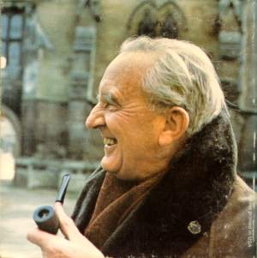
iV. Inspiration & encouragement
Met J. R. R. Tolkien on May 11, 1926
The Coalbiters, an early precursor to the Inklings
Author, Inkling, and encourager
”As C. S. Lewis said to me long ago, more or less – … ‘if they won’t write the kind of books we want to read, we shall have to write them ourselves.’”

Slide 20
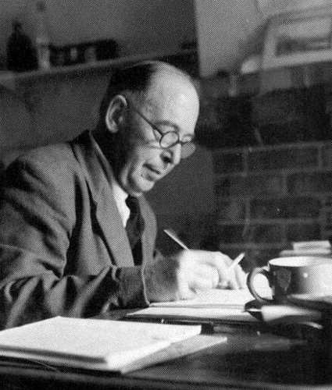
V. Major works during the war
Eight major works between 1939 and 1945:
The Personal Heresy (1940) (reprinted by CUP)
The Problem of Pain (1940)
A Preface to “Paradise Lost” (1942)
The Screwtape Letters (1942)
The Abolition of Man (1943)
Perelandra (1943)
That Hideous Strength (1945)
The Great Divorce (1945)

Slide 21
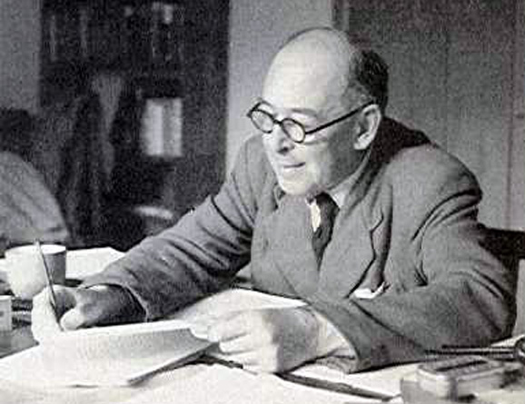
V. Major works during the war
Also most of Mere Christianity (1941-1944)
And numerous articles and papers, especially “Learning in War-Time,” “Dangers of National Repentance,” “Why I Am Not a Pacifist,” “The Grand Miracle,” “The Conditions for a Just War,” “To the author of ‘Flowering Rifle’,” “The Necessity of Chivalry” (in which he comments favorably on the virtues of British soldiers), and “The Weight of Glory.”

Slide 22
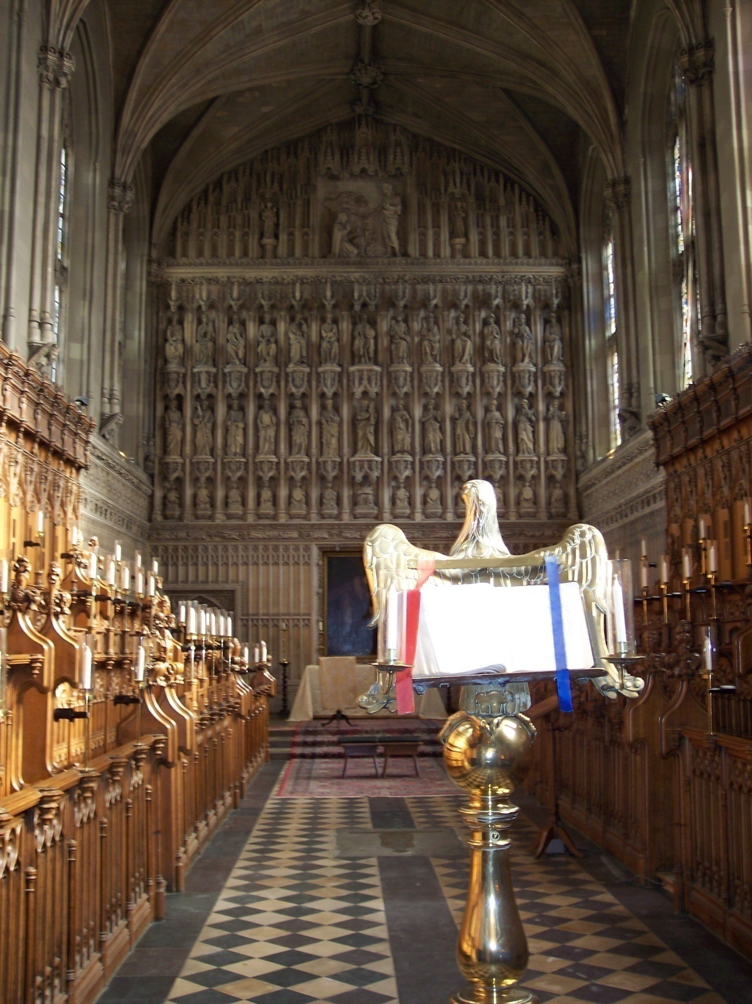

Slide 23
VI. The inklings
“If there was only someone with a richer talent and more leisure I think that this great ignorance might be a help to the evangelization of England; any amount of theology can now be smuggled into people’s minds under cover of romance without their knowing it.”
To Sister Penelope on August 9, 1939
Richer talent?
Then the Ransom Trilogy (1938, 1943, 1945)
And, of course, later the Chronicles of Narnia and The Great Divorce

Slide 24
“past watchful dragons”
I thought I saw how stories of this kind could steal past a certain inhibition which had paralyzed much of my own religion in childhood. Why did one find it so hard to feel as one was told one ought to feel about God or about the sufferings of Christ? I thought the chief reason was that one was told one ought to. An obligation to feel can freeze feelings. And reverence itself did harm. The whole subject was associated with lowered voices; almost as if it were something medical. But supposing that by casting all these things into an imaginary world, stripping them of their stained-glass and Sunday school associations, one could make them for the first time appear in their real potency? Could one not thus steal past those watchful dragons? I thought one could (“Sometimes Fairy Stories May Say Best What’s To Be Said”).

Slide 25
VIi. Writings in World war ii
Eligibility for military service if you are between the ages of 18 and 41
The Problem of Pain, 1940
A letter to Warren on July 20, 1940 that contains the germ of an idea that eventually becomes The Screwtape Letters
The talks that became Mere Christianity (see next slide)

Slide 26
Words from the Battlefield
More than one per page (247)
Battle, invasion/invade, force (20x), Allies, march, Gestapo, army, blow to bits, soldier (16x), war (80x), ration (21x), battle/battlefield, enemy (22x), fight (16x), struggle, German/Germany, Nazi, infantry, sabotage, rebel/rebellion (9x), surrender (8x), arms (7x), conquest, conquer, Jews, smuggle, and military
Written during World War Two by a veteran of World War One

Slide 27
Book Ii, chapter 2, The Invasion
Enemy-occupied territory—that is what this world is. Christianity is the story of how the rightful king has landed, you might say landed in disguise, and is calling us all to take part in a great campaign of sabotage. When you go to church you are really listening-in to the secret wireless from our friends: that is why the enemy is so anxious to prevent us from going. He does it by playing on our conceit and laziness and intellectual snobbery. I know someone will ask me, “Do you really mean, at this time of day, to reintroduce our old friend the devil—hoofs and horns and all?” Well, what the time of day has to do with it I do not know. And I am not particular about the hoofs and horns. But in other respects my answer is “Yes, I do.” I do not claim to know anything about his personal appearance. If anybody really wants to know him better I would say to that person, “Don’t worry. If you really want to, you will. Whether you’ll like it when you do is another question.”

Slide 28
Objective Value
The Personal Heresy
“I must make of him (the author) not a spectacle but a pair of spectacles.”
The Abolition of Man, the best defense of Natural Law in the English language

Slide 29
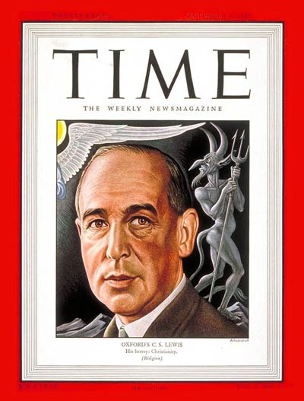
September 8, 1947 cover of Time magazine
The Screwtape Letters: Letters from a retired demon to a young demon on the art of temptation.

Slide 30
From Letter 1: reason vs. jargon
I note what you say about guiding your patient’s reading and taking care that he sees a good deal of his materialist friend. But are you not being a trifle naïve? It sounds as if you supposed that argument was the way to keep him out of the Enemy’s clutches. That might have been so if he had lived a few centuries earlier. At that time the humans still knew pretty well when a thing was proved and when it was not; and if it was proved they really believed it. They still connected thinking with doing and were prepared to alter their way of life as the result of a chain of reasoning.

Slide 31
From Letter 1: reason vs. jargon
But what with the weekly press and other such weapons, we have largely altered that. Your man has been accustomed, ever since he was a boy, to having a dozen incompatible philosophies dancing about together inside his head. He doesn’t think of doctrines as primarily “true” or “false,” but as “academic” or “practical,” “outworn” or “contemporary,” “conventional” or “ruthless.” Jargon, not argument, is your best ally in keeping him from the Church.

Slide 32
From Letter 1: reason vs. jargon
The trouble about argument is that it moves the whole struggle onto the Enemy’s own ground. He can argue too; whereas in really practical propaganda of the kind I am suggesting He has been shown for centuries to be greatly the inferior of Our Father Below. By the very act of arguing, you awake the patient’s reason; and once it is awake, who can foresee the result? Even if a particular train of thought can be twisted so as to end in our favor, you will find that you have been strengthening in your patient the fatal habit of attending to universal issues and withdrawing his attention from the stream of immediate sense experiences. Your business is to fix his attention on the stream. Teach him to call it “real life” and don’t let him ask what he means by “real.”

Slide 33
from letter 12: The gradual slope
You will say that these are very small sins; and doubtless, like all young tempters, you are anxious to be able to report spectacular wickedness. But do remember, the only thing that matters is the extent to which you separate the man from the Enemy. It does not matter how small the sins are, provided that their cumulative effect is to edge the man away from the Light and out into the Nothing.

Slide 34
Letter 12 (cont’d)
Murder is no better than cards if cards can do the trick. Indeed, the safest road to Hell is the gradual one—the gentle slope, soft underfoot, without sudden turnings, without milestones, without signposts.

Slide 35
Letter 5: worldliness
And how disastrous for us is the continual remembrance of death which war enforces. One of our best weapons, contented worldliness, is rendered useless. In wartime not even a human can believe that he is going to live forever.

Slide 36
Letter 28: worldliness
The Enemy has guarded him from you through the first great wave of temptations. But, if only he can be kept alive, you have time itself for your ally. The long, dull, monotonous years of middle-aged prosperity or middle-aged adversity are excellent campaigning weather. You see, it is so hard for these creatures to persevere. The routine of adversity, the gradual decay of youthful loves and youthful hopes, the quiet despair (hardly felt as pain) of ever overcoming the chronic temptations with which we have again and again defeated them, …

Slide 37
Letter 28 (cont’d)
… the drabness which we create in their lives, and the inarticulate resentment with which we teach them to respond to it—all this provides admirable opportunities of wearing out a soul by attrition. If, on the other hand, the middle years prove prosperous, our position is even stronger. Prosperity knits a man to the World. He feels that he is “finding his place in it,” while really it is finding its place in him. His increasing reputation, his widening circle of acquaintances, his sense of importance, the growing pressure of absorbing and agreeable work, build up in him a sense of being really at home on Earth, which is just what we want. You will notice that the young are generally less unwilling to die than the middle-aged and the old.

Slide 38
PS: Walter Hooper, Hon.D.
Private secretary to Lewis
Literary Executor
Author
Editor of the works of Lewis (19 on my shelves)
Honorary Doctorate from Concordia University Texas (2007)
Heck Sabbatical 2004
The Old Parsonage, Oxford, 2008

