Slide 1
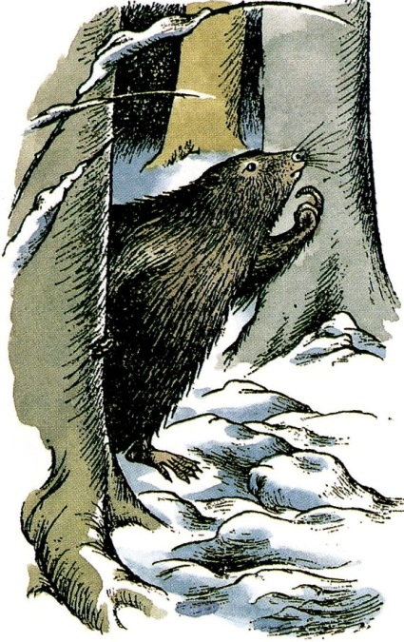
Narnia for Adults: Introduction to the Chronicles of Narnia
Austin Oaks
September-October 2017
Austin, Texas
Drawings by Pauline Baynes

Slide 2
The Lion, lions, & the last lion
Notes:
Trafalgar Square, London. Aslan, England, and Winston Churchill.

Slide 3
“It all Began with a Picture…” Of Other Worlds, p. 42

Slide 4
The Editor has asked me to tell you how I came to write The Lion, the Witch and the Wardrobe. I will try, but you must not believe all that authors tell you about how they wrote their books. This is not because they mean to tell lies. It is because a man writing a story is too excited about the story itself to sit back and notice how he is doing it. In fact, that might stop the works; just as, if you start thinking about how you tie your tie the next thing is that you find you can’t tie it. And afterwards when the story is finished, he has forgotten a good deal of what writing it was like.

Slide 5
One thing I am sure of. All my seven Narnian books, and my three science fiction books, began with seeing pictures in my head. At first they were not a story, just pictures.

Slide 6
The Lion all began with a picture of a Faun carrying an umbrella and parcels in a snowy wood. This picture had been in my mind since I was about sixteen. Then one day, when I was about forty, I said to myself: “Let’s try to make a story about it.”

Slide 7
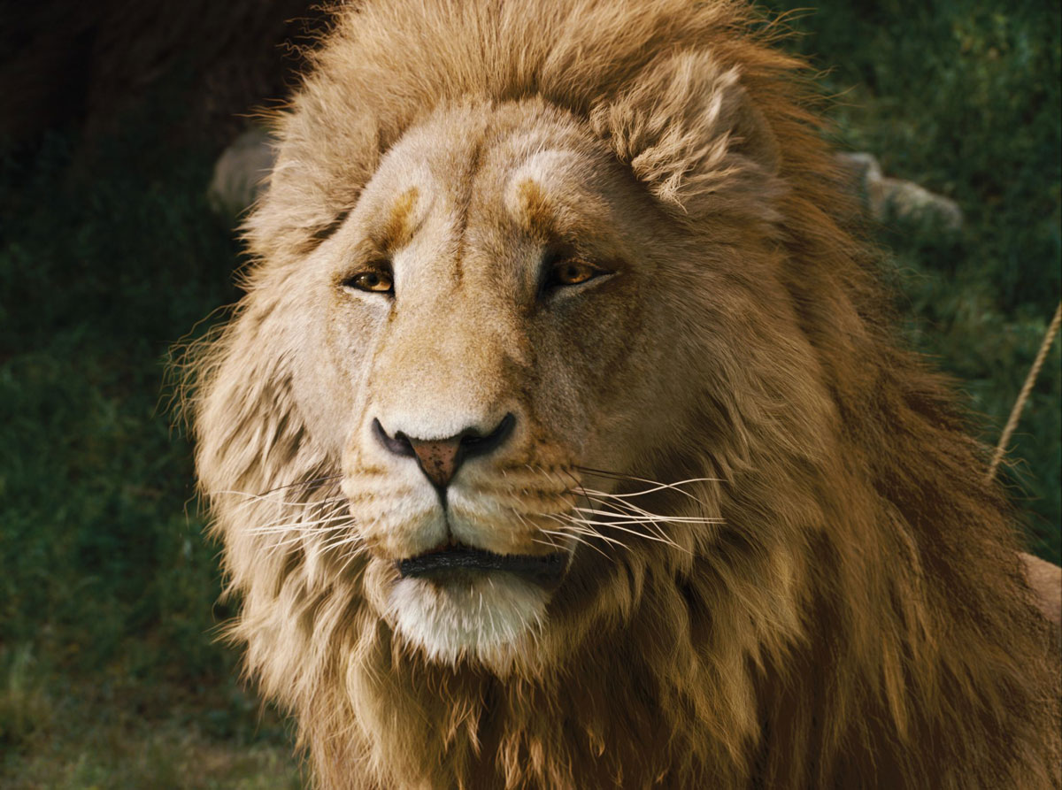
At first I had very little idea how the story would go. But then suddenly Aslan came bounding into it. I think I had been having a good many dreams of lions about that time. Apart from that, I don’t know where the Lion came from or why He came. But once He was there He pulled the whole story together, and soon He pulled the six other Narnian stories in after Him.
Notes:
Aslan “pulled the six other Narnian stories in after Him.” (“It All Began with a Picture,” Of Other Worlds: Essays and Stories, 42.)

Slide 8
So you see that, in a sense, I know very little about how this story was born. That is, I don’t know where the pictures came from. And I don’t believe anyone knows exactly how he “makes things up.” Making up is a very mysterious thing. When you “have an idea” could you tell anyone exactly how you thought of it?

Slide 9
I. Type of Literature
Not allegory
Supposal (or reenactment)
A letter to Patricia: “I’m more saying ‘Suppose there were a world like Narnia and it needed rescuing and the Son of God (or the “Great Emperor oversea”) went to redeem it, as He came to redeem ours, what might it, in that world, all have been like?’”

Slide 10
A Typical Fairy Tale
Lewis’s Fairy Tale
“Once upon a time, there lived ….”
An undefined time
Magic that is fanciful or arbitrary, e.g. frog to prince
A country that exists in a parallel world
2,555 years of Narnian time
Magic based on a Christian theological system

Slide 11
II. Lewis’s Style
Personal
Humor
Pro-maturity and anti-grownupness
Fascination with language (couch, davenport, settee, sofa, and divan [conference] in HHB or “tingle” [“star” in Old English] in VDT)
War Drobe in Spare Oom
Notes:
The words “sofa” and “divan” come from the Turkish, sofa when no conference is taking place and divan when there is. “Tingle” means “star” in Old English, and Lucy’s fingers tingle when she is searching Coriakin’s book of spells because Coriakin, the author of this book of spells, is himself a star.

Slide 12
II. Lewis’s Style
Authorial intrusions, e.g., TLWW, Chapter XV, “I hope no one who reads this book has been quite as miserable as Susan and Lucy were that night, but if you have been—if you’ve been up all night and cried till you have no more tears left in you—you will know that there comes in the end a sort of quietness.”
Notes:
The words “sofa” and “divan” come from the Turkish, sofa when no conference is taking place and divan when there is. “Tingle” means “star” in Old English, and Lucy’s fingers tingle when she is searching Coriakin’s book of spells because Coriakin, the author of this book of spells, is himself a star.

Slide 13
Intriguing characters: Reepicheep, Lucy, Puddleglum, Eustace Clarence Scrubb, etc.
Moral teaching
Concern for children: “… you should never shut yourself up in a wardrobe” (Chapter V, TLWW).

Slide 14
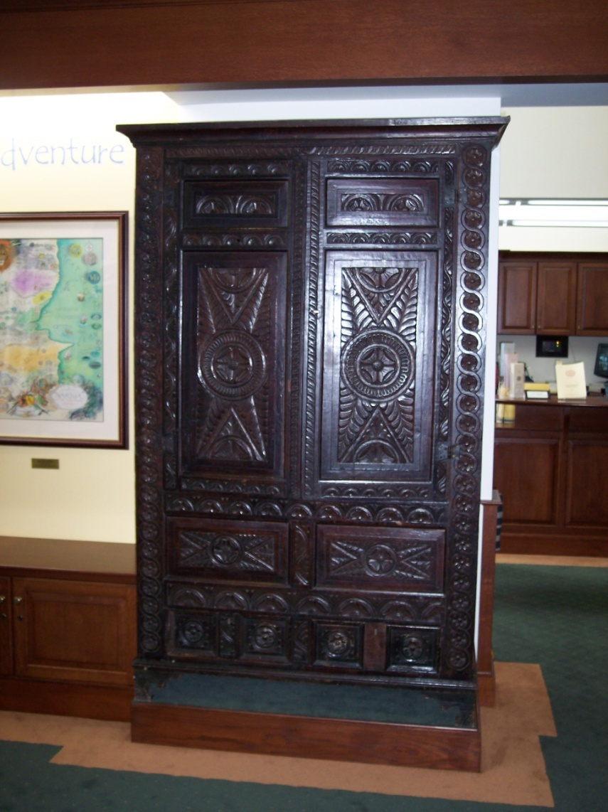
Notes:
The wardrobe that inspired TLWW at the Wade Center, Wheaton, Illinois.

Slide 15
III. Historical Context
A longing for another world
Children at the Kilns during WW2 and the issue of faith
The dynamics of children’s interaction and the rules of magic from Edith Nesbit, animal characterization from Beatrix Potter, the White Witch and the frozen nature of Narnia from Hans Christian Andersen, etc.
Anti-secularism
Fifth grade level (good for ESL)
Title from Roger Lancelyn Green
Michael Ward: Planet Narnia

Slide 16
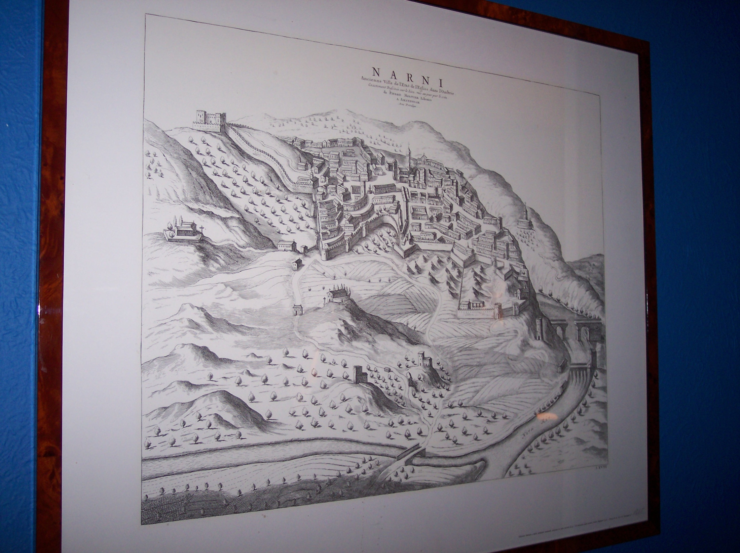
The real Narnia in Italy.
Notes:
The wall of Walter Hooper’s apartment in north Oxford.

Slide 17
IV. Their Importance
A. Fantasy and Children’s Literature
A renaissance in children’s literature
Popularizing of fantasy
Now translated into forty-seven languages and published in more than 125 million copies
B. Literary (Homer, Virgil, Dante, Spenser, Sir Thomas Malory, Milton, Bunyan, and others, which is one reason why adults get more from these books than children)
C. Other Worlds (as in an earlier slide)
D. A corrective for the extremely rational
Notes:
Harry Potter 7 sold 8.3 million copies in the first 24 hours. Harry Potter 1 sold 107 million overall (#5). TLWW (#10) has sold an estimated 85 million copies. The Lord of the Rings (#3) at 150 million copies and The Hobbit (#8) at 100 million copies. http://inklingsfocus.com/translation_index.html

Slide 18
Best-sellers by Lewis, Tolkien, and Rowling
Harry Potter 7 sold 8.3 million copies in the first 24 hours
Harry Potter 1 sold 107 million overall (#5).
TLWW (#10) has sold an estimated 85 million copies.
The Lord of the Rings (#3) is at 150 million copies.
The Hobbit (#8) is at 100 million copies.
http://inklingsfocus.com/translation_index.html

Slide 19
The Lion the Witch and the Wardrobe
Number 6 all-time on Ranker (The Lord of the Rings and The Hobbit are #2 and 3).
Number 9 at “how stuff works”
Number 17 at Publishing Perspectives
(They omit the Bible from their lists.)
#2 in BBC’s Culture column (behind Charlotte’s Web)
#4 in the School Library Journal’s list of the top 100 children’s novels
But listed not in the top 100 for Parent & Child magazine!

Slide 20
Collected Letters, Vol. II, 171
Lewis on five-year-old Michael on Dec. 7, 1935:
“Minto reads him the Peter Rabbit books every evening, and it is a lovely sight. She reads very slowly and he gazes up into her eyes which look enormous through her spectacles …. Would you believe it, that child had never been read to nor told a story by his mother in his life? Not that he is neglected. He has a whole time Nurse …, a hundred patent foods, is spoiled, and far too expensively dressed: but his poor imagination has been left without any natural food at all.”

Slide 21
V. Critical Reception
Not much attention at first
An academic prejudice against “popular” genres such as fantasy, science fiction, & children’s literature.
The assumption that children’s literature is by definition obvious, simplistic, and shallow.
Notes:
“In 1956 the review of The Last Battle in the Children’s Books Section of the Times Literary Supplement for 11 May included the entire Narnian ‘saga’ among the ‘greatest children’s books’” (Colin Manlove, 13).

Slide 22
V. Critical Reception
British Response
Initial response to The Lion, the Witch and the Wardrobe was hostile.
However, children loved it.
Criticisms: (1) not being real-life enough, (2) their Christianity, (3) their violence, (4) unpleasant child characters
However, on May 11, 1956, Times Literary Supplement called . . . The Narnia “saga” among “the greatest children’s books.”
Notes:
“In 1956 the review of The Last Battle in the Children’s Books Section of the Times Literary Supplement for 11 May included the entire Narnian ‘saga’ among the ‘greatest children’s books’” (Colin Manlove, 13).

Slide 23
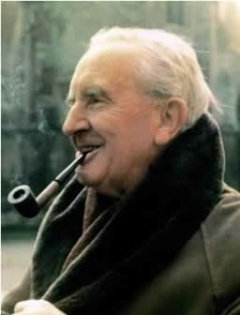
For children only?
“On Three Ways of Writing for Children”: “… writing a children’s story because [it] … is simply the right form for what the author has to say ….”
“On Juvenile Tastes”: “Even the fairy tale … was not originally intended for children.”
Lewis’s friendship with Tolkien, who also wrote books for children

Slide 24
On the Dedication Page of The Lion, the Witch and the Wardrobe
My dear Lucy,
I wrote this story for you, but when I began it I had not realized that girls grow quicker than books. As a result you are already too old for fairy tales, and by the time it is printed and bound you will be older still. But some day you will be old enough to start reading fairy tales again. You can then take it down from some upper shelf, dust it, and tell me what you think of it. I shall probably be too deaf to hear, and too old to understand a word you say, but I shall still be
your affectionate Godfather,
C. S. Lewis

Slide 25
VI. Christian Teachings & Purpose
As from Magdalene College,
Cambridge.
5 March 1961
Dear Anne –
What Aslan meant when he said he had died is, in one sense, plain enough. Read the earlier book in the series called The Lion the Witch and the Wardrobe, and you will find the full story of how he was killed by the White Witch and came to life again. When you have read that, I think you will probably see that there is deeper meaning behind it.

Slide 26
The whole Narnian story is about Christ. That is to say, I asked myself ‘Supposing there really were a world like Narnia, and supposing it had (like our world) gone wrong, and supposing Christ wanted to go into that world and save it (as He did ours) what might have happened?

Slide 27
The stories are my answer. Since Narnia is a world of Talking Beasts, I thought He would become a Talking Beast there, as he became a Man here. I pictured Him becoming a lion there because (a) The lion is supposed to be the King of beasts: (b) Christ is called ‘The Lion of Judah’ in the bible. (c) I’d been having strange dreams about lions when I began writing the books. The whole series works out like this:

Slide 28
The Magician’s Nephew tells the creation and how evil entered Narnia.
The Lion etc. – the Crucifixion and Resurrection
Prince Caspian – restoration of the true religion after a corruption
The Horse and his Boy – the calling and conversion of a heathen.
The Voyage of the Dawn Treader – the spiritual life (specially in Reepicheep)
The Silver Chair – the continued war against the powers of darkness
The Last Battle – the coming of Antichrist (the Ape). The end of the world, and the Last Judgment
All clear?
Yours
C. S. Lewis

Slide 29
“Dearest,” said Aslan very gently, “you and your brother will never come back to Narnia.”
“Oh, Aslan!” said Edmund and Lucy both together in despairing voices.
“You are too old, children,” said Aslan, “and you must begin to come close to your own world now.”
“It isn’t Narnia, you know,” sobbed Lucy. “It’s you. We shan’t meet you there. And how can we live, never meeting you?”
From The Voyage of the ‘Dawn Treader’

Slide 30
“But you shall meet me, dear one,” said Aslan.
“Are—are you there too, Sir?” said Edmund.
“I am,” said Aslan. “But there I have another name. You must learn to know me by that name. This was the very reason why you were brought to Narnia, that by knowing me here for a little, you may know me better there.”
From The Voyage of the ‘Dawn Treader’

Slide 31
“Sometimes Fairy Stories May Say Best What’s To Be Said”
“I thought I saw how stories of this kind could steal past a certain inhibition which had paralyzed much of my own religion in childhood. Why did one find it so hard to feel as one was told one ought to feel about God or about the sufferings of Christ? I thought the chief reason was that one was told one ought to. An obligation to feel can freeze feelings.

Slide 32
And reverence itself did harm. The whole subject was associated with lowered voices; almost as if it were something medical. But supposing that by casting all these things into an imaginary world, stripping them of their stained-glass and Sunday school associations, one could make them for the first time appear in their real potency? Could one not thus steal past those watchful dragons? I thought one could.”

Slide 33
Lewis’ Platonic Idea of the Person
Imagination
(outer circle)
Intellect
(middle circle)
Will

Slide 34
Imagination
“The battle is between faith and reason on one side and emotion and imagination on the other” (Mere Christianity).

Slide 35
The Next Seven Weeks
Some background to the story
A retelling of the story (you won’t have to read them at the rate of one per week, but you certainly may)
Two biblical parallels between the Bible and that Chronicle of Narnia with discussion
A Factual Quiz (just for fun)
A Narnian benediction based on that chronicle
And maybe even a quiz on the last week with the use of Smartphones. Kahoot.it

Slide 36
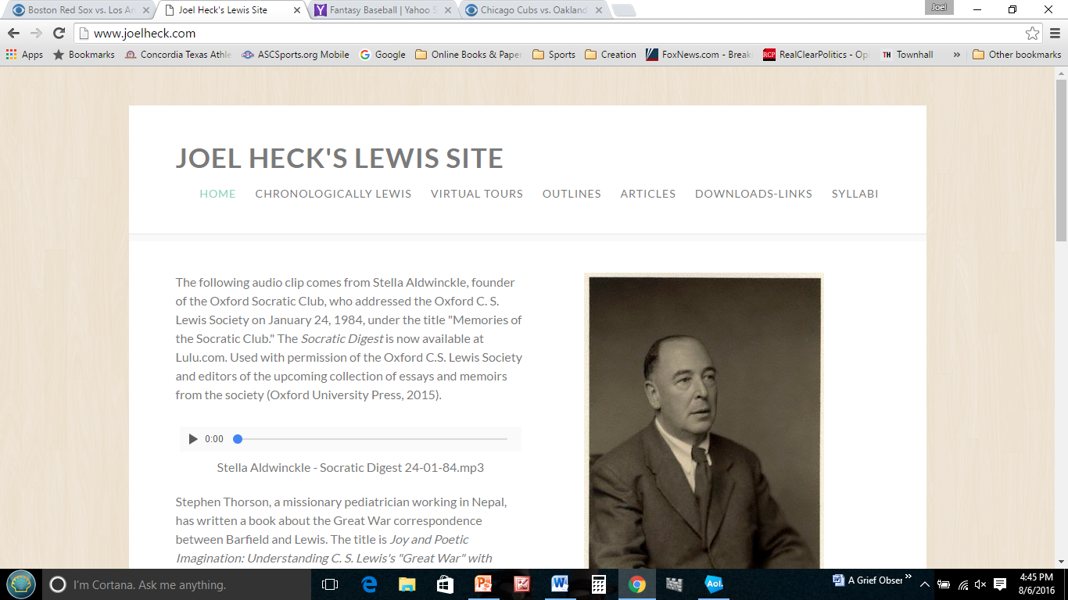
www.joelheck.com

Slide 37
Therefore … Narnia is not just for children.
So … read the Chronicles of Narnia.
Use the Chronicles of Narnia in Bible Classes, teaching, devotions, and conversations.
Recommend the Chronicles of Narnia.
Give them as gifts.
Use them as witness tools.
Maybe even thank God for them.
Good reading to you!
www.joelheck.com

Slide 38
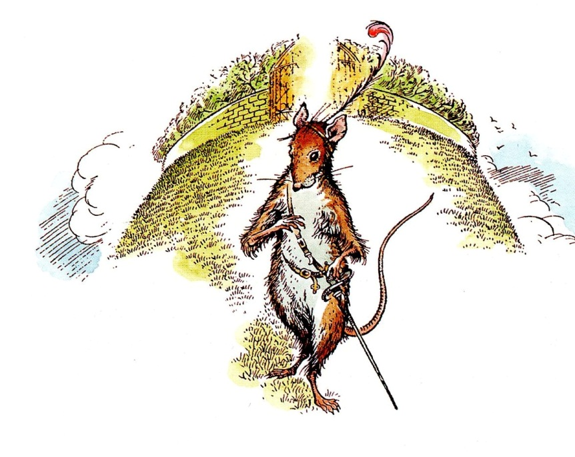
Next: The Lion, the Witch and the Wardrobe
Notes:
Reepicheep

