Slide 1
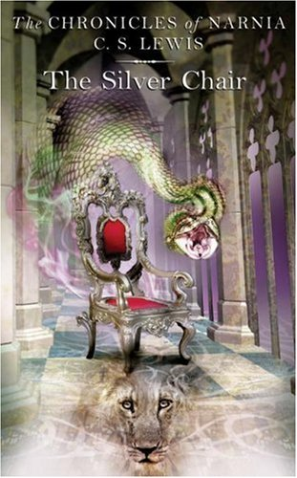
The Silver Chair
To Nicholas Hardie

Slide 2
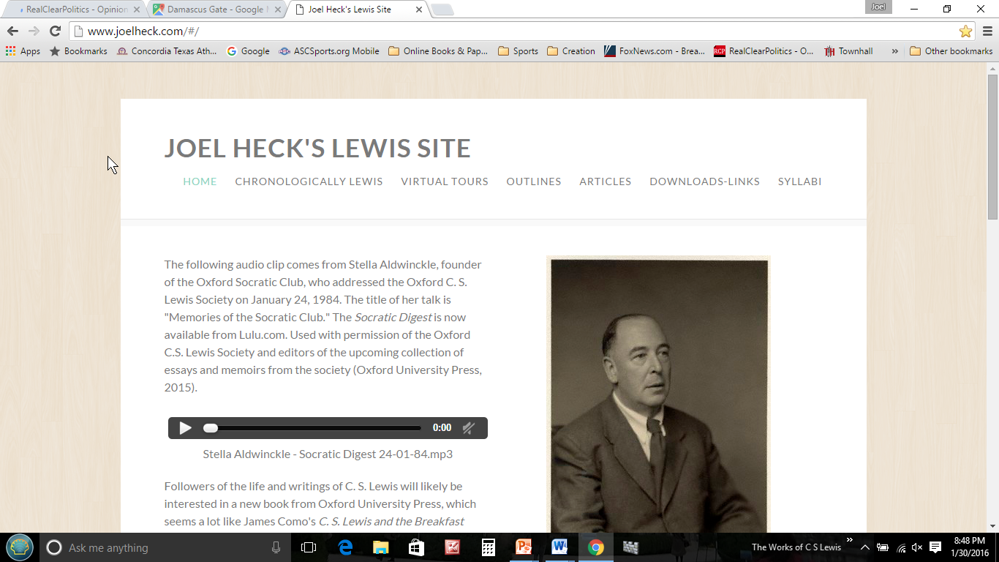
Don’t forget …
www.joelheck.com
Click on the “Outlines” link for downloading any of the PowerPoints in this series.
They appear in the left-hand column near the top of the page.

Slide 3
C. S. Lewis, Atheist
Came out January 2017 from Concordia Publishing House.
Remember that Lewis thought that the way religion had been presented to him in childhood had paralyzed him spiritually.
Why did he become an atheist?
Why and how did he return to the Christian faith?
What wrong turns did he make during his return?
Among his insights: “The vast majority of human beings, well in excess of ninety percent, believe in God, whether the God of Christianity, Judaism, Hinduism, Islam, or one of the lesser known religions. But an atheist, then as well as now, has to believe that the majority is wrong on this topic.”

Slide 5
The Plot
Jill and Eustace are chased by some bullies at school and get into Narnia by a gate at the edge of the school’s property.
They arrive in Aslan’s country, and Eustace falls off a high cliff.
Aslan blows him safely to his destination.
Jill gets thirsty, and Aslan invites her to drink.

Slide 6
The Plot
Aslan tells her about a task he gives her—to find the lost prince, Rilian, the son of the king.
Aslan gives her four signs, which she is instructed to remember.
Aslan blows her, and she and Eustace arrive at Cair Paravel and muff the first sign.
They go to a Parliament of Owls, meet Puddleglum (modeled after Fred Paxford), and travel North.

Slide 7
Narnia for Adults
“Now,” said Glimfeather, “I think we’re all here. Let us hold a parliament of owls.”
“Parlement of Foules” (Fowls, i.e., birds) is a story by Geoffrey Chaucer in the form of a dream vision.
Lewis knew Chaucer and deliberately drew this verbal parallel and created this word play (pun).
What child would understand this, even if you explained it?

Slide 8
The Plot
They travel through Ettinsmoor, where giants live, to Harfang, the home of the (not so) Gentle Giants.
From Harfang they see the City Ruinous and the chiseled words “UNDER ME” and escape.
Coming to Underland, they are taken to Rilian who is under a spell, caused by a silver chair to which he is bound for one hour a day.
They release Rilian from his silver chair, and he destroys the chair with his sword.
Harfang

Slide 9
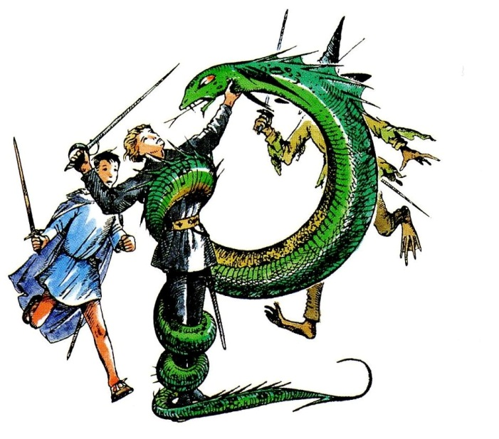
The Plot
The Green Lady arrives and attempts to enchant all of them, telling them there is no Narnia, no sun, no Aslan.
Thanks to the bravery of Puddleglum, they escape the enchantment.
The Green Lady turns into a snake, which they kill.
They leave for the surface on two horses.
They reach the surface and are pulled out of Underland by Narnian creatures.

Slide 10
The Plot
King Caspian returns from his voyage because Aslan tells him that Rilian is found.
Caspian dies shortly after arriving home.
Aslan arrives and blows Narnia away, and they find themselves in Aslan’s country again.
They see the dead king in a stream.
Aslan’s blood revives the king.

Slide 11
Quoting from the Last Chapter
“But,” said Eustace, looking at Aslan. “Hasn’t he [Caspian]—er—died?”
“Yes,” said the Lion in a very quiet voice, almost (Jill thought) as if he were laughing. “He has died. Most people have, you know. Even I have. There are very few who haven’t.”
“Oh,” said Caspian. “I see what’s bothering you. You think I’m a ghost, or some nonsense. But don’t you see? I would be that if I appeared in Narnia now: because I don’t belong there any more. But one can’t be a ghost in one’s own country. I might be a ghost if I got into your world. I don’t know. But I suppose it isn’t yours either, now you’re here.”

Slide 12
End of the Plot: The Last Chapter
Jill and Eustace return to Experiment House, and Aslan lets Caspian to join them and allows himself to be seen.
They use the flat of their swords against the bullies.
The Head comes, sees, and goes into hysterics.
“And in the inquiry all sorts of things about Experiment House came out, and about ten people got expelled. After that, the Head’s friends saw that the Head was no use as a Head, so they got her made an Inspector to interfere with other Heads. And when they found she wasn’t much good even at that, they got her into Parliament where she lived happily ever after.”

Slide 13
Background
First title: The Wild Waste Lands
Then Night under Narnia
Then Gnomes under Narnia
Then News under Narnia
Finally The Silver Chair
Influenced by The Princess and the Goblin
Kathryn Lindskoog: “Some readers find that The Silver Chair helps them to cope with their wrong turnings and the accidents that befall them in life.” Puddleglum said, “There are no accidents. Our guide is Aslan.”

Slide 14
Three Landmarks of England
Trafalgar Square: the lion Jill saw was lying in place just like the lions of Trafalgar Square (Chapter II. Jill Is Given a Task)
St. Paul’s Cathedral: the bridge of the giants soared as high as the dome of St. Paul’s Cathedral (Chapter VI. The Wild Waste Lands of the North)
Stonehenge: the stones of the bridge of the giants were as big as the stones at Stonehenge (Chapter VI. The Wild Waste Lands of the North)

Slide 15
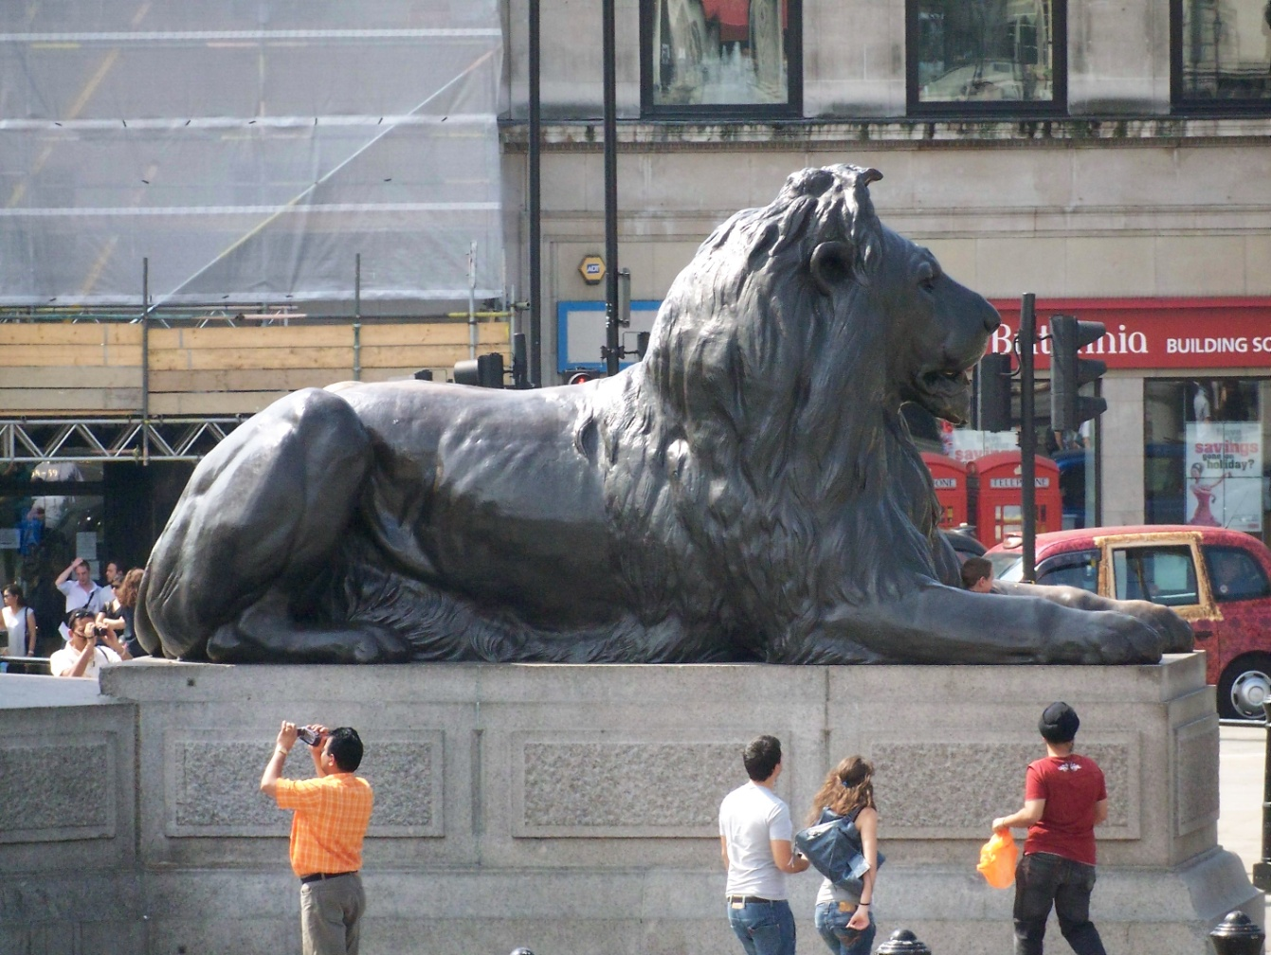

Slide 16
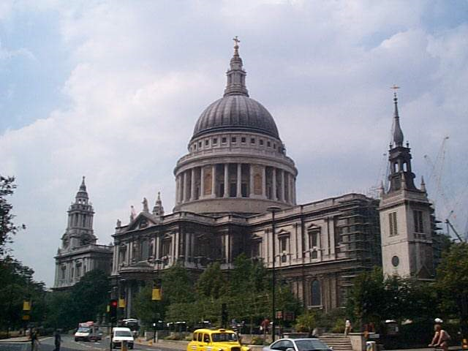

Slide 17
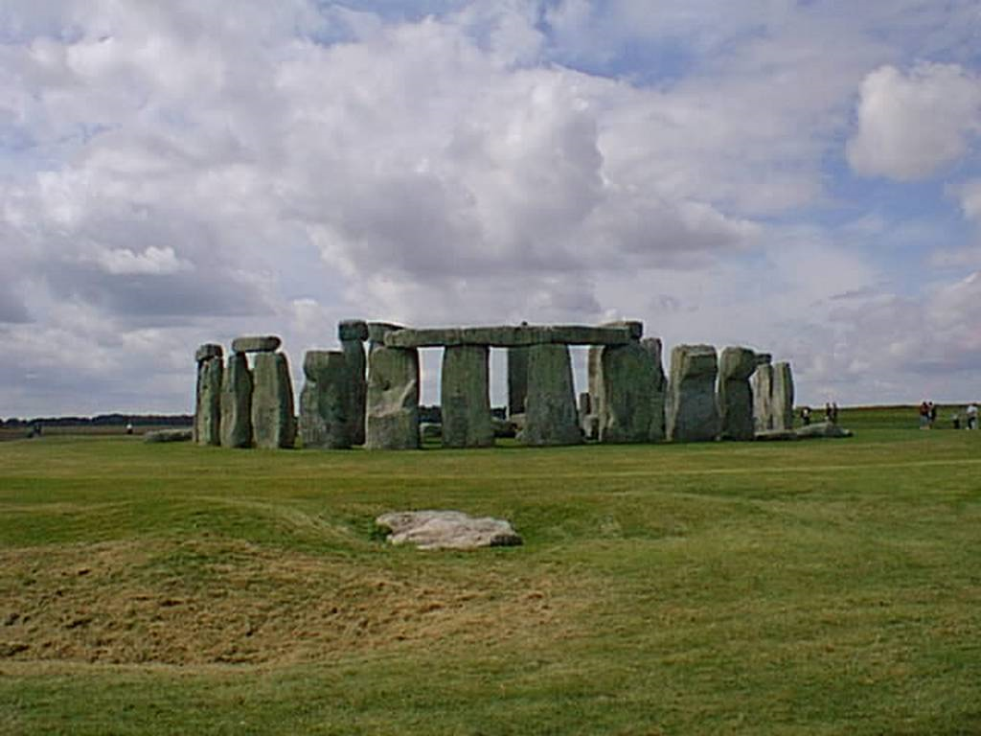

Slide 18
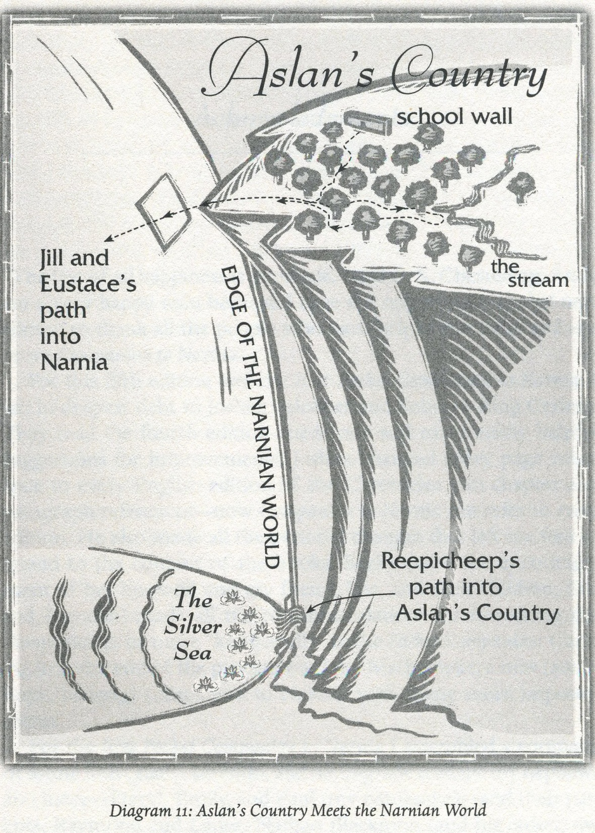
Geography
Where in Narnia is Jill when the story begins?

Slide 19
Water
Chapter 2, “Jill Is Given a Task”: “You didn’t need to drink much of it, for it quenched your thirst at once.”
So what?
This is the same water that was so powerful at the end of the last book, The Voyage of the Dawn Treader.

Slide 20
Parents Teaching Children
Aslan states, “Say them to yourself when you wake in the morning and when you lie down at night, and when you wake in the middle of the night.”
Deut. 6:7. “You shall teach them diligently to your children, and shall talk of them when you sit in your house, and when you walk by the way, and when you lie down, and when you rise.”

Slide 21
Lewis and Sexism
“Scrubb was quite right in saying that Jill (I don’t know about girls in general) didn’t think much about points of the compass.”

Slide 22
Medievalism in The Silver Chair
“Rilian knew that no physic in the world would do her good.”
Physic: medicine, especially a cathartic
Middle English: from Old French fisique ‘medicine,’ from Latin physica, from Greek phusikē (epistēmē ) ‘(knowledge) of nature.’
Ware (which Rilians says when the witch turns into a snake) is Old English (Anglo-Saxon, ca. 500-1100 A.D.), meaning “wary” or “aware”

Slide 23
Humor
Eustace (Chapter IV. A Parliament of Owls): “If this owls’ parliament, as you call it, is all fair and above board and means no mischief, why does it have to be so jolly secret—meeting in a ruin in dead of night, and all that?”
“Tu-whoo! Tu-whoo!” hooted several owls. “Where should we meet? When would anyone meet except at night?”
Chapter V. Puddleglum: “How beastly one feels after sleeping in one’s clothes,” said Jill, sitting up.
“I was just thinking how nice it was not to have to dress,” said Eustace.

Slide 24
Humor
Puddleglum (Chapter XIV): “And you must always remember there’s one good thing about being trapped down here: It’ll save funeral expenses.”
To ride on a Centaur is, no doubt, a great honor (and except Jill and Eustace there is probably no one alive in the world today who has had it) but it is very uncomfortable.

Slide 25
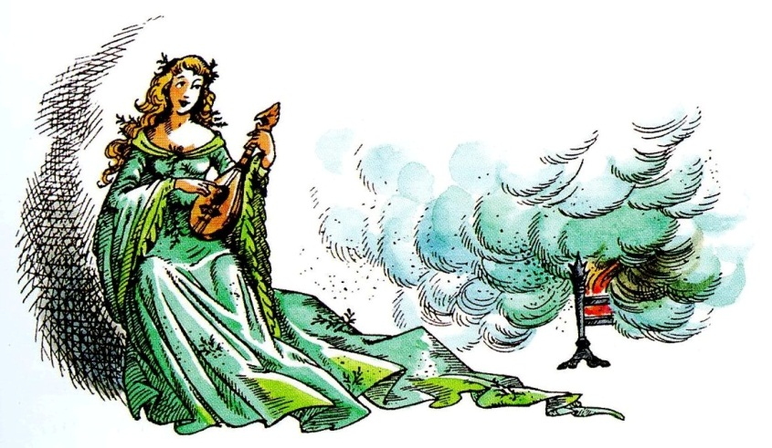
Biblical Theme I: Foot in the Fire
Rom. 12:2
James 4:7, “Submit yourselves, then, to God. Resist the devil, and he will flee from you.”
But be careful; it might hurt. It surely hurt Puddleglum!

Slide 26
Biblical Theme II: Bungled But Blessed
Jill caused Eustace to fall from the cliff.
They bungled the signs.
They bungled Harfang.
They bungled the enchantment, except for Puddleglum.
But Aslan said, “You have done the work for which I sent you into Narnia.”

Slide 27
Biblical Theme II: Bungled But Blessed
This is almost the theme of The Silver Chair.
Why? Puddleglum said it, “There are no accidents. Our guide is Aslan.”
Rom. 8:28, “And we know that in all things God works for the good of those who love him, who have been called according to his purpose.”
Acts 23:1
Gal. 1:15 (Paul’s belief)
1 Cor. 4:5, grace

Slide 28
Factual Quiz Just for Fun
Eustace Scrubb and Jill Pole got to Aslan’s country through (a) a picture of a ship, (b) a door in a school wall, (c) a railroad station.
The first sign Aslan gave Jill was (a) Eustace must greet his old friend as soon as he arrives in Narnia, (b) Jill must drink from a stream, (c) Eustace must save Jill from falling.
The children do not soon meet (a) Trumpkin, a deaf old dwarf, (b) Glimfeather, a large white owl, (c) Caspian, the old king, whose son is lost.

Slide 29
Factual Quiz Just for Fun
The children’s guide and helper was (a) Respectowiggle the Marshglum, (b) Puddlesquirm the Swamp-glum, (c) Puddleglum the Marsh-wiggle.
The second sign of Aslan was (a) to travel north to the ruined city of ancient giants, (b) to travel north to the giants’ castle, (c) to seek a beautiful lady.
The third sign of Aslan was (a) to obey the writing on a stone, (b) to obey the writing in a cookbook, (c) to attend a feast.

Slide 30
Factual Quiz Just for Fun
At the House of Harfang , Aslan showed the travelers the message (a) BEWARE, (b) PLAY DUMB, (c) UNDER ME.
Mullugutherum was (a) an Earthman in Underland, (b) Queen of the Deep Realm, (c) Warden of Overworlders.
The fourth sign of Aslan was (a) the lost prince was dressed in black, (b) the lost prince might be insane, (c) the lost prince would ask a favor in the name of Aslan.

Slide 31
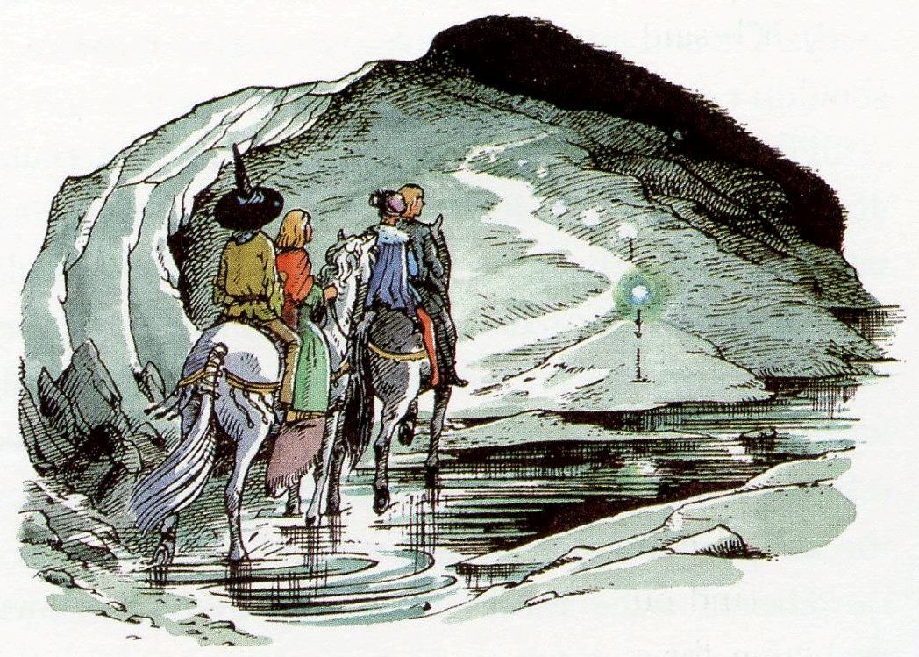
Factual Quiz Just for Fun
Which is false? (a) Jill emerged into a snow dance, (b) King Caspian was restored to youth and health, (c) Prince Rilian became king of Narnia, (d) Jill and Eustace returned to school alone, as they had left.

Slide 32
Planet Narnia
Planet: the Moon (lunar, lunatic, etc.)
There are two lunatics in the story: Prince Rilian and the headmistress of Jill’s and Eustace’s school.
Association with water because of the moon’s influence on the earth’s tides: the stream, Jill’s tears, Jill’s baths, the frequent rain, the Marsh-wiggle who is a wet blanket and who lives in the marshes, etc.
Two horses appear at the end of the story because in mythology a black horse and a white horse drew the moon’s chariot across the heavens.
The Centaur tells Jill and Eustace about “the influences of the planets.”

Slide 33
Planet Narnia
Metal: silver
The word “silver” appears 18 times in the book, including the title.
For example, Trumpkin’s silver ear-trumpet, Rilian’s silver mail, the silver shield, the lamp with a silver chain, the silver chair itself, the witch has a silvery laugh

Slide 34
Lady LUNA, in light canoe,
By friths and shallows of fretted cloudland
Cruises monthly; with chrism of dews
And drench of dream, a drizzling glamour,
Enchants us—the cheat! changing sometime
A mind to madness, melancholy pale,
Bleached with gazing on her blank count’nance
Orb’d and ageless.
In earth’s bosom
The shower of her rays, sharp-feathered light
Reaching downward, ripens silver,
Forming and fashioning female brightness,
—Metal maidenlike. Her moist circle
Is nearest earth.
Notes:
“The Planets,” written by Lewis in 1935.

Slide 35
Puddleglum vs. The Green Witch
With help from Steven Lovell, “Breaking the Spell of Skepticism: Puddleglum versus the Green Witch,” in The Chronicles of Narnia and Philosophy.

Slide 36
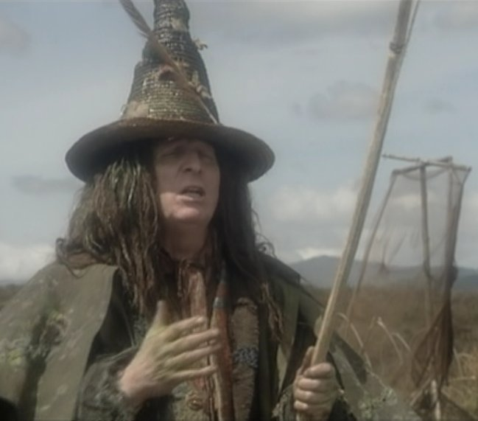
The Enchantment
Just for the sake of review…
The Queen returns
Green powder in the fireplace
Strumming on a mandolin
Reasoning with the four

Slide 37
Appearances & Reality
Attractive in appearance, yet bad in reality.
The Lady of the Green Kirtle
The Autumn Feast
The Silver Chair
Unattractive in appearance, yet good in reality.
Puddleglum
The Earthmen

Slide 38
Puddleglum vs. Sigmund Freud
She puts powder on the fire and plays the mandolin.
Are the sun and the lion figments of the imagination?
“I see,” she said, “that we should do no better with your lion, as you call it, than we did with your sun. You have seen lamps, and so you imagined a bigger and better lamp and called it the sun. You’ve seen cats, and now you want a bigger and better cat, and it’s to be called a lion. Well, ‘tis a pretty make-believe, though, to say truth, it would suit you all better if you were younger. And look how you can put nothing into your make-believe without copying it from the real world, this world of mine, which is the only world.”

Slide 39
The Freudian Critique of Belief
Freud: “The derivation of religious needs from the infant’s helplessness and the longing for the father aroused by it seems to me incontrovertible. . . . I cannot think of any need in childhood as strong as the need for a father’s protection. . . . The origin of the religious attitude can be traced back in clear outlines as far as the feeling of infantile helplessness” (Civilization and its Discontents, 1930).

Slide 40
The Freudian Critique of Belief
In other words, Freud: “at bottom God is nothing other than an exalted father” (Sigmund Freud, Totem and Taboo, 1913).
The Witch, paraphrased: “When you try to think out clearly what this God must be, you cannot tell me. You can only tell me He is like a father. Your God is a dream; and there is nothing in that dream that was not copied from an earthly father. Earthly fathers are the real thing; God is but a tale, a children’s story.”

Slide 41
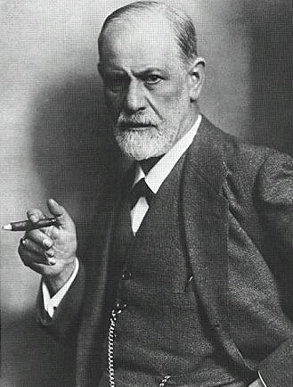
The Freudian Critique of Belief
What Freud would say: “You’ve seen fathers, and now you want a bigger and better father, and it’s to be called God. Well, ‘tis a pretty make-believe, though, to say truth, it would suit you all better if you were younger.”

Slide 42
The Witch’s Argument
It is unsound. Why?
How do we tell a copy from the original?
If two things are similar, apart from hard evidence there is no legitimate reason why we would consider one a copy. Similarity is all Freud has to go on. Can Freud prove that the earthly father is the original and God the copy?
Is the similarity between God and our earthly fathers an embarrassing fact?
Steven Lovell: “[The similarity between God and our earthly fathers] is just the sort of thing one might expect if God does exist.”

Slide 43
Whose Illusion?
Freud claims that belief in God is the result of wish-fulfillment.
Is the God of Christianity the type of God that people would wish for?
A God who sees all things, knows all thoughts, passes judgment on all deeds.
A God to whom we are accountable and from whom we can never be independent.
A God to whom we owe worship and obedience.

Slide 44
Whose Illusion?
Alvin Plantinga: “Many people thoroughly dislike the idea of an omnipotent, omniscient being monitoring their every activity, privy to their every thought, and passing judgment on all they do or think. Others dislike the lack of autonomy consequent upon their being a Someone by comparison with whom we are as dust and ashes, and to whom we owe worship and obedience” (Warranted Christian Belief, 2000).
If one were to wish for a God at all, it probably wouldn’t be the God of Christianity!
Could it be that atheists are the ones guilty of wish fulfillment?

Slide 45
Surprised by Joy
You must picture me alone in that room in Magdalen, night after night, feeling, whenever my mind lifted even for a second from my work, the steady, unrelenting approach of Him whom I so earnestly desired not to meet. That which I greatly feared had at last come upon me. In the Trinity Term of 1929 I gave in, and admitted that God was God, and knelt and prayed: perhaps, that night, the most dejected and reluctant convert in all England.
Notes:
Lewis’ wish was for God not to exist rather than for God to exist.

Slide 46
Surprised by Joy
I did not then see what is now the most shining and obvious thing; the Divine humility which will accept a convert even on such terms. The Prodigal Son at least walked home on his own feet. But who can duly adore that Love which will open the high gates to a prodigal who is brought in kicking, struggling, resentful, and darting his eyes in every direction for a chance of escape?

Slide 47
Susan and Lucy
In TLWW, what did Susan wish that Aslan might be?
“Ooh!” said Susan, “I’d thought he was a man. Is he—quite safe? I shall feel rather nervous about meeting a lion” (Chapter 8).
Might not atheism be the real wish fulfillment?

Slide 48
The Genetic Fallacy
Why is the witch’s argument wrong?
Should we reject a belief simply because of where it comes from (its genesis)?
If it’s a wish, isn’t it also true that wishes sometimes come true?
What if the wish reflects an inherent need for God?
Augustine (354-430 A.D.): “You have made us for Yourself and our hearts are restless until they find their rest in You.”

Slide 49
C. S. Lewis, Mere Christianity
“Creatures are not born with desires unless satisfaction for those desires exists. A baby feels hunger: well, there is such a thing as food. A duckling wants to swim: well, there is such a thing as water. Men feel sexual desire: well, there is such a thing as sex. If I find in myself a desire which no experience in this world can satisfy, the most probable explanation is that I was made for another world.”
A deep desire for God may be evidence for God!

Slide 50
The Failure of Freud and the Witch
We don’t know which is the original, sun or lamp, cat or lion, God or father, just because of similarity.
Atheism is as likely as religious belief to be the result of wish fulfillment.
One cannot prove that God doesn’t exist simply from the fact that some wish Him to exist.
If God does exist and created us with a need to be in relationship with Him, believing in Him on the basis of that need would not constitute wishful thinking.

Slide 51
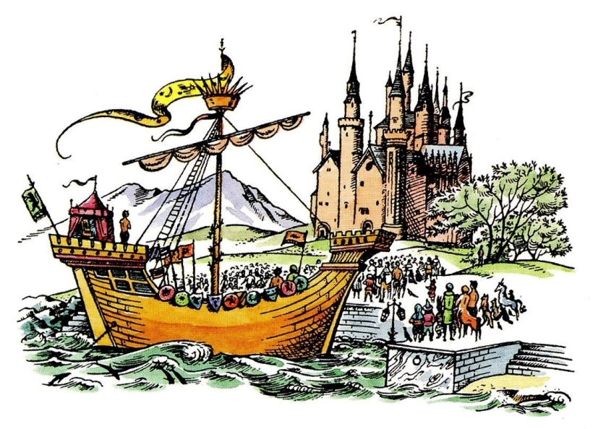
A Postscript
Blaise Pascal and William James argued that it is possible to decide to believe in God without conclusive evidence.
If the witch is right, then nothing is of value.
Pascal’s Wager:
We have nothing to lose by believing in God (or Aslan).
If the witch is wrong, then we have a lot to lose.

Slide 52
A Postscript (Puddleglum)
Not easily taken in: He doubted whether the knight with the Green Lady was really a person inside that armor. He doubted that Harfang would be worth the visit, and he wanted to take a closer look at what turned out to be the Ruined City! And he is the one who says they need to follow the fourth sign and release Rilian.
Notes:
Puddleglum’s speech. Remember that Puddleglum was not easily taken in. He doubted whether the knight with the Green Lady was really a person inside that armor.

Slide 53
A Postscript (Puddleglum)
“Suppose we have only dreamed, or made up, all those things—trees and grass and sun and moon and stars and Aslan himself. Suppose we have. Then all I can say is that, in that case, the made-up things seem a good deal more important than the real ones. Suppose this black pit of a kingdom of yours is the only world. Well, it strikes me as a pretty poor one. And that’s a funny thing, when you come to think of it. We’re just babies making up a game, if you’re right.”

Slide 54
A Postscript (Puddleglum)
“But four babies playing a game can make a play world which licks your real world hollow. That’s why I’m going to stand by the play world. I’m on Aslan’s side even if there isn’t any Aslan to lead it. I’m going to live as like a Narnian as I can even if there isn’t any Narnia. So, thanking you kindly for our supper, if these two gentlemen and the young lady are ready, we’re leaving your court at once and setting out in the dark to spend our lives looking for Overland. Not that our lives will be very long, I should think; but that’s small loss if the world’s as dull a place as you say.”
Notes:
Puddleglum’s speech.

Slide 55
Benediction
Lord of the Real sun,
Help me to remember my signs.
Deliver me from the many Houses of Harfang in this world.
Show me how to tell sanity from insanity.
Give me the courage to break enchantments, even when it hurts.
And bring me at last to your holy mountain where life is renewed.
Next: The Horse and His Boy

