Slide 1
The Liberal Arts, Antidote for Atheism
A Partial Theological Justification
for the Liberal Arts

Slide 2
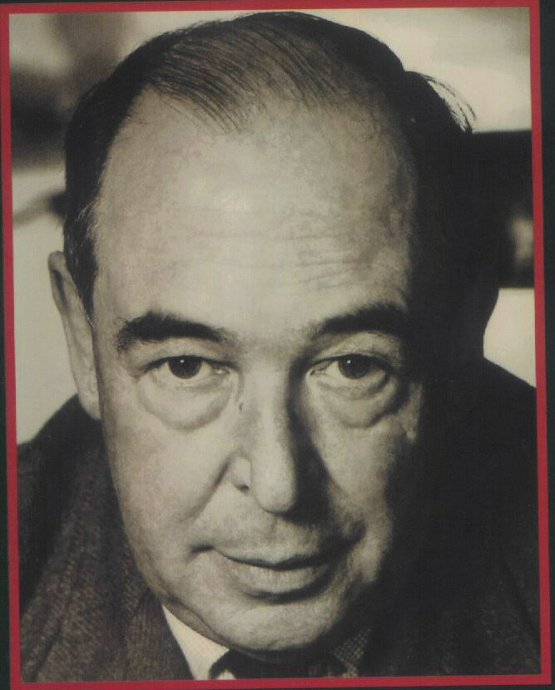
The Initial Quotation
1932 letter to Arthur Greeves (Collected Letters, II, 93.)
“…one of the contentions of the book is that the decay of our old classical learning is a contributory cause of atheism.”
The Pilgrim’s Regress, 1933
“An Allegorical Apology for Christianity, Reason and Romanticism”

Slide 3
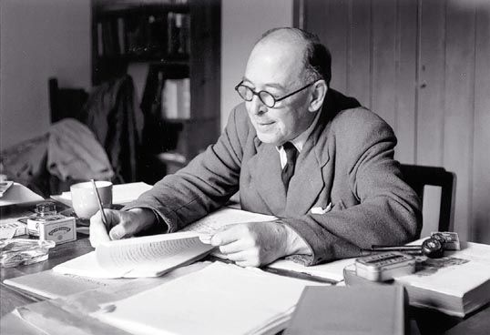
I. The Classics

Slide 4
The Classics …
… prevent the mind from being isolated in its own age.
… provide an infusion of the better elements of Paganism.
… teach us the value of old books.
Reading the literature of the old Pagans meant …
These religions “contain at least some hint of the truth.”

Slide 5
II. Dying and Rising Gods

Slide 6
Dying and Rising Gods
“The idea of the dying and reviving god (Balder, Adonis, Bacchus) … moved me provided I met it anywhere except in the Gospels.”
T. D. (“Harry”) Weldon on the historicity of the Gospels
Virgil: “… Now the Virgin returns, the reign of Saturn returns, and the new child is sent down from high heaven.”
Plato: “imagine a perfectly righteous man treated by all around him as a monster of wickedness. We must picture him, still perfect, while he is bound, scourged, and finally impaled.”

Slide 7
III. “Matter” from the Classics

Slide 8
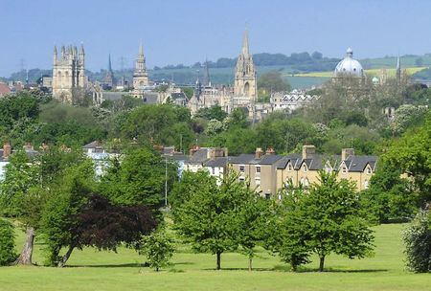
“Matter” from the Classics
The Classics “gave us Matter…new things to write and feel about” (“The Idea of an ‘English School’”).
“…to lose what I owe to Plato and Aristotle would be like the amputation of a limb.”

Slide 9
IV. Myth

Slide 10
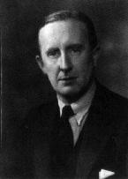
Myth
“Myth Became Fact”
A theology of mythology
“… the Pagan stories are God expressing Himself through the minds of poets, using such images as He found there, while Christianity is God expressing Himself through what we call ‘real things.’”

Slide 11
V. An Interest in pre-Christian Worlds

Slide 12
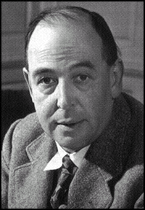
An Interest in pre-Christian Worlds
Till We Have Faces
Glome
Virgil and Homer
Early Prose Joy, “There is no temperament and no environment which he [God] has left without a witness of Himself.”

Slide 13
VI. The Conversion of C. S. Lewis

Slide 14
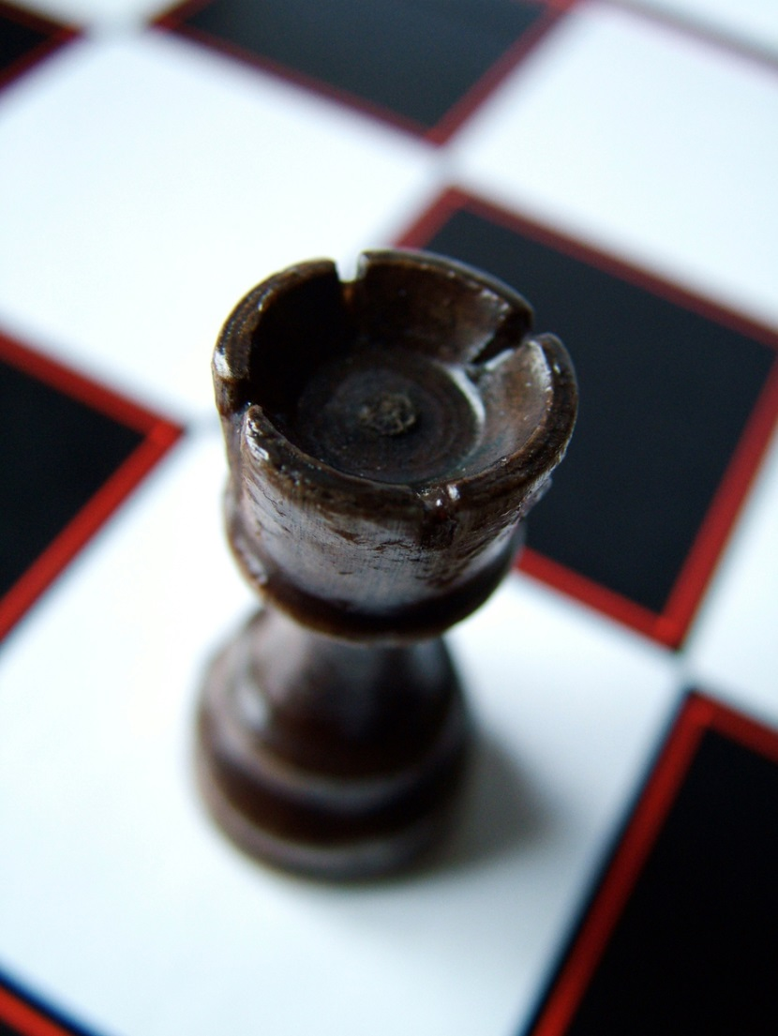
The Conversion of C. S. Lewis
Loss of first bishop: Euripides’ Hippolytus
Loss of second bishop: “Enjoyment” vs. “Contemplation”
Check: Joy linked to philosophical Idealism
Checkmate: “the Absolute” is God

Slide 15
VII. C. S. Lewis, Patron Saint of the Liberal Arts

Slide 16
Patron Saint of the Liberal Arts
Greek and Latin texts
History
Philosophy
Literature
Theological writings
To read Lewis widely is to receive a liberal arts education.
Let’s call C. S. Lewis “the patron saint of the Liberal Arts”!

