Slide 1
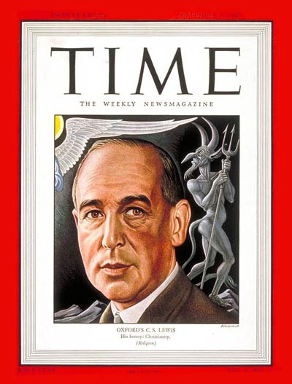
The Letters of C. S. Lewis
Thousands and thousands

Slide 2
Chad Walsh
The first biographer of C. S. Lewis, whose book, C. S. Lewis: Apostle to the Skeptics, was published in 1949, even before Narnia.
Professor of English at Beloit College in Beloit, Wisconsin.
Lewis’s books had helped convert him from agnosticism to Christianity.
“Any consideration of his impact on America must take these letters into account” (Light on C. S. Lewis, 116).
If true of his impact on America, then it is also true of his total impact on the public.

Slide 3
Nature and Origin of the Letters
A strong family tradition for decades (cf. The Lewis Papers)
BBC broadcasts, August 1941: “For the rest of his life, he had an enormous amount of correspondence” (George Sayer, Jack, 278).
He answered every letter he ever received!
Many people kept his letters because of the reputation of the author and the helpful contents of the letters.
Letters to friends and family members were usually long.
A fair number of letters were quite brief because the original letter was quite brief. To save paper . . .

Slide 4
Time and Numbers
He often spent as much as two hours of letter-writing in the morning. Once, after a vacation, he mentioned in correspondence that he had just spent nine hours catching up on letter-writing.
Wednesday, Feb. 26, 1930: He writes nine letters.
August-September 1941: BBC broadcasts & letters.
Tuesday, Feb. 24, 1942: He writes thirty-five letters.
Thursday, January 3, 1946: Lewis states that he writes about seven letters a day year round.

Slide 5
Time and Numbers (continued)
Friday, July 4, 1947: Lewis writes to Arthur, stating that he writes an hour and a half or two hours of letters every morning.
Tuesday, October 7, 1947: Lewis receives eighteen letters.
Monday, September 14, 1953: After two weeks of vacation, Lewis finds about sixty letters waiting for him.

Slide 6
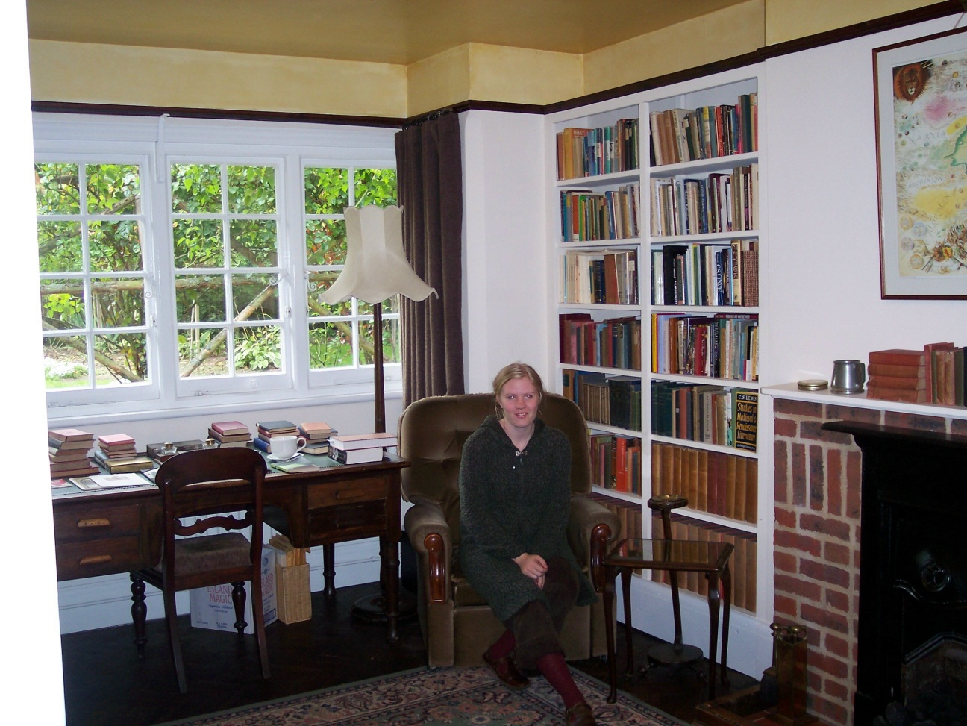
How and Why
How: at his desk at the Kilns, using a nib pen, i.e. a fountain pen that he dipped into the inkwell regularly.
Why? What do you think?

Slide 7
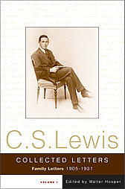
Letter-writing as a Young Man
As a young man, he wrote required letters to home or letters freely written to his brother Warren or close friend Arthur Greeves, often about books he was reading, current events, or childish happenings.

Slide 8
An Abridged Version
Yours, Jack: Spiritual Direction from C. S. Lewis
Edited by Paul Ford
400 pages
2008
HarperOne

Slide 9
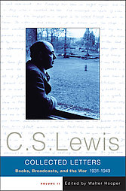
Letter-writing as a Grown Man
Practical matters of spiritual and intellectual formation, such as advice-giving (“I think advice is best kept till it is asked for”), faith (“we shall proceed to faith only by acting as if we had it”), guilt feelings, recommended books, spiritual struggles (“where people can resist or ignore arguments, they may be unable to resist lives”), suffering, free will, literary reflection, etc.

Slide 10
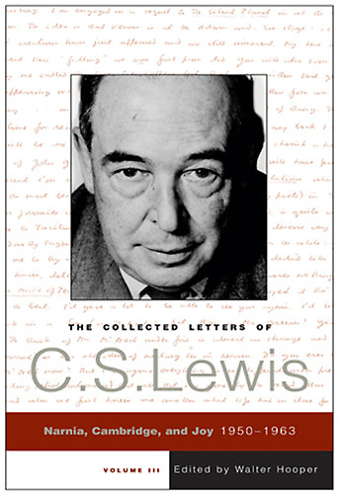
Letter-writing as a Grown Man
Therefore, he often was a spiritual mentor to those who had read his books or heard his broadcast.
One of those mentees…

Slide 11
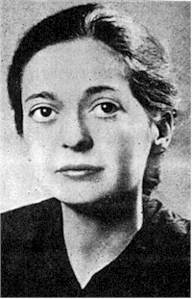
Joy Davidman
First letter in 1950
First met in 1952
First married in 1956
Married again in 1957
This story is told in the movie “Shadowlands.”

Slide 12
The Conversion of C. S. Lewis
Three letters to Arthur Greeves
Sept. 22, 1931: The midnight conversation with Tolkien and Dyson, which took place on Saturday evening, Sept. 19-20.
Oct. 1, 1931: The fact of his conversion.
Oct. 18, 1931: The nature of the midnight conversation that led to his conversion, i.e. “…the story of Christ is simply a true myth…”

Slide 13
Collections of Letters
Letters of C. S. Lewis (1966)
Letters to an American Lady (138 letters, 1967)
Mary Willis Shelburne, Washington DC (the Lewisian profile of a person who wrote to him was an American woman)
C. S. Lewis Letters to Children (1985)
The Latin Letters of C. S. Lewis
(34 letters in Latin between 1947 and
1961 to Italian priests Don Giovanni Calabria and
Don Luigi Pedrollo, 1987)
And the most impressive collection …

Slide 14
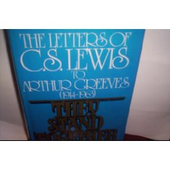
They Stand Together: The Letters of C. S. Lewis to Arthur Greeves (296 letters, 1979)

Slide 15
But not . . .
The Screwtape Letters (1942)
Letters to Malcolm: Chiefly on Prayer (1964)
Why?
Both of these collections are fictional letters.

Slide 16
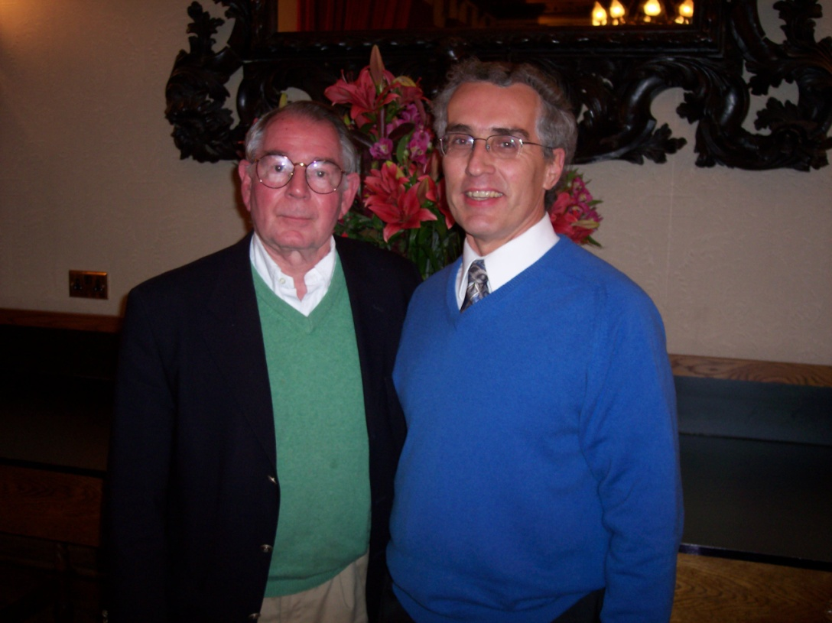
Collected Letters, I, II, and III
Approximately 3,700 letters
My guess for a total: 30,000
Warren’s typing: 12,000 letters
Volume I (2000): 1057 pages, 1905-1931
Volume II (2004): 1132 pages, 1931-1949
Volume III (2006): 1810 pages, including the “Great War” letters with Owen Barfield, 1950-1963
And you thought J.K. Rowling’s books kept getting longer!

Slide 17
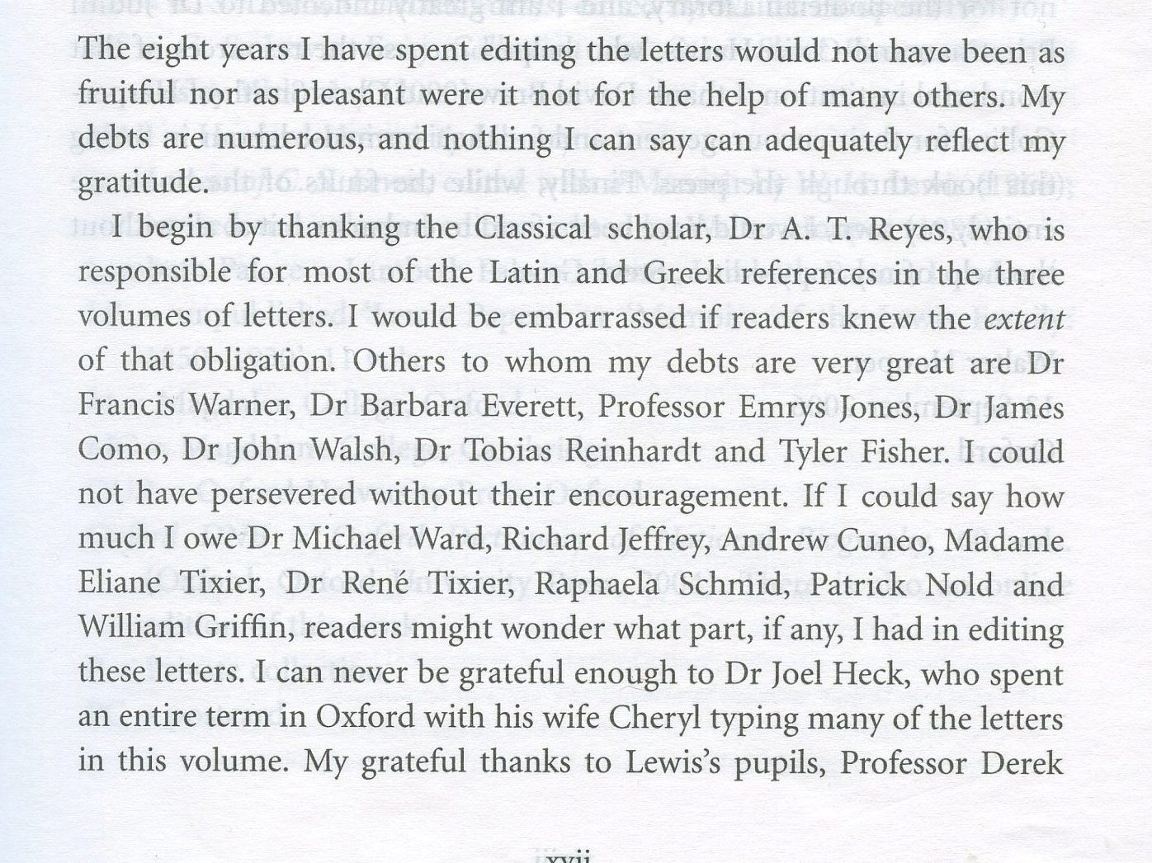
2004 Sabbatical
Preface, page xvii

Slide 18
Two Samples, First a Letter to a Child
June 3rd 1953
Dear Hila (is that right) Newman
Thank you so much for your lovely letter and pictures. I realized at once that the colored one was not a particular scene but a sort of lineup like what you would have at the very end if it was a play instead of stories. The Dawn Treader is not to be the last: There are to be 4 more, 7 in all. Didn’t you notice that Aslan said nothing about Eustace not going back? I thought the best of your pictures was the one of Mr. Tumnus at the bottom of the letter.

Slide 19
As to Aslan’s other name, well I want you to guess. Has there never been anyone in this world who (1.) Arrived at the same time as Father Christmas. (2.) Said he was the son of the Great Emperor. (3.) Gave himself up for someone else’s fault to be jeered at and killed by wicked people. (4.) Came to life again. (5.) Is sometimes spoken of as a Lamb (see the end of the Dawn Treader). Don’t you really know His name in this world. Think it over and let me know your answer!

Slide 20
Reepicheep in your colored picture has just the right perky, cheeky expression. I love real mice. There are lots in my rooms in College but I have never set a trap. When I sit up late working they poke their heads out from behind the curtains just as if they were saying, ‘Hi! Time for you to go to bed. We want to come out and play.’
All good wishes,
Yours ever
C. S. Lewis

Slide 21
Second, a Letter to an Adult
June 8th 1953
Dear Mrs. Van Deusen
Yes, I think your position is the right one. If one is asked for advice, then, and then only, one has to have an opinion about the exact rule of life which wd. suit some other Christian. Otherwise, I think the rule is to mind one’s own business.

Slide 22
St. Paul goes further than this: it may even be proper at times to adopt practices which you yourself think unnecessary, and which are unnecessary to you, if your difference on such points is a stumbling-block to the Christians you find yourself among. Hence, you see, other Christians’ practices concern us, when at all, as a ground for concessions on our part, not for interference or complacent assertion that our way is best. This is in Romans chap. XIV: read the chapter and meditate on it. I am very glad you have seen the real point.

Slide 23
My ‘troubles’, thanks, are in abeyance, except that I am suffering from Sinusitis: but that too is better than it was.
Don’t doubt that you and Genia are in my daily prayers. Hasn’t what you are kind enough to say about our Coronation a wider relevance? – that nothing stirs us if it has the sole purpose of stirring us: i.e. the stirring must be a by-product.
God bless you.
Yours
C. S. Lewis

Slide 24
By the way . . .
www.joelheck.com
PowerPoint Outlines
Left-hand column a couple of files down the page

