Slide 1
Chronologically Lewis
A Database on the Lives of the
Lewis Brothers

Slide 2
Testimony
Dr. Jerry Root, Wheaton College
“Chronologically Lewis is one of the best sources for fact checking dates and events in the life of C. S. Lewis. Joel Heck has provided the world of Lewis scholarship and enthusiasts a valuable resource.”

Slide 3
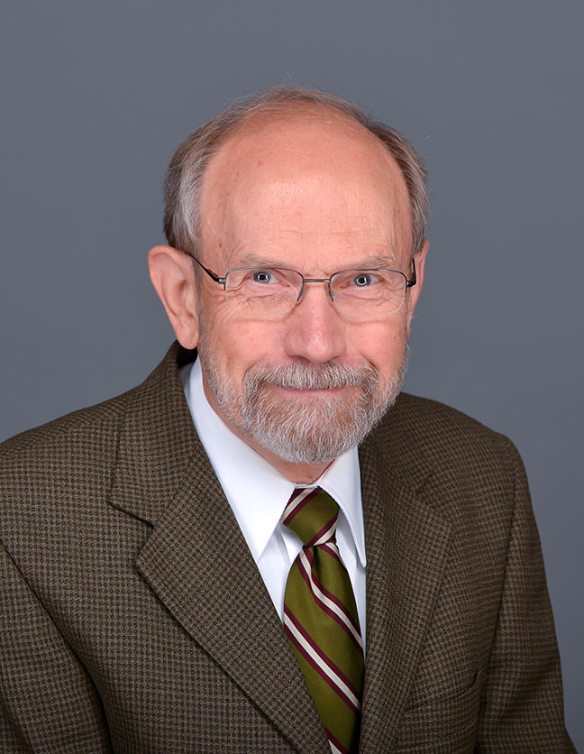
Beginnings
An idea while at the Wade Center in 2004
I was reading Peter Schakel’s book, Imagination and the Arts in C. S. Lewis: Journeying to Narnia and Other Worlds.
Hope College, Hope, Michigan
In walked Peter Schakel!

Slide 4
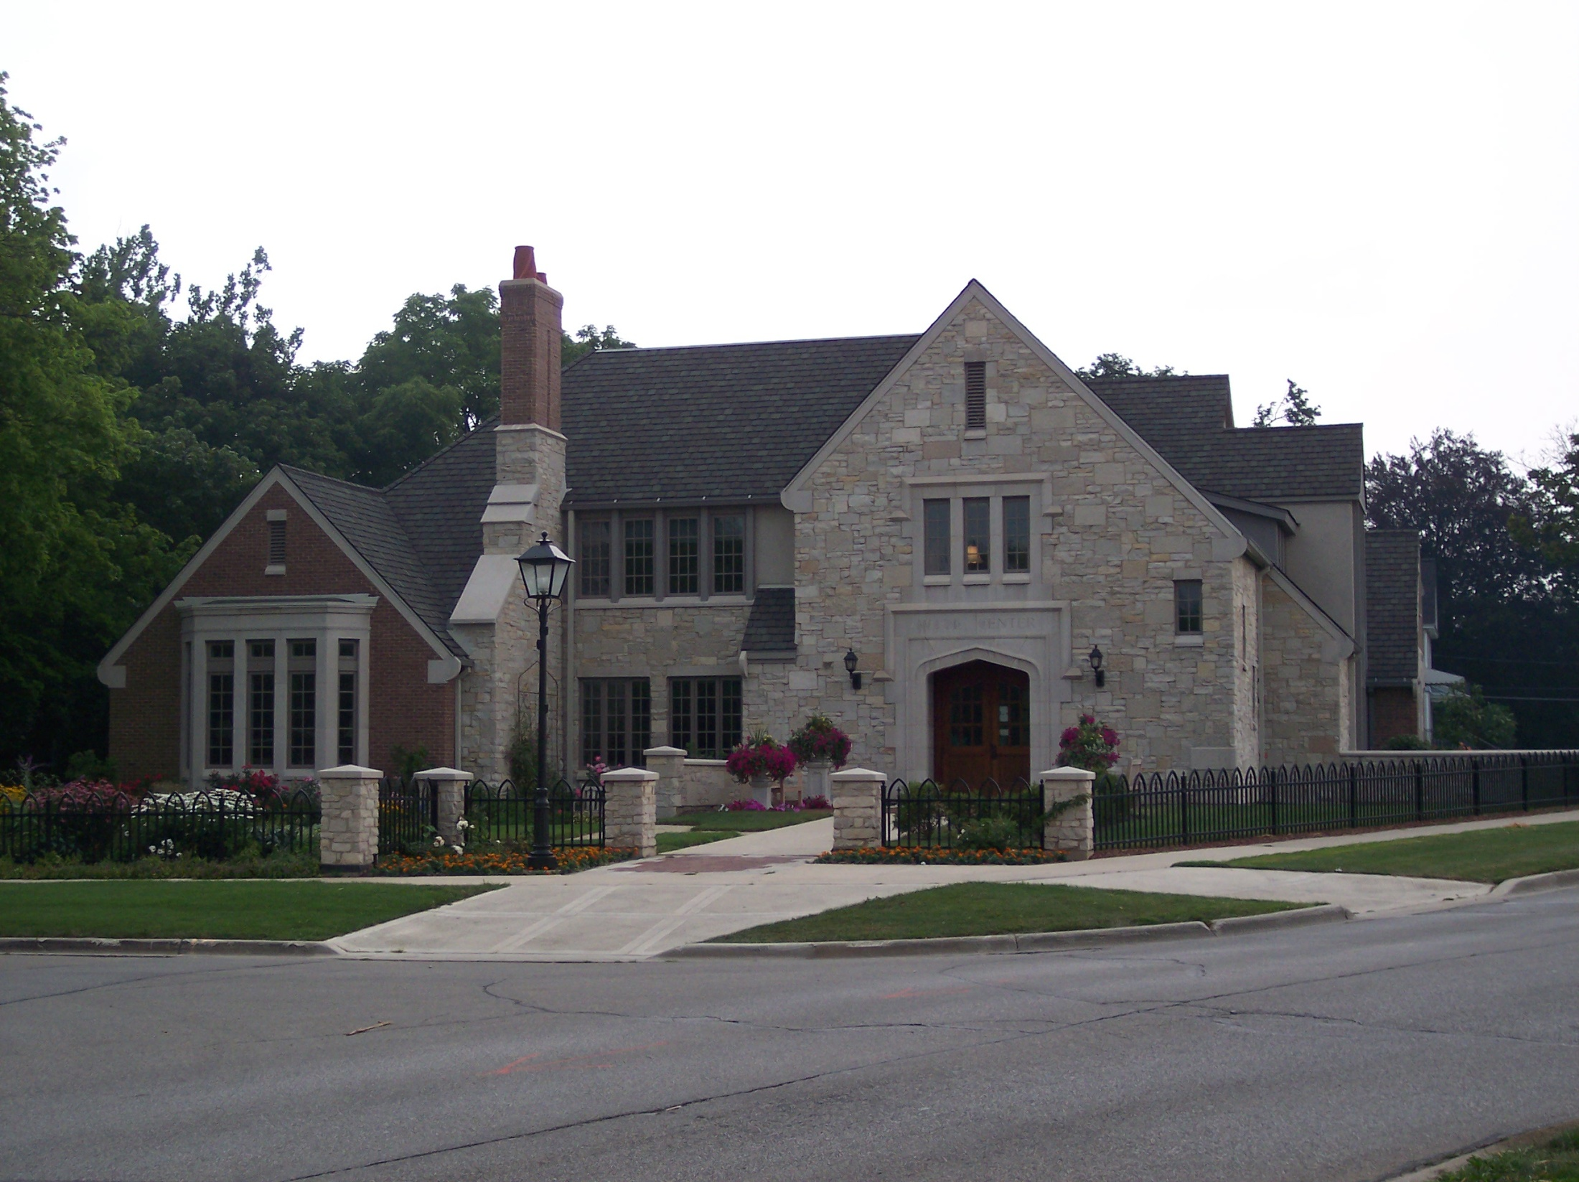

Slide 5
In Summary
The “go-to” place for historical information …
A fifteen-year project thus far—an estimated 2,500 hours of work
Everything you might want to know about what happened in the life of C. S. Lewis and his brother Warren (and a lot you don’t care to know, but someone else might)
Currently a searchable pdf at 1,300 pages, single-spaced
More than 710,000 words
More than 4,000 footnotes
186 resources (bibliography)

Slide 6
Features
Chronological by day, month, and year
Lists the number of entries for each month and each year
Lists the location of each brother at the start of each month
Places in bold type important events
Underlines the name of Jack and Warren the first time they are used on each date
Includes some brief biographical information about many names
Includes the year of publication of many books that Jack read

Slide 7
Features
Contains dates and details of meetings with the Commission to Revise the Psalter
Contains details about the honorary doctorate he received in absentia on October 6, 1962 from the University of Dijon, Dijon, France.
Information about serving for four-and-a-half years on the Council of Westcott House, Cambridge.
The military record of Warren Lewis
Spotlight
The dates that C. S. Lewis signed contracts for Dymer and for The Pilgrim’s Regress
Information about the Skemp Memorial Lecture, “Addison,” at the University of Bristol on October 7, 1943.

Slide 8
Available Online
PDF format
At www.joelheck.com
Fairly regular updates
All major sources have been incorporated.
Nearing completion, but who knows?
E.g., Stephanie Derrick’s recent book brought new information to light.

Slide 9
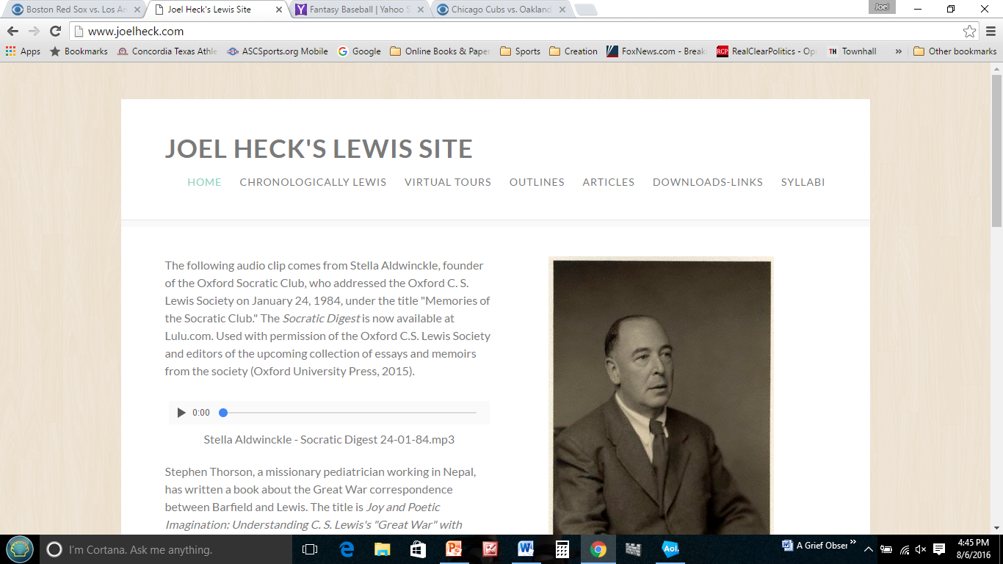
www.joelheck.com

Slide 10
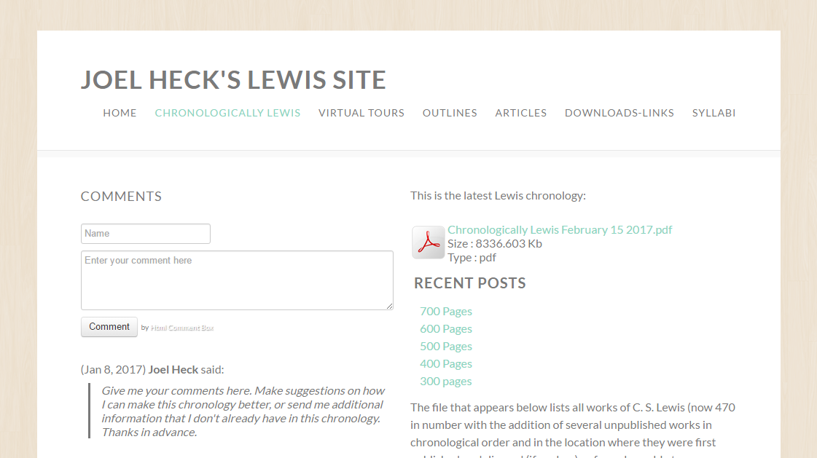
Latest version with date.

