Slide 1
Prince Caspian: The Return to Narnia
Dedicated to
Mary Clare Havard
Notes:
Dedicated to Mary Clare Havard, the daughter of the Lewis family doctor, Robert Emlyn Havard.

Slide 2
Some Introductory Facts
The second in the series, written in late 1949
Published in 1951
Like the others, illustrated by Pauline Baynes
The initial setting is England in 1941, fourteen months after they first went to Narnia.
In Narnia, it is 1,300 years after The Lion, the Witch and the Wardrobe, year 2303 in Narnian time.
The topic according to Lewis: “restoration of the true religion after a corruption”

Slide 3
Lewis and longing
When the children travel from England to Narnia, they almost never leave from their home.
By never depicting the children at home, Lewis is able to evoke a longing for home, for a true home.
See “The Weight of Glory,” where Lewis claims that we all have a desire for “our own far off country.”

Slide 4
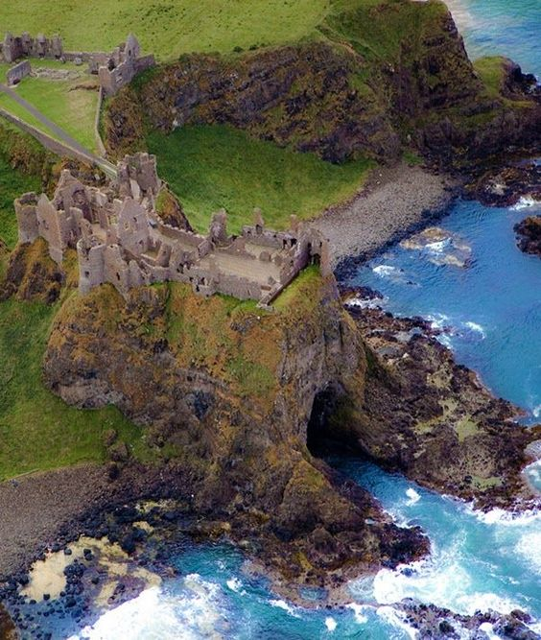
Notes:
Dunluce Castle, an influence on this story as well as the original Cair Paravel. Joel Heck theory: the type of erosion around Dunluce Castle suggested to him that eventually the castle would be on an island separate from the mainland. It also appears on the artwork of a Led Zeppelin album.

Slide 5
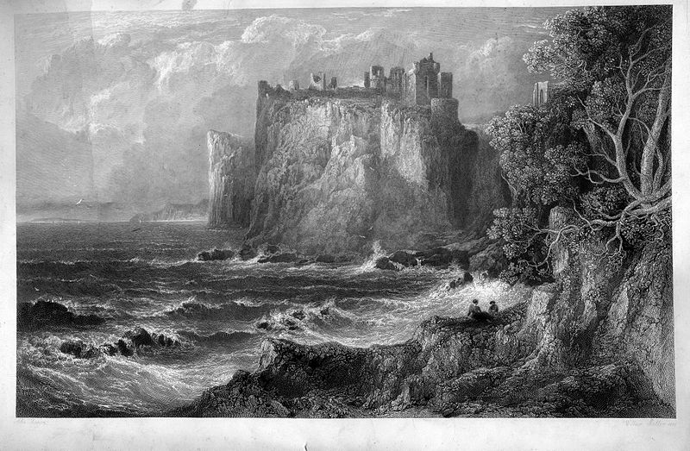
An 1848 engraving
Notes:
An 1848 engraving of Dunluce Castle by William Miller. It has been abandoned for three hundred years.

Slide 6
Notes:
Artist’s drawing, from Paul Ford’s Companion to Narnia.

Slide 7
Pauline Baynes
Notes:
This drawing shows the Pevensie children after they are drawn into Narnia and have made their way around most of the island. They realize they are on an island.

Slide 8
New Zealand’s Cathedral Cove, the site of some filming of Prince Caspian

Slide 9
By the way …
Some complain that Lewis thinks less of women, so let’s look at an early scene where Trumpkin the Dwarf matches against Susan in an archery contest. They have just rescued Trumpkin from a certain death.
The Dwarf shoots first.
“Twang went the string. It was an excellent shot. The tiny apple shook as the arrow passed, and a leaf came fluttering down. Then Susan went to the top of the steps and strung her bow. She was not enjoying her match half so much as Edmund had enjoyed his; not because she had any doubt about hitting the apple but because Susan was so tenderhearted that she almost hated to beat someone who had been beaten already. The Dwarf watched her keenly as she drew the shaft to her ear. A moment later, with a little soft thump which they could all hear in that quiet place, the apple fell to the grass with Susan’s arrow in it.”

Slide 10
And …
On the trip from Cair Paravel to Aslan’s How and how to get there:
“I hope you’re right,” said Susan. “I can’t remember all that at all.”
“That’s the worst of girls,” said Edmund to Peter and the Dwarf. “They never can carry a map in their heads.”
“That’s because our heads have something inside them,” said Lucy.
Furthermore, “except you become as a little child, you shall not enter …” Which child?

Slide 11
Notes:
At Cair Paravel before they realize what it is. An apple orchard has grown up.

Slide 12
Plot summary
The four children are drawn by Susan’s horn (which had been left behind) into Narnia, as the story begins in medias res (the plot does not advance until chapter 8).
They discover a ruined Cair Paravel, although they do not realize it at the time.
They rescue the dwarf Trumpkin, who tells of Miraz, the Telmarines, and the Narnians driven underground.
Caspian, nephew; an heir is born to Miraz; at the urging of his tutor Doctor Cornelius (whose name means “horn”), Caspian rides away on his horse Destrier and begins to gather an army around him after a council of war at Dancing Lawn.
The four children make a long and arduous journey with Trumpkin to Aslan’s How.
On the way Lucy sees Aslan, but the others don’t believe her. Sub-plot: Lucy’s faith vs. Trumpkin’s skepticism.

Slide 13
Chapter XI. The Lion Roars
“But she [Lucy] forgot them [i.e. things she was going to say to Susan] when she fixed her eyes on Aslan. He turned and walked at a slow pace about thirty yards ahead of them.”
Hebrews 12:2, “… fixing our eyes on Jesus, the pioneer and perfecter of faith.”

Slide 14
Plot summary
Later, Lucy meets Aslan in the night. He says, “Every year you grow, you will find me bigger.”
Lucy wakes the others and follows Aslan.
They arrive at Aslan’s How and prevent Caspian from going to the dark side.
Peter proposes monomachy and wins.
The trees and river gods awaken and win the battle; some are sent home.
Aslan and Trumpkin
Notes:
Monomachy = one on one combat

Slide 15
A Favorite Vignette
“And now!” said Aslan in a much louder voice with just a hint of a roar in it, while his tail lashed his flanks. “And now, where is this little Dwarf, this famous swordsman and archer, who doesn’t believe in lions? Come here, Son of Earth, come HERE!” and the last word was no longer the hint of a roar but almost the real thing.
“Wraiths and wreckage,” gasped Trumpkin in the ghost of a voice. The children, who knew Aslan well enough to see that he liked the Dwarf very much, were not disturbed; but it was quite another thing for Trumpkin who had never seen a lion before, let alone this Lion. He did the only sensible thing he could have done; that is, instead of bolting, he tottered towards Aslan.

Slide 16
Aslan pounced. Have you ever seen a very young kitten being carried in the mother cat’s mouth? It was like that. The Dwarf, hunched up in a little, miserable ball, hung from Aslan’s mouth. The Lion gave him one shake and all his armor rattled like a tinker’s pack and then—hey-presto—the Dwarf flew up in the air. He was as safe as if he had been in bed, though he did not feel so. As he came down the huge velveted paws caught him as gently as a mother’s arms and set him (right way up, too) on the ground.
“Son of Earth, shall we be friends?” asked Aslan.
“Ye—he—he—hes,” panted the Dwarf, for it had not yet got its breath back.

Slide 17
Moral Development/plato
Moral Development. Trumpkin to Caspian: “You are my King. I know the difference between giving advice and taking orders. You’ve had my advice, and now it’s the time for orders.”
Plato. “Welcome, Prince,” said Aslan. “Do you feel yourself sufficient to take up the Kingship of Narnia?”
“I—I don’t think I do, Sir,” said Caspian. “I’m only a kid.”
“Good,” said Aslan. “If you had felt yourself sufficient, it would have been a proof that you were not.
Notes:
Insight on Plato from the last chapter. Similar idea in The Last Battle with Frank and Nellie.

Slide 18
Spiritual growth
“Welcome, child,” he said.
“Aslan,” said Lucy, “you’re bigger.”
“That is because you are older, little one,” answered he.
“Not because you are?”
“I am not. But every year you grow, you will find me bigger.”

Slide 19
Humor
An author Doctor Cornelius uses to teach the young Prince Caspian is named Pulverulentus Siccus, the author of a grammar textbook.
The name Pulverulentus Siccus comes from both Latin and seventeenth-century English. Together the words mean “dry as dust.”
Clodsley Shovel the Mole: named after a notorious British admiral, Cloudesley Shovell, whose poor navigation was responsible for a disastrous naval shipwreck in 1707.
Hogglestock the Hedgehog: named after a fictional town in one of Anthony Trollope’s books

Slide 20
Michael Ward
Planet Narnia (scholarly) and The Narnia Code (popular)
As mentioned in week one: Lewis wrote seven Chronicles of Narnia because there were seven planets in the medieval worldview. And other points of medievalism.
The planet Lewis chose to associate with Prince Caspian was a planet whose metal is iron, where faithful obedience is the chief benefit, and whose key features are militarism and silvanism (the presence and influence of trees). That planet?
Mars
Notes:
Other things medieval: when Peter, as a medieval knight, lets Miraz rise after tripping.

Slide 21
Mars and PC
March (originally Martius) is the month of Mars because that is the time of year when the woods come back to life.
Hence, wood or woods are a prominent feature in the book.
The military (“martial”) features of Prince Caspian are numerous: rediscovering armor, rescuing the dwarf from soldiers, the swordsmanship and archery test, etc.
Even the chess piece discovered early in the book at Cair Paravel is a chess knight.

Slide 22
Mars and PC
Queen Prunaprismia’s name comes from a Charles Dickens character in the book Little Dorrit, who often says “prunes and prism.” Her name?
Mrs. General
Military settings, military actions, various kinds of armor and weapons
The bears have a hereditary right to be marshals (a pun on “martial”). (And a bear attacks the children and Trumpkin during their journey.)
Lewis loved Chaucer’s Knight’s Tale.
Peter is the model of a true knight.

Slide 23
Mars and PC
Destrier means “war horse.” The name Lewis means “famous warrior.”
Lewis was proud of the fact that on his mother’s side “the blood went back to a Norman knight whose bones lie at Battle Abbey.”
Characters become more martial as the story progresses. For example, Caspian begins “to harden” as he sleeps “under the stars.” And Peter is better prepared to fight in hand-to-hand combat.
Edmund makes a comment about “knights errant.”
There is a lot of (military) marching in the story.

Slide 24
Biblical Theme I: Irresistibly Drawn
Edmund: “Golly! It’s a bit uncomfortable to know that we can be whistled for like that. It’s worse than what Father says about living at the mercy of the telephone.”
Acts 9, Paul on the road to Damascus
Judges 6:14, Gideon, “Am I not sending you?”
Isaiah 6:8, Isaiah

Slide 25
Biblical Theme I: Irresistibly Drawn
Mark 1:16-18, Peter
Luke 5:27-28, Levi
John 6:44, “No one can come to me unless the Father who sent me draws him.”
Perhaps even you.
The greatest adventure is the one that is thrust upon us.
P.S. Lewis’s original title: Drawn into Narnia.

Slide 26
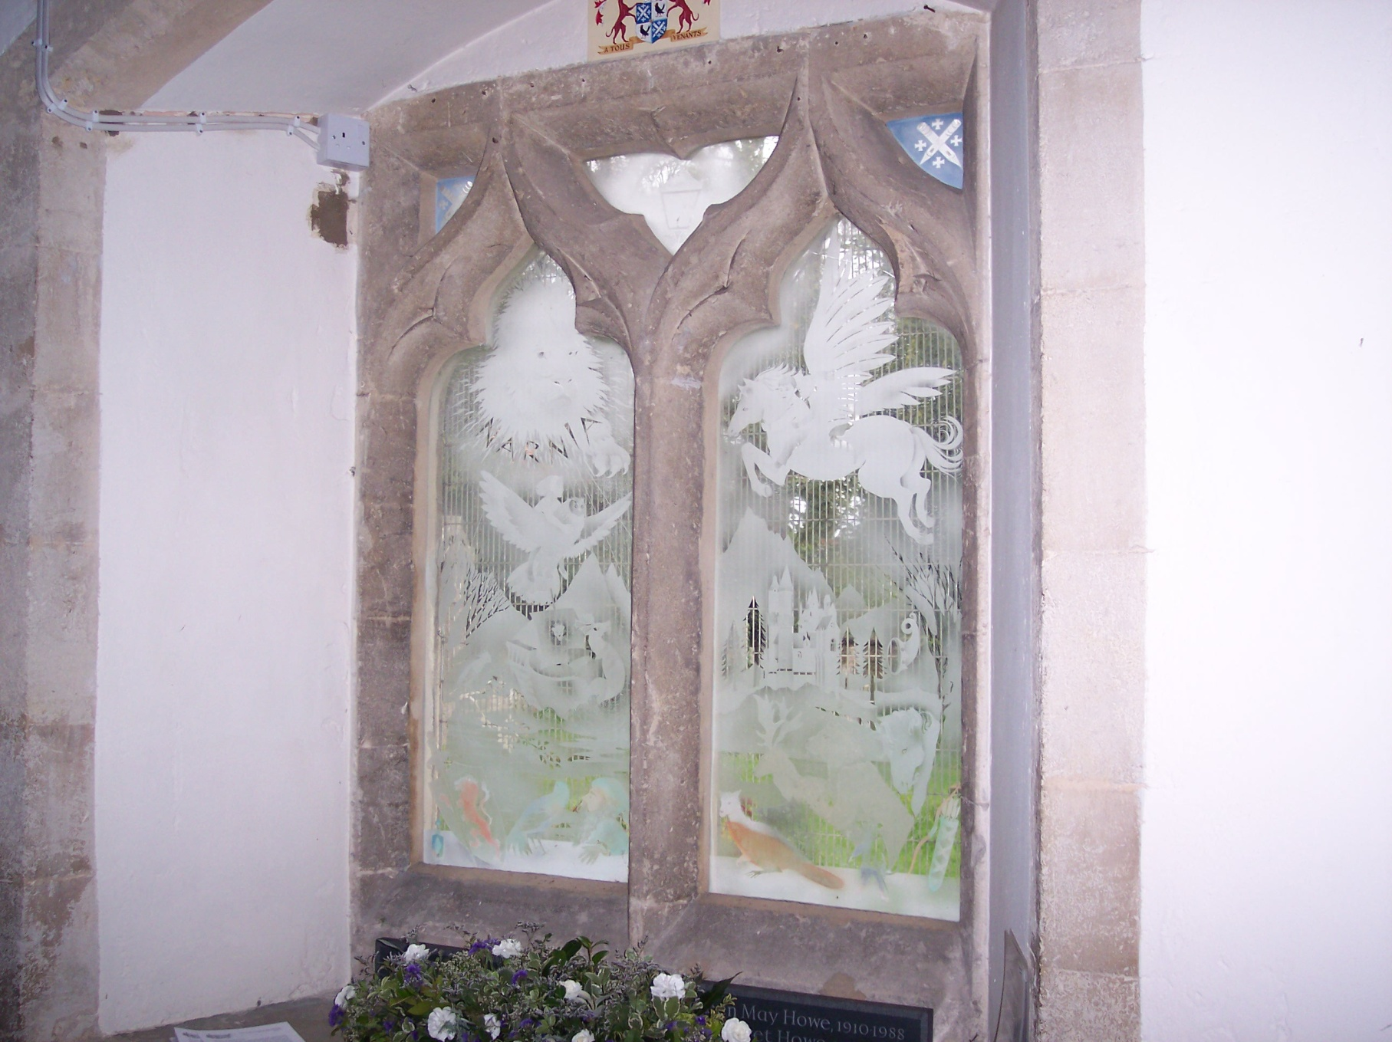
The Gifts of Father CHristmas
Susan’s Horn
Sword & Shield
Bow & Arrows
Cordial
Notes:
The Narnia Window in Holy Trinity, Headington Quarry, the church the Lewis brothers attended.

Slide 27
Biblical Theme II: Old Narnians
“What do you mean by old Narnians, please?” asked Lucy.
“Why, that’s us,” said the Dwarf. “We’re a kind of rebellion, I suppose.”
The true church is an underground resistance movement.
Notes:
“Enemy-occupied territory—that is what this world is.” Lewis, Mere Christianity.

Slide 28
Biblical Theme II: Old Narnians
1 Peter 1:1
Deut. 26:5
1 Chron. 16:19, God gave the land of Canaan to His people when …
Matt. 7:14
Rev. 12:11
Dancing Lawn
Notes:
“Enemy-occupied territory—that is what this world is.” Lewis, Mere Christianity.

Slide 29
Notes:
Aslan’s How at the left arrow, and Cair Paravel at the right arrow. The River Rush is between them, flowing into the Great River.

Slide 30
The River Rush

Slide 31
Notes:
Monomachy: King Peter vs. King Miraz. In Exodus, we have Pharoah vs. Yahweh.

Slide 32
Mars silvanus
“Silva” or “sylva” is Latin for “wood.”
Mars was associated with the month of March because that is the month when Mars made his impact felt. The woods came back to life as spring emerged.
Lewis puts tree spirits in Prince Caspian.
The word “tree” appears 100 times in Prince Caspian, more than in the rest of the Chronicles of Narnia combined.

Slide 33
Mars silvanus
The children arrive in a woods: Peter says, “I can’t see a yard in all these trees.”
When they arrive, they learn that trees have overgrown Cair Paravel.
The trees awaken when Lucy meets Aslan.
The trees win the battle at the end.

Slide 34
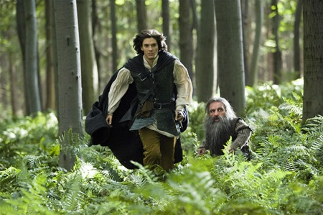
More silvan facts
Prince Caspian meets the old Narnians in the woods.
In the book, the government-inspected school is destroyed by “a mass of shimmering green.”
In the book, a child-abuser is turned into a withered tree.

Slide 35
Notes:
The doorway Aslan erected for the return to our world.

Slide 36
Notes:
At the end of the story at the train station.

Slide 37
Factual Quiz Just for fun
In this book the children enter Narnia from (a) a wardrobe, (b) a church door, (c) a seat in a railway station, (d) an orchard.
The reason they didn’t recognize Cair Paravel was that (a) it was so splendid, (b) it was in ruins, (c) they had forgotten it.
Peter’s sword was named (a) Rhindon, (b) Caspian, (c) Fenris Ulf, (d) Destrier.
Doctor Cornelius was not (a) Caspian’s tutor, (b) part dwarf, (c) a rebel against Miraz, (d) a real Telmarine.

Slide 38
Factual Quiz Just for fun
The mysterious hollow mound built centuries ago over the Stone Table is called (a) Aslan’s Who, (b) Miraz’s Why, (c) Caspian’s Where, (d) Aslan’s How.
Which is not one of the three key magical places in Narnia? (a) the Stone Table, (b) Lantern Waste, (c) Telmar, (d) Cair Paravel.
Much of this story is told by (a) Trumpkin, (b) Nikabrik, (c) Caspian, (d) King Peter.
Who received special guidance from Aslan and failed to follow it? (a) Peter, (b) Edmund, (c) Susan, (d) Lucy.

Slide 39
Factual Quiz Just for fun
The formal duel between Peter and Miraz did not end in (a) murder, (b) a draw, (c) general battle, (d) a forest alive and rushing to the river.
The children returned to England through (a) a blast on the horn, (b) the Wardrobe, (c) a door in the air, (d) a long hike.

Slide 40
Benediction
Give me patience when I get tired of my day-to-day diet of life.
Give me the courage to follow your leading, even when it makes me unpopular.
Let me always learn and teach with integrity.
Give me a foretaste of joy in the victory feast.
Give me the grace to walk bravely, when my time comes, through your Door in the Air.

Slide 41
P.S.
“And finally he [Miraz] persuaded the seven noble lords, who alone among all the Telmarines did not fear the sea, to sail away and look for new lands beyond the Eastern Ocean, and, as he intended, they never came back.” (Chapter V. Caspian’s Adventure in the Mountains)
This sets up the next book, The Voyage of the ‘Dawn Treader.’

