Slide 1
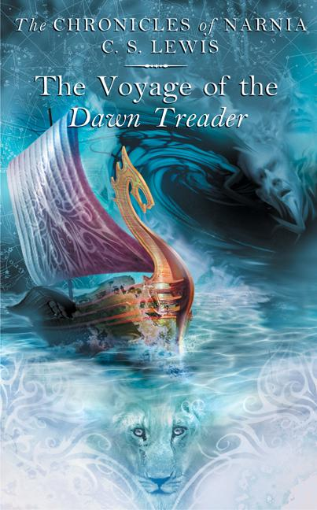
The Voyage of the ‘Dawn Treader’
To Geoffrey Corbett (Barfield)
Notes:
The book was dedicated to Owen Barfield’s son.

Slide 2
But first … our Kahoot sample.

Slide 3
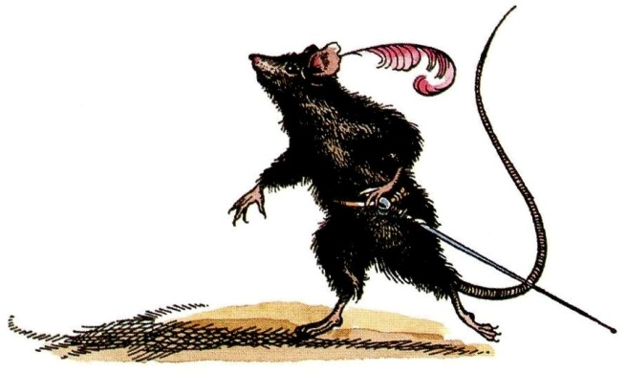
Background
From the prologue to Spirits in Bondage, a collection of poems by Lewis:
In my coracle of verses
I will sing of lands unknown. . . .
Sing about the Hidden Country fresh
and full of quiet green.
Sailing over seas uncharted to a port
that none has seen.

Slide 4
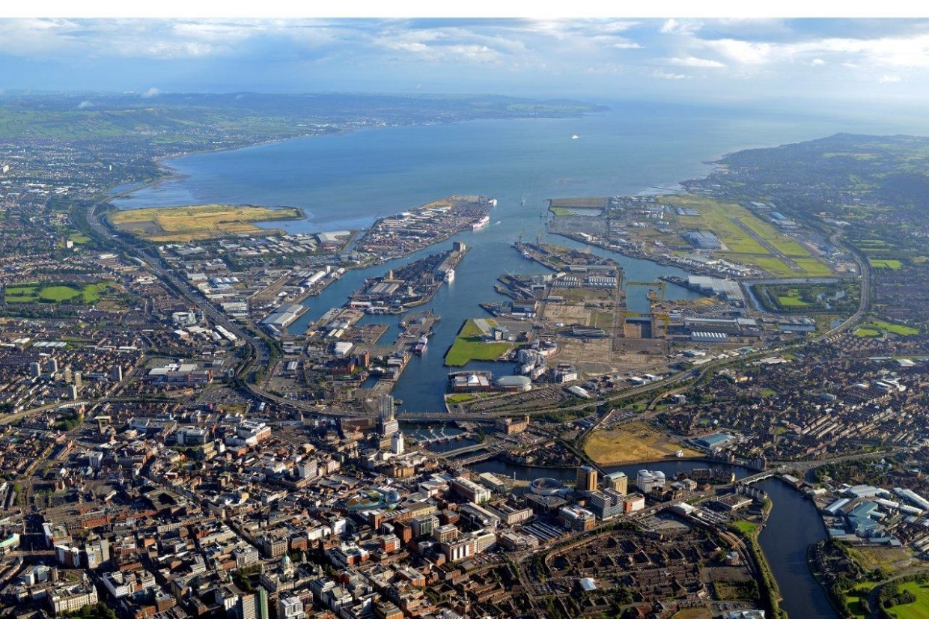
Background
Lewis lived on an island nation.
He once wrote, “And the sea! I cannot bear to live too far away from it.”
Belfast, Northern Ireland
Notes:
“And the sea! …” They Stand Together, p. 68. A letter to Arthur Greeves on March 30, 1915.

Slide 5
VDT & Dante’s Divine Comedy
Marsha Daigle-Williamson (MDW): “The first part of this Narnian journey recalls the journey in the Purgatorio, while the second part creatively replicates journey events in the Paradiso.”
MDW: “Eustace’s physical and moral transformation … condenses several experiences of Dante’s pilgrim….”
Notes:
Marsha Daigle-Williamson, Reflecting the Eternal: Dante’s Divine Comedy in the Novels of C. S. Lewis, Hendrickson Publishers, 2015.

Slide 6
Dante’s Divine Comedy
Dante’s pilgrim travels effortlessly up into the heavens, while the Narnian crew travels effortlessly because of a strong current.
As Dante’s pilgrim nears heaven, the light increases; as the Dawn Treader travels east, the light increases.
Beatrice’s appearance becomes brighter as she moves up through the spheres, while the Narnians sail east and “their own faces and bodies became brighter and brighter.”
Dante uses lilies as a metaphor for the apostles, while the Narnian crew sails through a sea of lilies.
And ten other similarities.
Notes:
Marsha Daigle-Williamson lists a total of 14 similarities.

Slide 7
Opening Sentence
“There was a boy called Eustace Clarence Scrubb, and he almost deserved it.”
American Book Review ranked it as #47 on its list of “The 100 Best First Lines from Novels.”
Bruce Edwards: Lewis chose a name that conveys “a sense of conceited self-satisfaction.”
“Not for the first time, an argument had broken out over breakfast at number four, Privet Drive.”
Notes:
Last bullet: first line of J. K. Rowling’s Harry Potter and The Chamber of Secrets. Second novel in the series.

Slide 8
Opening Sentence
The first sentence of this book has also been quoted in a collection of unusual first sentences by Douglas Loney, who thinks Lewis chose the name Eustace in memory of a spoiled brat named Eustace Robinson in E. M. Forster’s short story, “The Story of a Panic.”

Slide 9
The Frequency of Names in VDT
Reepicheep: 116 times
Edmund: 145 times
Eustace: 158 times
Caspian: 260 times
Lucy: 270 times
Notes:
The number of times each name is used in The Voyage of the ‘Dawn Treader.’ This means, of course, that Lucy is quite important. Will Poulter played Eustace in the movie directed by Michael Apted.

Slide 10
Michael Ward & Planetary Influence
The Planet: the Sun, giver of light
Christ is the “bright Morning Star” (Rev. 22:16).
The sun makes people wise and free; produces fortunate events.
The sun’s sphere is the heaven of theologians and philosophers.
Metal: Gold (a word that appears 37 times)

Slide 11
Planetary Influence
Water as “drinkable light” in the Eastern Sea
The book’s title: a voyage toward the sun
The ship’s flag has a picture of a golden lion, the stern cabin has a “flat gold image of Aslan.”
The prow of the ship is a gilded, i.e. golden, dragon’s tail “covered with gilding.”
Lord Restimar was killed by aurification!
Notes:
Aurification = being turned to gold

Slide 12
Notes:
A drawing of the ship for the HarperCollins edition of the Chronicles of Narnia.

Slide 13
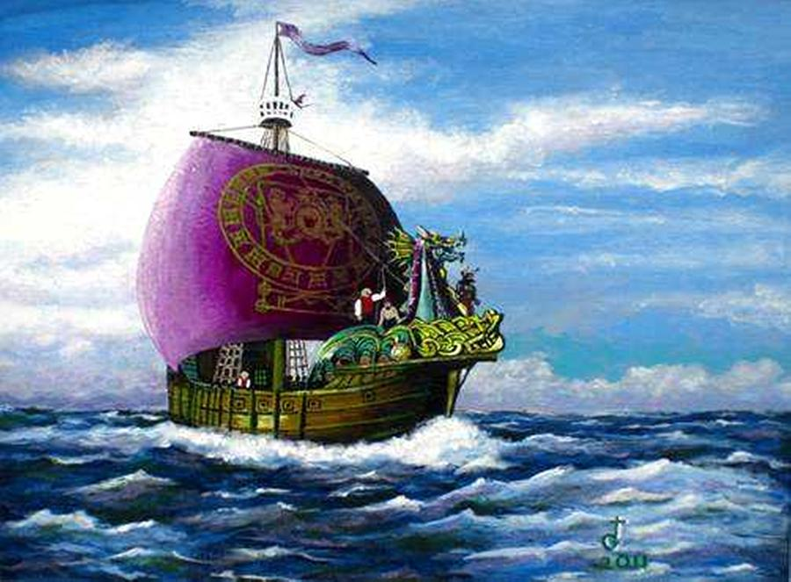

Slide 14
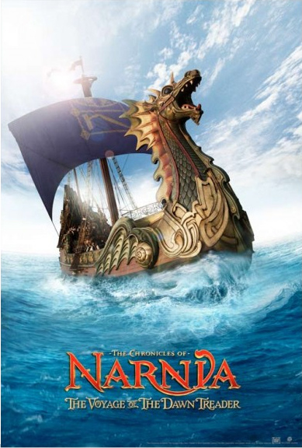

Slide 15
Planetary Influence
The Greek god Apollo, the god of light, was known as a dragon slayer. In VDT, four dragonish creatures are defeated.
First, the old dragon on Dragon Island. Then Eustace, who had become a dragon. Then the sea serpent, and last the Dawn Treader itself.
Eyesight becomes sharper at the end of the story (more light usually improves our vision).
Aslan’s golden character is emphasized.
The sun looks larger later in the story.

Slide 16
Narnian Time
In Narnia, 2306-2307: Narnian dates of the voyage, when Caspian was 16 (3 years since the end of Prince Caspian)
In England, 1942: the year of Edmund, Lucy and Eustace’s voyage, when they were 12, 10, and 9

Slide 17
The Plot: Search for the Seven Lost Lords
Edmund and Lucy stay at the house of their annoying cousin Eustace Clarence Scrubb because their Dad is on a summer lecture tour in America (with his wife and Susan).
As Eustace teases them, a painting comes alive, and they find themselves in Narnia on board the Dawn Treader.
They sail East to the Lone Islands, are captured by slave traders, find Lord Bern (#1), but escape and rearrange the leadership on the islands.
They leave the Lone Islands, sailing east and eventually face a fierce storm, which damages the Dawn Treader.
They repair and recover at Dragon Island, where Lord Octesian (#2) had died.
Eustace walks away to avoid work, gets lost, and eventually turns into a dragon.

Slide 18
The Plot: Eustace’s Self-Revelation
“In spite of the pain, his first feeling was one of relief. There was nothing to be afraid of any more. He was a terror himself now and nothing in the world but a knight (and not all of those) would dare to attack him. He could get even with Caspian and Edmund now …
“But the moment he thought this he realized that he didn’t want to. He wanted to be friends. He wanted to get back among humans and talk and laugh and share things. He realized that he was a monster cut off from the whole human race. An appalling loneliness came over him. He began to see the others had not really been fiends at all. He began to wonder if he himself had been such a nice person as he had always supposed. He longed for their voices. He would have been grateful for a kind word even from Reepicheep.”

Slide 19
The Dawn Treader
Notes:
Lucy gets her bottle of cordial back. See Peter’s sword and shield, plus Susan’s bow and quiver of arrows. The Dawn Treader appears in the left panel.

Slide 20
The Plot (cont’d)
They continue their journey, with Eustace undragoned, face a sea serpent and Deathwater Island, where they find another lost lord, Lord Restimar (#3).
They stop at the Island of the Voices, Lucy makes the Dufflepuds visible, and they meet Coriakin the magician.
At the Dark Island they pick up Lord Rhoop (#4).
They arrive at Ramandu’s island, find the last three lords (Argoz, Mavramorn, & Revilian, #5, 6, & 7) in an enchanted sleep at Aslan’s Table, and they leave for the world’s end to break the enchantment.
As they go east, they have more sunlight and need less sleep and food.
They come to the end of the world. Reepicheep goes to Aslan’s country, while Edmund, Lucy, and Eustace return to the bedroom in Aunt Alberta’s home.

Slide 21
Humor
Eustace to Edmund: “And by the way, I’d like to apologize. I’m afraid I’ve been pretty beastly.”
The Chief Dufflepud: “…and there we all were as invisible as you could wish to see.”
A Dufflepud: “Getting dark now; always does at night.”
The Chief Dufflepud: “And what I say is, when chaps are visible, why they can see one another.”

Slide 22
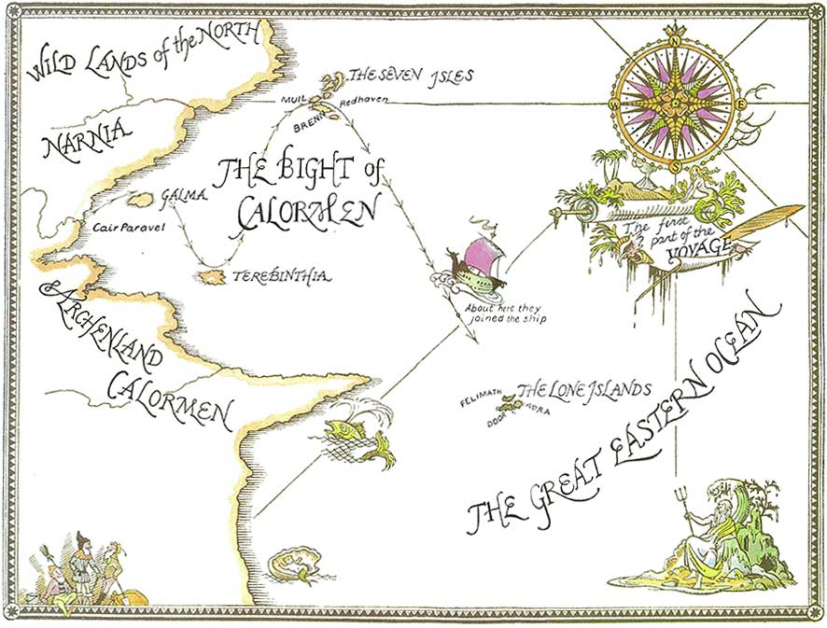

Slide 23
Biblical Theme I: A Change of Clothes

Slide 25
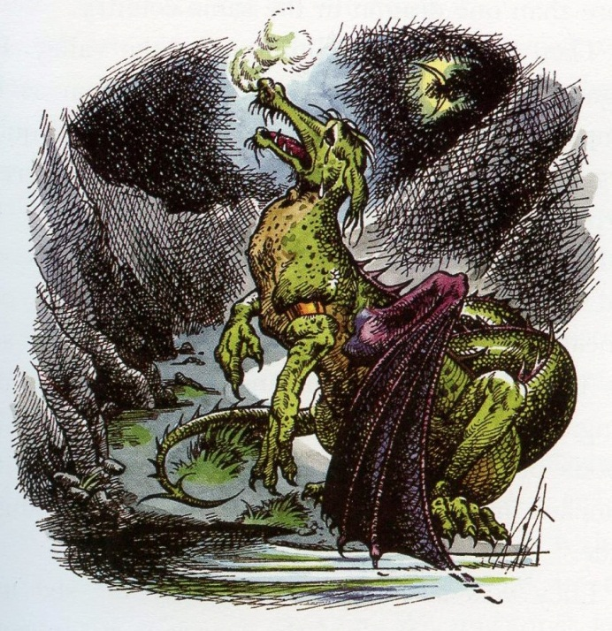
Biblical Theme I: A Change of Clothes
What does the undragoning of Eustace mean?
Aslan, “You will have to let me undress you.”
Jer. 13:23
Rom. 7:24-25
Rom. 6:3-5
Rev. 3:5

Slide 26
Biblical Theme II: Heart’s Desire
The Dryad’s cradle song to Reepicheep:
“Where sky and water meet,
Where the waves grow sweet,
Doubt not, Reepicheep,
To find all you seek,
There is the utter East.”
Luke 9:61-62
Heb. 11:13, 16
Psalm 73:25
Jer. 29:12-13

Slide 27
Aslan’s Seven Appearances
To the undragoned Eustace
On Deathwater Island
On the Island of the Duffers when Lucy sees his picture
When Aslan appears on the Island of the Duffers after her spell
The albatross
In “the flat gold image” inside Caspian’s cabin
At the Very End of the World as a lamb and a lion

Slide 28
A Favorite Quotation
“Well, don’t tell me about it, then,” said Eustace. “But who is Aslan? Do you know him?”
“Well—he knows me,” said Edmund.

Slide 29
Eustace on Books & the Value of Reading
“He [Eustace] liked books if they were books of information and had pictures of grain elevators or of fat foreign children doing exercises in model schools.”
“I had to apologize…It comes in the sort of books those Pevensie kids read.”
“Something was crawling. Worse still, something was coming out. Edmund or Lucy or you would have recognized it at once, but Eustace had read none of the right books.”
Notes:
Leaders are readers.

Slide 30
Eustace on Books & the Value of Reading
“Most of us know what we should expect to find in a dragon’s lair, but, as I said before, Eustace had read only the wrong books. They had a lot to say about exports and imports and governments and drains, but they were weak on dragons.”
“Eustace (never having read the right books) had no idea how to tell a story straight.”
“This [i.e. to agree to stay overnight with the three sleepers] was very brave of him because never having read of such things ….”

Slide 31
Caspian and Leadership Development
In his essay “Answers to Questions on Christianity,” Lewis wrote, “If you think of this world as a place intended simply for our happiness, you find it quite intolerable: think of it as a place of training and correction and it’s not so bad.”
Caspian is now sixteen. He does more and makes more decisions than in the previous story.

Slide 32
Stars
“In our world,” said Eustace, “a star is a huge ball of flaming gas.”
“Even in your world, my son, that is not what a star is but only what it is made of.”
(Chapter XIV. The Beginning of the End of the World)

Slide 33
Knightly Chivalry
Reepicheep is the consummate gentleman and chivalrous knight.
Reepicheep: “its manners courtly” (Chapter 1)
Reepicheep: “I ask your pardons all.”
Reepicheep: “the respect due to a knight” (Chapter 2)
Reepicheep: “Master Rhince, you never spoke a word that became you less.” (Chapter 6)
Caspian calls him “Sir Reepicheep, the good knight”

Slide 35
Eustace’s Moral Development
Many compare Eustace’s dragon form to his selfish inner nature, and his being undragoned to salvation. How perfect was Eustace after his transformation?
Answer: “It would be nice, and fairly nearly true, to say that ‘from that time forth Eustace was a different boy.’ To be strictly accurate, he began to be a different boy. He had relapses.”

Slide 36
More Moral Development
Caspian: “We must just keep close watch and, as soon as it is light, go down to the beach and give it battle.”
On Eustace the dragon: “… greatly to his surprise, Reepicheep was his most constant comforter.”
Eustace to Edmund: “I’d like to apologize.”
Lucy leant her head on the edge of the fighting top and whispered, “Aslan, Aslan, if ever you loved us at all, send us help now.”

Slide 37
Humor
Reepicheep playing chess
“It was, however, clear to everyone that Eustace’s character had been rather improved by becoming a dragon.”

Slide 38
Cup, Sword, Tree, Green Hill
In the story from the magician’s book, to what do the cup, sword, tree, and green hill refer?
Answer: Christ’s Last Supper, arrest, death and resurrection. Why? Four reasons.
The four elements line up chronologically with the details from the New Testament.
This is a story that does not seem to belong in Narnia.
It comes after Lucy’s greatest transgression in the Chronicles and therefore provides the way for her spirit to be made fresh again.
Aslan tells Lucy, “I will tell it to you for years and years.”
The Spell for the Refreshment of the Spirit
Notes:
In Coriakin’s house.

Slide 39
Spell
By the way …
The word spell has a double meaning.
In “On Fairy-Stories,” Tolkien notes that the word spell, in its Old English roots, “means both a story told, and a formula of power over living men.”
Furthermore, the word gospel, derived from spell, literally means “good story.”

Slide 40
Another Favorite Quotation
Aslan: “I will not tell you how long or short the way will be; only that it lies across a river. But do not fear that, for I am the great Bridge Builder. . . . But there I have another name. You must learn to know me by that name. This was the very reason you were brought to Narnia, that by knowing me here for a little, you may know me better there.”

Slide 41
Factual Quiz Just for Fun
Eustace Clarence Scrubb was the Pevensies’ (a) cousin in Cambridge, (b) friend in Oxford, (c) nephew in Narnia.
Eustace, Lucy and Edmund entered Narnia through (a) a door in the sky, (b) a wardrobe, (c) a picture of a ship.
Caspian was looking for (a) revenge against Miraz, (b) the World’s End, (c) seven friends of his murdered father.

Slide 42
Factual Quiz Just for Fun
The evil that Lord Bern helped the voyagers destroy in the Lone Islands was (a) a magic curse, (b) slavery, (c) evil dreams.
After leaving the Lone Islands, the “Dawn Treader” suffered two weeks of (a) storm and drifting, (b) attacks from sea serpents, (c) captivity.
Dragon Island is where (a) Eustace’s cure began, (b) Eustace became perfect, (c) Eustace was condemned.

Slide 43
Factual Quiz Just for Fun
Deathwater Island is where (a) gold means death, (b) Lord Restimore became rich, (c) all water was poison.

Slide 44
Factual Quiz Just for Fun
Which of Aesop’s fables is told in this story? (a) The Mischievous Dog, (b) Androcles and the Lion, (c) The Dog and the Wolf.
The Dark Island was (a) made light by Caspian, (b) where dreams come true, (c) where Aslan was seen as a Lamb.
Ramandu was (a) a retired star with a lovely daughter, (b) a magician, (c) a lost lord.

Slide 45
Benediction
Lord of the Utter East, you know where each of us is on this life voyage.
Please preserve us from Deathwater curses and Dark Island dreams.
Give us the courage to endure through rough storms and dull calms.
Keep telling us how to get to your country from our world.
And help us to know you better here.
Next Week: The Silver Chair

