Slide 1
The Making of a Rhetorician:
The Education of C. S. Lewis
Joel D. Heck

Slide 2
Summary
He was educated
  At home
  W. T. Kirkpatrick
  University College
He was an educator and “a congenital rhetorician”
  Oxford University
  Cambridge University
He thought deeply about education
He wrote about education
Rhetoric fits into all of these categories

Slide 3
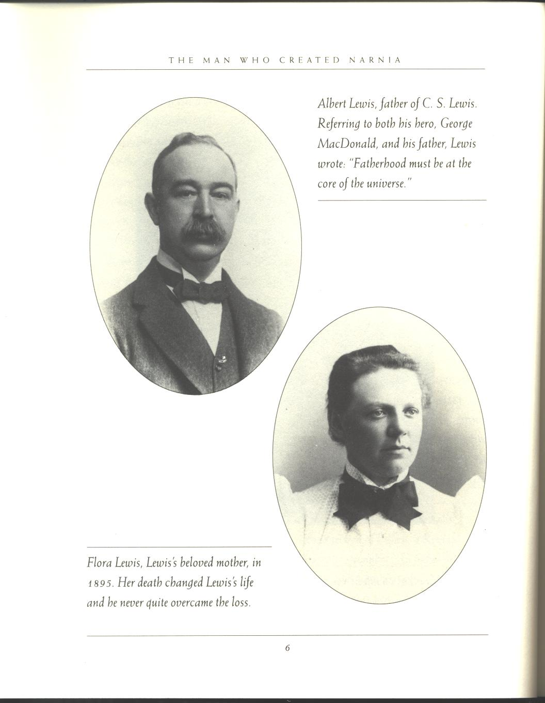
I. His parents
Flora Hamilton Lewis (1862-1908) earned a degree in math and logic from Queen’s College, Belfast
Albert James Lewis (1863-1929), a Belfast solicitor, was also a Queen’s graduate (with a rhetorical bent)

Slide 4
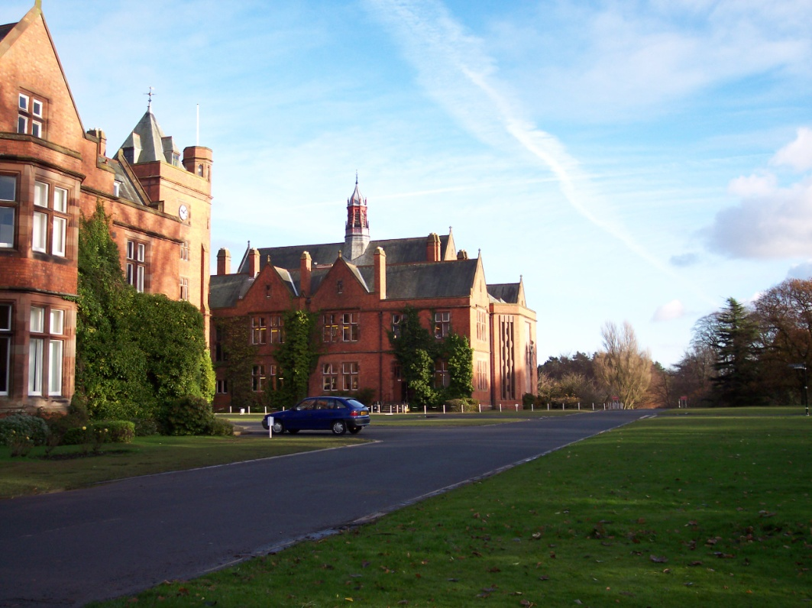
II. Early Years
Beatrix Potter
Little Lea
Death of his mother
Wynyard School, 1908-1910
Campbell College in the fall of 1910
Cherbourg House and Malvern College
Campbell College, Belfast, 1910

Slide 5
Wynyard School
Sept. 18, 1908 to July 1910
“…the putting on of the school clothes was … the assumption of a prison uniform.”
James Adams McNeill and the poetry of Matthew Arnold (first semi-formal training in rhetoric)

Slide 6
The Medieval Trivium
Grammar
Logic (Dialectic)
Rhetoric

Slide 7
Malvern College
Malvern College and Harry Wakelyn Smith, a master of the Classics (Smewgy)
Poetry, i.e. “how it should be savored and mouthed in solitude.”
“Smewgy taught me Grammar and Rhetoric and Kirk taught me Dialectic” (SBJ, 141).

Slide 8
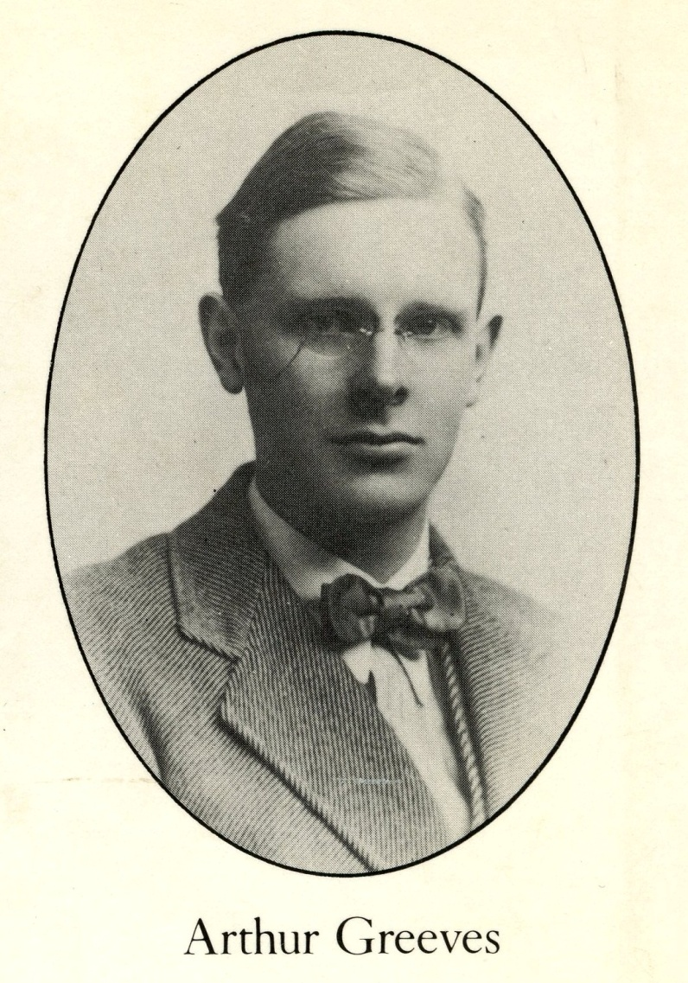
Arthur Greeves
Sensitivity to nature
Interested in art
Also interested in northernness
Especially taught Lewis humility

Slide 9
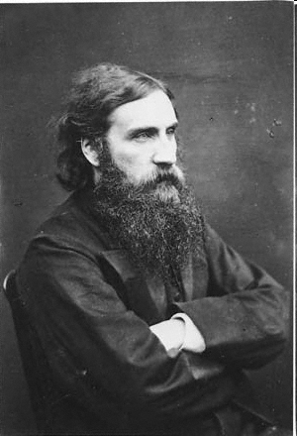
George MacDonald
The discovery, in 1916, of MacDonald’s book Phantastes (Imagination)
Lewis later called MacDonald “my master”
He once said that he never wrote a book in which MacDonald’s influence did not appear

Slide 10
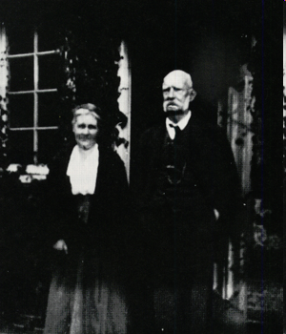
W. T. Kirkpatrick
W. T. Kirkpatrick, “The Great Knock”
His Tutor from Sept. 19, 1914 to April 25, 1917
Preparation for Oxford University
“If ever a man came near to being a purely logical entity, that man was Kirk.”
A man who “thought not about you but about what you said.”

Slide 11
W. T. Kirkpatrick
Their meeting
Kirkpatrick’s style
Lewis’s later style
The impact of such style
What he could have done differently

Slide 12
Lewis and Kirkpatrick Meet
Surprised by Joy, Chapter IX, “The Great Knock”
You will often meet with characters in nature so extravagant that a discreet poet would not venture to set them upon the stage. LORD CHESTERFIELD
The Date: Saturday, Sept. 19, 1914
Liverpool to London to Waterloo to Great Bookham in Surrey
“I came prepared to endure a perpetual lukewarm shower bath of sentimentality” (133).

Slide 13
“He was over six feet tall, very shabbily dressed (like a gardener, I thought), lean as a rake, and immensely muscular. His wrinkled face seemed to consist entirely of muscles, so far as it was visible; for he wore mustache and side whiskers with a clean-shaven chin like the Emperor Franz Joseph.”
“I said I was surprised at the “scenery” of Surrey; it was much “wilder” than I had expected.”

Slide 14
“ ‘Stop!’ shouted Kirk with a suddenness that made me jump. ‘What do you mean by wildness and what grounds had you for not expecting it?’”
“A few passes sufficed to show that I had no clear and distinct idea corresponding to the word ‘wildness,’ and that, in so far as I had any idea at all, ‘wildness’ was a singularly inept word.”
“ ‘Do you not see, then,’ concluded the Great Knock, “ ‘that your remark was meaningless?’”

Slide 15
“Having analyzed my terms, Kirk was proceeding to deal with my proposition as a whole. On what had I based (but he pronounced it baized) my expectations about the Flora and Geology of Surrey? Was it maps, or photographs, or books? I could produce none. It had, heaven help me, never occurred to me that what I called my thoughts needed to be ‘baized’ on anything. Kirk once more drew a conclusion—without the slightest sign of emotion, but equally without the slightest concession to what I thought good manners: ‘Do you not see, then, that you had no right to have any opinion whatever on the subject?’”

Slide 16
“By this time our acquaintance had lasted about three and a half minutes; but the tone set by this first conversation was preserved without a single break during all the years I spent at Bookham.”
!!!
“The idea that human beings should exercise their vocal organs for any purpose except that of communicating or discovering truth was to him preposterous. The most casual remark was taken as a summons to disputation.”

Slide 17
The Medieval Trivium
Grammar
Logic (Dialectic)
Rhetoric (Kirk had Lewis read the great Greek and Roman rhetoricians)
For Lewis, Logic and Rhetoric merge to some extent.

Slide 18
“Refutation (when we got so far) always followed the same lines. Had I read this? Had I studied that? Had I any statistical evidence? Had I any evidence in my own experience? And so to the almost inevitable conclusion, ‘Do you not see then that you had no right, etc.’”
The very next sentence: “Some boys would not have liked it; to me it was red beef and strong beer.”

Slide 19
“After being knocked down sufficiently often I began to know a few guards and blows, and to put on intellectual muscle. In the end, unless I flatter myself, I became a not contemptible sparring partner. It was a great day when the man who had so long been engaged in exposing my vagueness at last cautioned me against the dangers of excessive subtlety.”

Slide 20
An Example
“These fiendish German atrocities—” “But are not fiends a figment of the imagination?”—“Very well, then; these brutal atrocities—” “But none of the brutes does anything of the kind!”—“Well, what am I to call them?” “Is it not plain that we must call them simply Human?”

Slide 21
Teaching Style
“…he announced that we would begin Homer on Monday. I explained that I had never read a word in any dialect but the Attic, assuming that when he knew this he would approach Homer through some preliminary lessons on the Epic language.”

Slide 22
“At nine o’clock we sat down to work in the little upstairs study which soon became so familiar to me. It contained a sofa (on which we sat side by side when he was working with me), a table and chair (which I used when I was alone), a bookcase, a gas stove, and a framed photograph of Mr. Gladstone. We opened our books at Iliad, Book I. Without a word of introduction Knock read aloud the first twenty lines or so in the ‘new’ pronunciation, which I had never heard before.”

Slide 23
“He then translated, with a few, a very few explanations, about a hundred lines. I had never seen a classical author taken in such large gulps before. When he had finished he handed me over Crusius’ Lexicon and, having told me to go through again as much as I could of what he had done, left the room. It seems an odd method of teaching, but it worked. At first I could travel only a very short way along the trail he had blazed, but every day I could travel further. Presently I could travel the whole way. Then I could go a line or two beyond his furthest North” (141).

Slide 24
“a kind of madness”
“But Homer came first. Day after day and month after month we drove gloriously onward, tearing the whole Achilleid out of the Iliad and tossing the rest on one side, and then reading the Odyssey entire, till the music of the thing and the clear, bitter brightness that lives in almost every formula had become part of me” (145).

Slide 25
Reading!
“No days, even at Bookham, were happier than those on which the afternoon post brought me a neat little parcel in dark gray paper. Milton, Spenser, Malory, The High History of the Holy Grail, the Laxdale Saga, Ronsard, Chénier, Voltaire, Beowulf and Gawain and the Green Knight (both in translations), Apuleius, the Kalevala, Herrick, Walton, Sir John Mandeville, Sidney’s Arcadia, and nearly all of Morris, came volume by volume into my hands” (147f.).

Slide 26
In summary … again
“Smewgy and Kirk were my two greatest teachers. Roughly, one might say (in medieval language) that Smewgy taught me Grammar and Rhetoric and Kirk taught me Dialectic.”
“My debt to him is very great, my reverence to this day undiminished” (148).

Slide 27
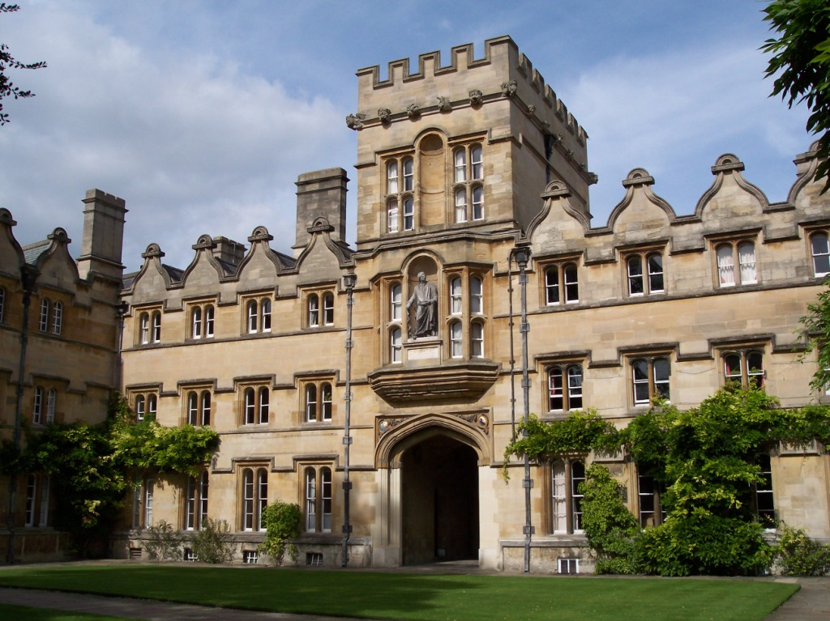
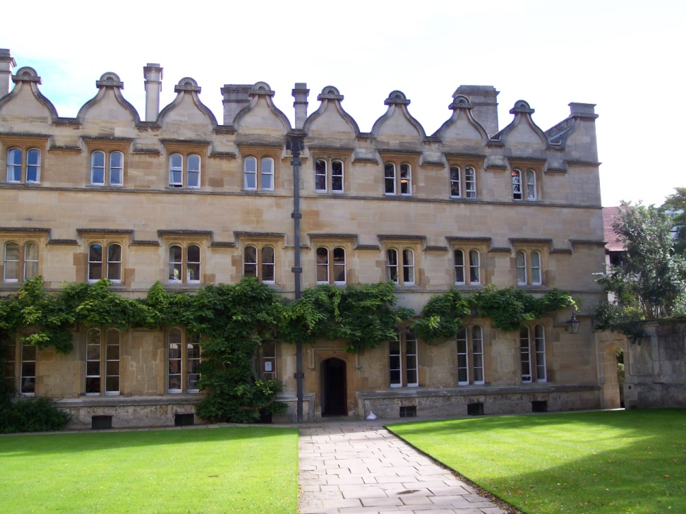
University College (Univ.)
Lewis’s rooms, third floor

Slide 28
The Liberal Arts at Univ.
Honour Moderations—Greek and Latin texts
Greats—Philosophy and Ancient History
English Language and Literature

Slide 29
How an Oxford curriculum was different
One subject
Three years
Tutorials
Lectures
Preliminary exams
Final exams
Viva voce

Slide 30
Rhetoric in Action
The Martlets, an undergraduate literary society where he sharpened his rhetorical and debating skills (1919ff.)
The Inklings (1933-1949)
The Socratic Club (1942-1954)

Slide 31
His Readings
Quintilian
Hugh Blair’s Lectures on Rhetoric and Belles Lettres
I. A. Richards, The Philosophy of Rhetoric

Slide 32
His Writings
“Rhetoric and Poetry … definitely aim at doing something to an audience. And both do it by using language to control what already exists in our minds” (Preface, 53). He is here indebted to Aristotle.
“I also am an Irishman and a congenital rhetorician” (Collected Letters, II, 444).
Always writing for the ear (BBC talks).

Slide 33
“The differentia of Rhetoric is that it works to produce in our minds some practical resolve … and it does this by calling the passions to the aid of reason” (Preface, 53).
“…in Rhetoric imagination is present for the sake of passion (and, therefore, in the long run, for the sake of action), while in poetry passion is present for the sake of imagination, and therefore, in the long run, for the sake of wisdom or spiritual health” (Preface, 54).
The End
www.joelheck.com

