Slide 1
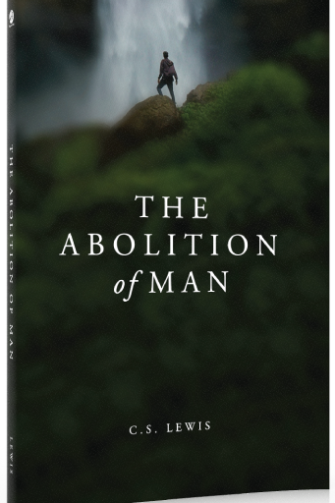
The Abolition of Man
C. S. Lewis on Objective Values

Slide 2
Your Hosts
Dr. Rob Koons, Philosophy, The University of Texas, Austin, Texas
Josiah Peterson, M.A., Great Hearts Classical School in Phoenix, Arizona
Rev. Dr. Joel Heck, Redeemer Lutheran Church, Austin, Texas

Slide 3
The G.O.A.T.
This book has been described as the best defense of an objective standard of right and wrong in the English language, so it could be called Lewis’s “Greatest of All Time,” the G.O.A.T.

Slide 4
Ward’s Chapter 1: Reception (4 pages)
Michael Ward, pages 1-2: The Abolition of Man has been “almost totally ignored by the public.”
J. R. Lucas, “No summary can do justice to the fineness of Mr. Lewis’s thought.” And three others.
Plus Jacobs, Wilson, Nuttall, Midgley, Hailsham, Ratzinger, von Balthasar, Gray, Fukuyama, Berry, and Green & Hooper.

Slide 5
Ward’s Chapter 2: Occasion and Context (6 pages)
World War II, i.e., the war and “the War” (spiritual)
Michael Aeschliman: “The case against traditional ethics that Ayer made and the attitude toward reality that he proposed were Lewis’s chief targets in The Abolition of Man ….”

Slide 6
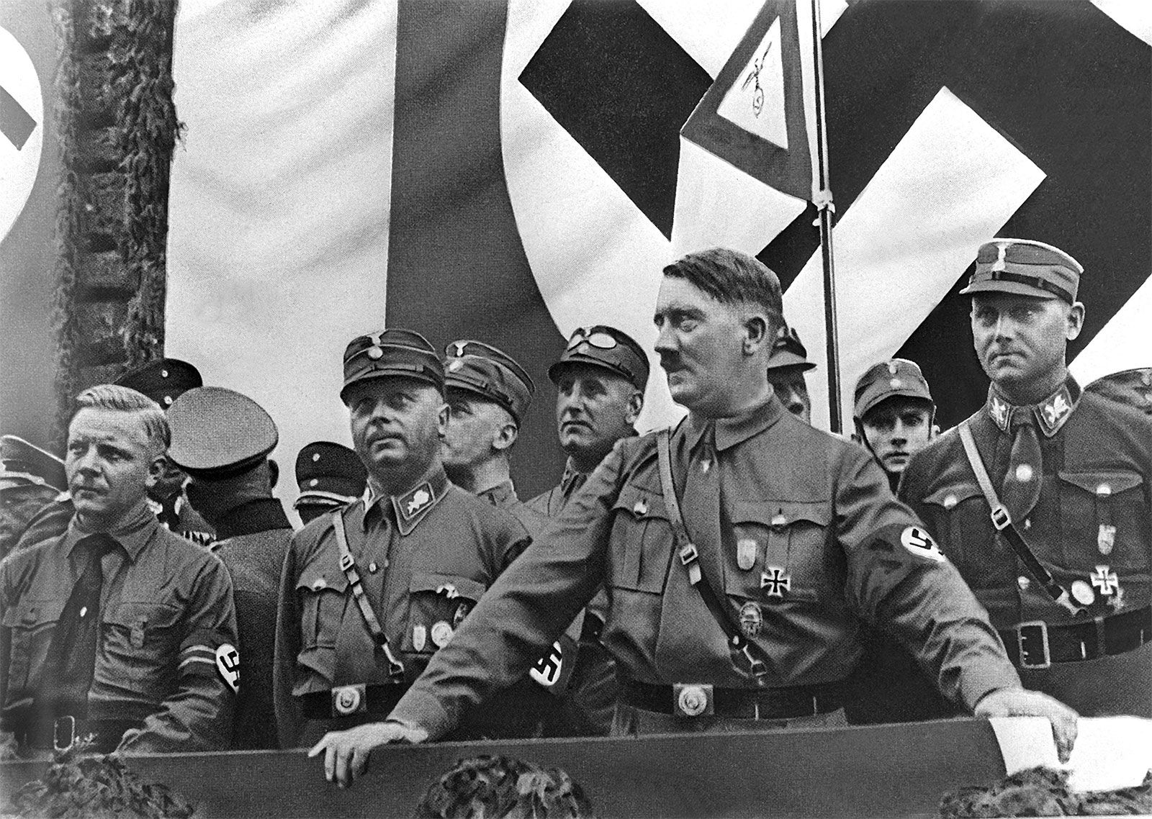

Slide 7
Ward’s Chapter 3: Overview (8 pages)
The Green Book reflects I. A. Richards’ work on subjectivism, which King and Ketley echo.
Richard’s book is The Meaning of Meaning: A Study of the Influence of Language upon Thought and of the Science of Symbolism (1923).
Michael Ward’s summary of Abolition: The check-up (subjectivism), the diagnosis (devalued values), and the prognosis (not good; the will to power).

Slide 8
Ward’s Chapter 4: A Religious Work? (4 pages)
Not an apology for Christianity.
James 1:17—any truth is light, not just biblical truth.
Objective value underlies all religions.
“One can only be a religious human being, Lewis implies, if one is first a human being ….” (21).

Slide 9
Ward’s Chapter 5: Background (14 pages)
Michael Ward documents where in Lewis’s other works the ideas of Abolition appear, and they are many.
Logical Positivism and subjectivism dominated philosophical circles in Oxford in 1943 (24).
Lewis had training in philosophy, tutored philosophy students in his early years of teaching, and had a sharp mind for philosophical discussion.

Slide 10
Ward’s Chapter 6: Legacy (6 pages)
Abolition’s significant influence on philosopher John Lucas, English professor Paul Piehler, philosopher & political commentator George Grant, polymath Michael Polanyi, philosopher Elizabeth Anscombe, and philosopher Alasdair MacIntyre (After Virtue).
And its influence on Virtue Ethics

Slide 11
Peter Kreeft on Philosophy
Philosophers are that breed of people who go down deeper, stay down longer, and come up drier than any other group.
C. S. Lewis, writing to his father on August 14, 1925:
“I have come to think that if I had the mind, I have not the brain and nerves for a life of pure philosophy….

Slide 12
Peter Kreeft on Philosophy
… A continued search among the abstract roots of things, a perpetual questioning of all that plain men take for granted, a chewing the cud for fifty years over inevitable ignorance and a constant frontier watch on the little tidy lighted conventional world of science and daily life—is this the best life for temperaments such as ours? Is it the way of health or even of sanity?” (Collected Letters, I, 648)

Slide 13
Fact vs. Opinion, an exercise
Mozart was born in Salzburg.
Mozart wrote beautiful music.
John Paul II was the Pope for over 20 years.
John Paul II was a good Pope.
Bell-bottoms were popular in the 1970s.
Bell-bottoms are strange.
Notes:
Grab a blank piece of paper, put your name on it, and put numbers from 1 to 6 on the left side. Source: Michael Matheson Miller, “C. S. Lewis, Scientism, and the Moral Imagination.” The Magician’s Twin: C. S. Lewis on Science, Scientism, and Society, 313f.

Slide 14
Fact vs. Opinion, an exercise
All six statements are facts!
Michael Aeschliman: “Modern scientistic doctrine holds all fact to be objective and all value to be subjective.”
Notes:
P. 74.

Slide 15
Fact vs. Opinion
Mozart’s music is beautiful whether we happen to like it or not.
John Paul II was indeed a good pope, whether you are Catholic or not.
No matter what you think, bell-bottoms are not cool.
Summary: All the odd numbered statements are more obviously facts (about beauty and goodness), but all the even numbered statements are also objectively true.

Slide 16
College Students in 2015
John Paul II was a good Pope.
Fact: 0. Opinion: 6.
Bell-bottoms were popular in the 1970s.
Fact: 4. Opinion: 2.
Bell-bottoms are strange.
Fact: 0. Opinion: 6.
Reality: All six are facts.
Mozart was born in Salzburg.
Fact: 6. Opinion: 0.
Mozart wrote beautiful music.
Fact: 0. Opinion: 6.
John Paul II was the Pope for over 20 years.
Fact: 6. Opinion: 0.

Slide 17
College Students in 2018
John Paul II was a good Pope.
Fact: 0. Opinion: 10.
Bell-bottoms were popular in the 1970s.
Fact: 9. Opinion: 1.
Bell-bottoms are strange.
Fact: 0. Opinion: 10.
Reality: All six are facts.
Mozart was born in Salzburg.
Fact: 10. Opinion: 0.
Mozart wrote beautiful music.
Fact: 0. Opinion: 10.
John Paul II was the Pope for over 20 years.
Fact: 10. Opinion: 0.

Slide 18
Music Faculty on Mozart
Mozart (Beethoven, Bach etc.) - their music is beautiful because it is …
1) … well-crafted, brilliant composition, innovative harmony, melody, form.
2) Their patrons, court or church, of their employment expected the music to be of the highest quality.
3) History counts on what other composers, musicians, teachers have written and said about his music.

Slide 19
Music Faculty on Mozart
Mozart (Beethoven, Bach etc.) - their music is beautiful because …
1) the way I feel when I listen to his music.
2) Analytically and theoretically, I can see the genius in his work (melody, form, harmony, rhythm).
3) Studies have shown that listening to Mozart makes children smarter. Above all, Mozart, Bach, Beethoven, the Great Masters - their music is beautiful because God gave them each a gift and talent to put dots on a page that eventually turn into sound. Those sounds have given me and so many others pleasure like no other.

Slide 20
Background
Alternate title: or Reflections on education with special reference to the teaching of English in the upper forms of schools.
Written in 1943 as the Riddell Memorial Lectures and delivered on the evenings of February 24-26 at the University of Durham.
Published by Oxford University Press in 1944.
Rated the seventh most important work of non-fiction of the past century in a 2013 National Review poll (Winston Churchill #1; Mere Christianity, #26).

Slide 21
The Green Book by Gaius & Titius
The Control of Language (1939)
By Alec King and Martin Ketley, two English schoolmasters teaching in Australia
Its cover was green!
Lewis also refers to another book by Orbilius (E. G. Biaggini) entitled The Reading and Writing of English (Ward, 61)

Slide 22
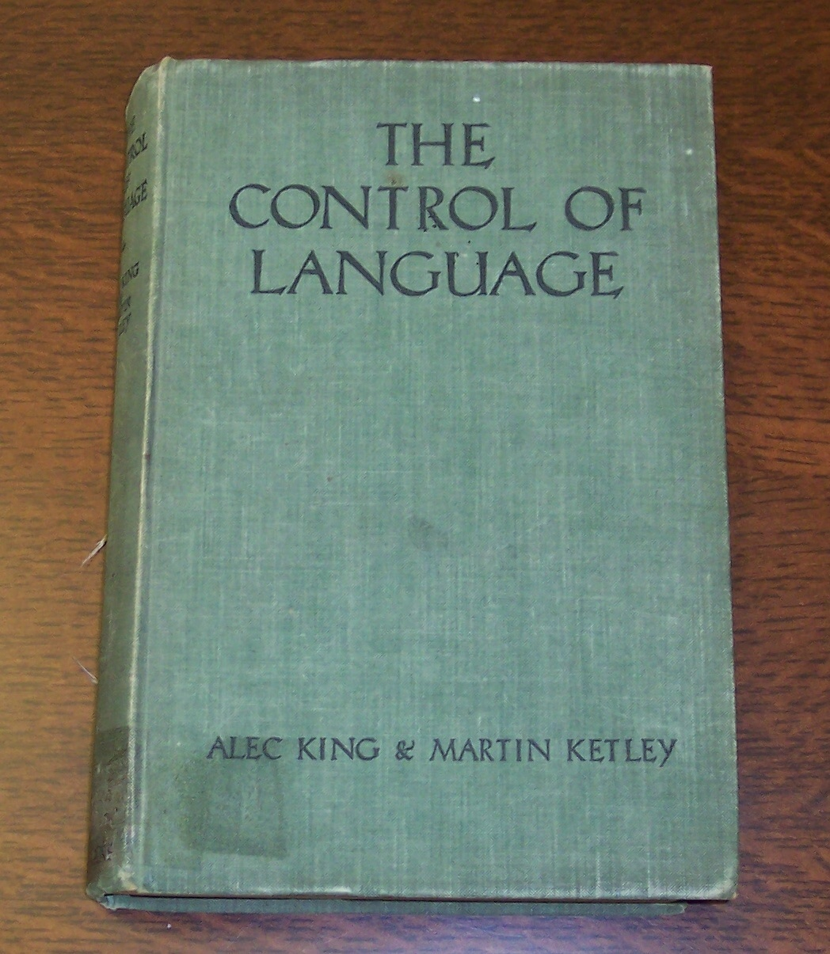
The Green Book
Notes:
This is Lewis’s copy, kept at the Wade Center in Wheaton, Illinois. This was the last slide viewed and discussed on 9/11/2022.

Slide 23
Three Parts of The Abolition of Man
Part I. Men without Chests (a lament) against the subjectivist—the problem with thinking that all values are subjective (the negative chapter)
Part II. The Way (a challenge) against the innovator—the inconsistency in stepping outside the Tao and yet using the Tao; the need to integrate the head with the belly (the positive chapter)
Part III. The Abolition of Man (implications) against the conditioner—the problem with elevating subjective values (and losing trained emotions) above the Tao is that we ruin ourselves; the will to power (the prophetic chapter)
Notes:
See Michael Ward’s third chapter. Lewis chooses the word “chest” instead of “heart,” because the latter could easily be confused with emotionalism (Ward, 73f.).

Slide 24
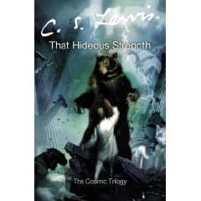
That Hideous Strength
Notes:
The title comes from the line of a poem written in 1555 by David Lyndsay, referring to the Tower of Babel.

Slide 25
Terms and Key Issues
The Tao
Subjectivism (see “The Poison of Subjectivism”)
Scientism
The Abolition of Man
Men without Chests

Slide 26
Terms and Key Issues
The Tao: The key idea of the Tao is that certain human responses and emotions are appropriate and others inappropriate to the way the Universe is. It is (Chapter 1, p. 18) “the doctrine of objective value, the belief that certain attitudes are really true, and others really false, to the kind of thing the universe is and the kind of things we are.” Lewis argued that the Tao is a common core of values to be found in the Ethical teachings of all major cultures throughout history.
Mark8mywords#
Notes:
The phrase “the right side of history” comes from Karl Marx and from Hegel. Tolerance is part of the Tao.

Slide 27
Terms and Key Issues
Question (W1): Does Lewis’s argument benefit or suffer from his use of the word Tao? Why does he not use a term such as “Objective Morality” or “Natural Law”? (15, After Humanity)
The Tao is the opposite of some socially or psychologically constructed set of values (Ward, 71).
Notes:
Question 1 in Ward, p. 199. Michael Ward: Lewis uses the term Tao “in order to de-emphasize Western categories and remind his readers that moral reality is universal” (15, 71). And, “it is universally held to be objective” (15). Doris Myers: “Lewis uses the term to get away from the associations the term ‘natural law’ has with Christian ethics.” (Ward, 70). Lewis may be trying to evoke I. A. Richards and attack him (Ward, 71).

Slide 28
Terms and Key Issues
Subjectivism (see “The Poison of Subjectivism”): This is the idea, attacked by Lewis, that all statements of aesthetic or moral value are really only reports of the speaker’s emotional state.
Question (W3): Does Lewis distinguish adequately between aesthetic judgments and ethical judgments?
Notes:
Question 3 in Ward, p. 199.

Slide 29
Terms and Key Issues
Scientism: Scientism is the view that only what can be observed and measured by scientific methods is really objective or “valid.” It is present among those ignorant of real science who have an almost religious veneration for science and scientists. Scientism is not the same as science. Science is simply the attempt to …

Slide 30
Terms and Key Issues
… understand and describe nature. Many great scientists have also believed in reality beyond nature, e.g., Newton and Einstein. Scientism is an attitude toward science, the view that science is the sole source of knowledge relevant to human experience. It therefore assumes Naturalism, the thesis that nature is …

Slide 31
Terms and Key Issues
… everything, contrary to many scientists. One version of scientism was Verificationism, which claimed that a statement was literally meaningful only if it can be verified (or refused) by some possible observation. According to this view, religious or ethical statements …

Slide 32
Terms and Key Issues
… are literally meaningless, and if they are meaningful at all, it is only as indirect statements of our own emotion. Thus, Scientism leads to Subjectivism.

Slide 33
Terms and Key Issues
The Abolition of Man: Lewis thought that the Tao is what makes humans human. Scientism threatens to exclude the Tao on the grounds that value judgments are not “scientific.” When that is done, humans will come to regard themselves as no more than another piece of nature….

Slide 34
Terms and Key Issues
… Without any ethical guidelines, humans thus become the objects of all sorts of experimentation and eugenics, as suggested by That Hideous Strength. The human conquest of nature now becomes the human conquest of humanity itself. While other conquests of nature have given humans more power, this threatens to enslave us.

Slide 35
Question
In what areas of our culture today do we find the devaluing of human beings, or the placement of animals on the same level as humans?
Notes:
Did this slide last on 9/18/2022.

Slide 36
Three Quotations
Rabelais: “Science without conscience is nothing but the death of the spirit.”
Einstein: “religion without science is lame, but science without religion is blind.”
Jaki: “science … has been unable to foster a vivid appreciation in man for an understanding of purpose.”
Agree? Disagree?
Is science objective?
Notes:
Cited in Aeschliman, 19, 21. Last question answered by Paul Holmer in After Humanity, p. 66: “… Lewis will not concur with the notion that the language of science is uniquely objective.”

Slide 37
Four Different Quotations
Bacon: “We must put nature to the rack, to compel it to answer our questions.”
Diderot: man is learning to “torment nature.”
Nietzsche: man is “beyond good and evil”
Aeschliman: “Science is a good servant but a bad master.”
Comment?
Notes:
Cited in Aeschliman, 19, 21. Aeschliman, “It is this religion and this historical concentration of amoral knowledge and power of the few over the many and over nature itself that Lewis called “that hideous strength.”

Slide 38
Terms and Key Issues
For example, science professor Augustus Frost says that one activity at the N.I.C.E. “is justified by the fact that it is occurring, and it ought to be increased because an increase is taking place.”
Is it ever justifiable to do some particular action for no other reason than because you can?
What are some good reasons for doing what we do? What are some bad reasons?
Notes:
THS, 295.

Slide 39
Terms and Key Issues
Men without Chests: Following Plato, Lewis argued that there are three elements significant for human motivation, The Intellect or Reason (the “head”), the Appetite or Desire (the “belly”) and the Affections or Heart (the “chest”). As Plato said, the head rules the belly through the chest. The problem with scientism, Lewis thinks, is that it has no room for the Heart or, as we would now call it, the affective dimension….
Notes:
See Ward, 73f., on “heart” vs. “chest.”

Slide 40
Terms and Key Issues
… Since it denies that our valuations are ever valid, all we are left with is reason and desire, which leads to all kinds of selfishness and the destruction of community. Lewis followed Aristotle in thinking that we can and should educate people not merely to think, but also to have appropriate attitudes, to care about what is really valuable: in other words, he thought we had a responsibility to create people with well-developed hearts.

Slide 41
Buddhism vs. Christianity
In Buddhism, desire is the problem.
In Christianity, our desires are too weak. They are directed in the wrong way.

Slide 42
Footnote: Head, Belly, Chest
“The head rules the belly through the chest—the seat, as Alanus tells us, of Magnanimity, of emotions organized by trained habit into stable sentiments. The Chest—Magnanimity—Sentiment—these are the indispensable liaison officers between cerebral man and visceral man. It may even be said it is by this middle element that man is man: for by his intellect he is mere spirit and by his appetite mere animal.” (The Abolition of Man, starting the second line from the bottom of p. 24)

Slide 43
Jeff Dryden
“What I Failed to Learn from C. S. Lewis.” November 2021, Didaktikos Journal, 31-35.
“They [students] first process things emotionally, then ethically, and lastly intellectually.”
“I ask students how a particular doctrine or text makes them feel. I am glad none of my professors ever asked me this question when I was a graduate student. I don’t think it would have worked for our generation. Today’s students process things primarily emotionally. If we don’t do it in the classroom, then we are not dealing with the core of who they are as students.”
So, today, belly, then chest, then the head.

Slide 44
The Opening of The Abolition of Man
In what areas do we accept truth as relative?
How about appreciation of differing musical styles?
In what areas do we not accept truth as relative?
The Chronicles of Narnia help to develop “men (and women) with chests” (Part 1 of The Abolition of Man is entitled “Men without Chests”).
Bassham, Gregory and Jerry L. Walls. The Chronicles of Narnia and Philosophy. Chicago: Open Court Publishing Company, 2005. Chapter 2: “Why Uncle Andrew Couldn’t Hear the Animals Speak”
Notes:
The word “truth” must be defined, because sometimes what passes for truth is preference, opinion, or falsehood. This is not even a matter of truth. Last slide seen on 10/2/2022.

Slide 45
Where Truth is Not Relative
Would a math teacher conclude from the fact that each of his students had a different answer for some mathematical problem that there was no right answer?
Does anyone seriously think that the delight a psychopath takes in murder is just as “valid” as the revulsion of others?
Defenders of the Tao realize that our emotions are just a response: their appropriateness or otherwise is another matter, a matter of virtue.
Notes:
We can have an inappropriate response to circumstances, almost as easily as an appropriate one.

Slide 46
Epigraphs
Before the Table of Contents, Lewis cites Confucius.
“The Master said, He who sets to work on a different strand destroys the whole fabric.” Confucius
Why do you think he cites Confucius?
Before the first paragraph on page one, he cites a Christmas carol about King Herod: “So he sent the word to slay/And slew the little childer.” Why?
Alan Jacobs: Herod could kill the body, but our teachers are killing our children’s souls.

Slide 47
1. Men Without Chests: Introduction
“The task of the modern educator is not to cut down jungles but to irrigate deserts. The right defense against false sentiments is to inculcate just sentiments.” (13f.)
Question (W8): Lewis criticizes propagandists but praises the inculcating of “just sentiments.” How does behaviorist conditioning differ from moral training?
Question (W13): Does Lewis think it is possible (for the individual or the culture) to make moral progress? If so, how?
Notes:
His advice to Mary Neylan. Questions 8 and 13 in Ward, p. 199.

Slide 48
1. Men Without Chests: Introduction
Questions (W6): What does Lewis mean by “cutting down jungles” and “irrigating deserts”?
Why does he emphasize the latter?
Do you agree with his emphasis?
If you had to put yourself in one category or the other, would you say you suffer from “a weak excess of sensibility” or “the slumber of cold vulgarity”?
Notes:
Question 6 in Ward, p. 199.

Slide 49
1. Men Without Chests
The story of Coleridge at the waterfall.
Was the waterfall “sublime” or “pretty”?
Was Coleridge saying something about the waterfall or about his feelings?
Lewis says the former, while Gaius and Titius claim the latter.
The emotions we get from an impressive waterfall are not sublime feelings, but feelings of veneration or humility, i.e., their correlates.
Notes:
Dorothy Wordsworth, Recollections of a Tour in Scotland, A.D. 1803. The River Clyde in Lanarkshire.

Slide 50
Correlatives & “almost opposites”
You won’t have cute feelings while looking at something cute, and you won’t have tall or proud feelings standing next to a seven-foot center for the Boston Celtics.
Lewis: “This is sublime” leads to “I have humble feelings.”
Can you think of other examples where an experience leads to an opposite reaction?

Slide 51
Notes:
The falls in the River Clyde in Lanarkshire. Probably much different today, more than two hundred years later.

Slide 52
Absurdities according to Lewis
“You are contemptible means I have contemptible feelings” (when they are actually just). And . ..
“Your feelings are contemptible means My feelings are contemptible.”

Slide 53
1. Men Without Chests
Two Gaius and Titius propositions (4):
“All sentences containing a predicate of value are statements about the emotional state of the speaker.
“All such statements are unimportant.”
The practical results of these propositions is a missed opportunity to teach what makes good writing (6).
Notes:
Find a contemporary example of this problem, such as in library books, on the television, or in the movie theater.

Slide 54
1. Men Without Chests
Another practical result is that Gaius and Titius have cut out the students’ soul (9) by not explaining to “the man of real sensibility” how metaphor can help or to “the mere trousered ape” that the Atlantic Ocean is more than cold salt water.
Question: What is the meaning of “trousered ape” (and “urban blockhead”) (11)
Question: How can metaphor help?
Notes:
Not Ward’s questions. Last slide on 10/9/2022.

Slide 55
1. Men Without Chests
Orbilius, who is E. G. Biaggini, The Reading and Writing of English (1936)
“the same operation” (10)
Readers could learn about the magnificence of horses, writes Lewis, as both Achilles and the book of Job teach.

Slide 56
1. Men Without Chests
And they could learn not to treat horses as mere beasts of burden (Anna Sewell, Black Beauty).
Orbilius, Gaius, and Titius are operating as amateur philosophers rather than grammarians.
Question (W12): Lewis faults Gaius and Titius for smuggling subjectivist philosophy into what is meant to be a grammar textbook for use in an English class. Is he being inconsistent when he smuggles his own philosophy into That Hideous Strength and the Narnia Chronicles?
Notes:
Lewis is very open about his intentions, but Gaius and Titius are not open about this, perhaps not even aware. Question 12 in Ward, p. 199.

Slide 57
1. Men Without Chests
Why are they amateur philosophers (12)?
First, literary criticism is difficult (13).
Second, they have misunderstood “the pressing educational need of the moment” (13).
Gaius and Titius are cutting down the wrong jungles.
Third, some objects truly merit certain emotions. There is no point in disagreeing if the responses are merely emotions (14f.).

Slide 58
“Trained emotions”
Anger—do you know of anyone who has a hair-trigger temper?
Fear—do you know of anyone who is afraid of his own shadow?
Sadness—do you know of anyone whose outlook on life is excessively and unrealistically sad?
Why are they this way? How could they be different?
Notes:
1 Samuel 25:13 on David’s anger. Fear is seen in virtually anyone in Scripture to whom an angel appeared.

Slide 59
1. Men Without Chests
The Tao (18)—“the reality beyond all predicates”
“It is the doctrine of objective value ….” (18)
“… emotional states can be in harmony with reason … or out of harmony with reason …” (19)
Question: Are emotions wrong or usually wrong?
For Gaius and Titius emotion is irrational.
Emotion is non-rational but not often irrational. Cf. Miracles.

Slide 60
Lewis on Kirkpatrick
On page 20, Lewis uses the phrase “the dignity of error.” In Surprised by Joy, he writes about Kirk:
The most encouraging of all was, “I hear you.” This meant that your remark was significant and only required refutation; it had risen to the dignity of error. Refutation (when we got so far) always followed the same lines. Had I read this? Had I studied that? Had I any statistical evidence? Had I any evidence in my own experience? And so to the almost inevitable conclusion, “Do you not see then that you had no right, etc.” (SBJ, 136)
Notes:
Abolition, 20, “the dignity of error.”

Slide 61
1. Men Without Chests
Question (W21): Lewis tries to establish the “ultimate values” of Gaius and Titius (see chapter 2, note 1). Select a contemporary figure with whom you are familiar (e.g., a thinker, writer, politician, celebrity) and try to establish, if you can, their ultimate values from what they write or say or from the policies they propose or the behavior they model.
Notes:
Emotion is non-rational and sometimes irrational, but not always irrational. Ward’s Question 21 on p. 200.

Slide 62
1. Men Without Chests
Question (W22): Why do we need a moral law at all? Why can we not say, “Existence is its own justification”? See pages 109-111 in The Abolition of Man for Lewis’s own answer. Do you agree with him?
Notes:
Much of the answer is the innate corruption of our human nature. Question 22 in Ward, p. 200.

Slide 63
1. Men Without Chests
An example from Horace—it is “a sweet and seemly thing to die for his country” (21)
From within the Tao this is propagation, i.e., “men transmitting manhood to men.” (23)
From outside the Tao this is propaganda (focus on one ideology).
Notes:
A new value for Gaius and Titius is that which is useful, i.e., pragmatism (30). Another one is a rationalism that opposes emotion, and still another one is posterity. However, most of the values they want are undefined. They seem to be mainly against traditional values.

Slide 64
1. Men Without Chests
From within the Tao this is propagation, i.e., “men transmitting manhood to men.”
From outside the Tao this is propaganda (focus on one ideology).
Peter Kreeft, C. S. Lewis for the Third Millennium: “Propagation is ‘old birds teaching young birds to fly.’ Propaganda is programming parrots. Propagation is the transmission of tradition. Propaganda is the invention of innovation.”
Notes:
Peter Kreeft. C. S. Lewis for the Third Millennium. San Francisco: Ignatius Press, 1994, p. 49.

Slide 65
1. Men Without Chests
Question (W18): At times Lewis indicates it is possible to step outside the Tao. At other times he suggests that new systems of value consist of fragments of the Tao “wrenched from their context in the whole and then swollen to madness in their isolation, yet still owing to the Tao … such validity as they possess.” (44) Is he being inconsistent?
Notes:
Question 18 in Ward, p. 200.

Slide 66
1. Men Without Chests
“Without the aid of trained emotions, the intellect is powerless against the animal organism” (24).
“The head rules the belly through the chest” (24).
Question (W7): What does Lewis mean by “the Chest”? How could you strengthen or weaken your chest?
Michael Ward describes the head ruling the belly as a matter of integrating the rational and the sensual (14). Do you agree?
The Green Book will produce men without chests, (i.e., magnanimity, or just sentiments, 25). Or it will produce undeveloped sentiments.
Notes:
Question 7 in Ward, p. 199. “Magnanimity” literally means “great soul.” That is, a person with a noble purpose, someone who takes the high road.

Slide 67
Playing Cards (24)
What is the issue? What does Lewis mean by his preference to play cards with a man who is skeptical about ethics but was taught that a gentleman does not cheat?
IMHO: Lewis prefers the man who was trained right to the one trained wrong. Trained in the Tao vs. not trained in the Tao.

Slide 68
1. Men Without Chests
We develop courage, for example, by facing danger again and again, evaluating, and deciding how to face it more courageously. And by reading about such circumstances and imagining myself in those situations. How would I respond? What would I do or say?
Notes:
JH: my comment in the last bullet.

Slide 69
1. Men Without Chests: A Classic Conclusion
“We make men without chests and expect of them virtue and enterprise. We laugh at honor and are shocked to find traitors in our midst. We castrate and bid the geldings be fruitful” (26).
That is, we hinder the development of just sentiments, making it difficult for people to live virtuous lives.

Slide 70
Preface to D. E. Harding’s The Hierarchy of Heaven and Earth
We can observe a single one-way progression. At the outset the universe appears packed with will, intelligence, life and positive qualities; every tree is a nymph and every planet a god. Man himself is akin to the gods. The advance of knowledge gradually empties this rich and genial universe: first of its gods, then of its colors, smells, sounds and tastes, finally of solidity itself as solidity was originally imagined. As these items are taken from the world, they are transferred to the subjective side of the account: classified as our sensations, thoughts, images or emotions. The Subject becomes gorged, inflated, at the expense of the Object.

Slide 71
2. The Way
The chapter begins with a quotation from Confucius that expresses the importance of the foundation of our lives.
“must” not “may”
Para. 1: Death is better than moral dishonor. So it may be dulce et decorum (“sweet and fitting”) to die for one’s country. (22, 30)
Notes:
Start here on October 23.

Slide 72
2. The Way
Question (W11): Could it ever be dulce et decorum (“sweet and fitting”) to die for one’s country? If so, when and how? Under what circumstances? (30)
The Greek phrase in the first paragraph of the chapter: “kill us in the light” (Homer, Iliad)
Notes:
Question 11 in Ward, p. 199.

Slide 73
2. The Way
Micah Watson: “ ‘The Way’ is an extended meditation on the truth of the first principle of practical reason. That principle … is to do good and avoid evil” (Ward, 110).

Slide 74
2. The Way
How are Gaius and Titius inconsistent in their rejection of the Tao? (27)
Lewis writes, “From propositions about fact alone no practical conclusion can ever be drawn” (31). Discuss this. Do you agree or disagree?
Notes:
That is no “should” in an “is,” but a condition of hunger could lead to the conclusion, “Feed that person.”

Slide 75
2. The Way
After writing about the words “pretty” and “sublime,” Lewis writes about “the false equivalency of ‘good’ with ‘progressive’ ” (Abolition, 28; Ward, 90).
Why is it false?
Do we hesitate to use moral language and call certain ideas right or wrong?

Slide 76
2. The Way
If King and Ketley reject the Tao, they certainly consider absolutely true their presuppositions, “their ideal,” by which they reject it.
While debunking the values of others, they assume their own values are acceptable.
Questions: What role is there for “debunking” (undercutting pretensions) when reading literature? Is Lewis encouraging an uncritical approach?
Notes:
“Good philosophy must exist, if for no other reason, because bad philosophy needs to be answered.” “Learning in War-Time,” in Fern-Seed and Elephants and other essays on Christianity. Question 5 in Ward, p. 199. A new value such as usefulness.

Slide 77
2. The Way
What are the values that Gaius and Titius hold to be true?
Your thoughts?
The importance of posterity. Lewis mentions this as one of their values.
Notes:
See Ward for the values of Gaius and Titius.

Slide 78
2. The Way
P. 30, Lewis rejects utility, or usefulness, as a real value.
P. 32, 35f.—in looking for the core of reality, some look to instinct instead of the moral law, the Tao, or reason (the organ of morality), since you can’t get an “ought” from an “is.”
Question: Why can we not base moral decision-making on instinct?
Notes:
See Lewis’s argument on this topic in the first book of Mere Christianity. Aeschliman, p. 62, “… the scientistic faith in collective human progress gradually displaced the belief in the primacy of moral responsibility and personal progress that lies at the heart of the traditional religious and philosophical view of the world.” Question 10 in Ward, p. 199.

Slide 79
2. The Way
P. 33. This is the same argument about instinct as in Mere Christianity. There is another aspect to personality that prefers one instinct above another, so it can’t be instinct that decides. They think of the preservation of the species as the ultimate goal.
P. 35—it’s not that we must obey instinct, but that we ought to.

Slide 80
2. The Way
P. 37, Lewis doubts whether there is an instinct that wants to preserve the species.
P. 39, you can’t base a system of values on instinct or on what is (vs. what ought to be).
P. 39, all these principles have been around forever (which means they are not arbitrary).

Slide 81
2. The Way
P. 40, these principles are axiomatic, they are premises, not mere sentiments or subjectivity or personal preferences. So, Thomas Aquinas.
Question: Does Lewis’s argument allow him to admit any truth to the saying “Beauty is in the eye of the beholder,” or to deny any value to subjectivity?
“If nothing is self-evident, nothing can be proved. Similarly, if nothing is obligatory for its own sake, nothing is obligatory at all” (41).
Notes:
A. Richards: “Few competent persons are nowadays so deluded as actually to hold the mystical view that there is a quality Beauty which inheres or attaches to external objects” (Ward, 8). Ayer has the same view of ethics, e.g., theft, i.e., its wrongness is an interior feeling only. Lewis attacks Richards’ Principles of Literary Criticism in chapter 2 of Abolition.
Question 2 in Ward, p. 199. The answer to the question above is “No.” See Ward, pp. 65, 68.

Slide 82
2. The Way
P. 41, “all the values which he [the Innovator] uses in attacking the Tao, and even claims to be substituting for it, are themselves derived from the Tao.”
Notes:
Start here on November 6.

Slide 83
2. The Way
P. 41f., when King and Ketley hold up posterity as a value, they get it from the Tao, which includes our duty to do good to all people and duty to our own kin (43). Galatians 6:10.
P. 43, the Tao is Natural Law or Traditional Morality.
Questions: How can a law be “natural”? If the Tao is “natural,” why do children need to be taught it?
Notes:
“natural” has several meanings. It can mean that you don’t have to learn it, or it can mean that your understanding of law is in agreement with the law’s nature. Also, we are corrupted with original sin, so we don’t want to do the right thing. Ward’s Question 4 on p. 199.

Slide 84
2. The Way: Equivalent Terms
The Tao
Natural Law
The Law of Human Nature
Traditional (Time-tested) Morality
The First Principles of Practical Reason
The First Platitudes

Slide 85
2. The Way
Famous quotation (p. 44): “The human mind has no more power of inventing a new value than of imagining a new primary color, or, indeed, of creating a new sun and a new sky for it to move in.”
Michael Ward: Lewis is emphasizing what different traditions have in common, not what is peculiar to each, thereby granting additional credence to these truths.

Slide 86
2. The Way
P. 46, there is a difference between moral advance and mere innovation.
Lewis would bless us if he gave some clear examples. The Golden Rule is a good example of moral advance, but what is Nietzsche’s morality? See Ward, p. 107.
For Nietzsche, it’s the ignoring of the weak or the survival of the fittest and it’s seeing the division between good and evil as a “calamitous error.”

Slide 87
2. The Way
Is Shakespeare vs. Basic English one of those examples?
P. 49, Lewis argues that Christian moral principles are not different from moral principles.
Question (W16): P. 49, “You must not hold a pistol to the head of the Tao.” Why not?
Notes:
Question 16 in Ward, p. 200. Last bullet: perhaps by knocking down the Tao we knock down all moral principles. Defunding the police while using the police for defense.

Slide 88
2. The Way
Question (W19): Given that Lewis admits he is “a Theist, and indeed a Christian” (49), shouldn’t he have argued for a supernatural origin for the Tao? Is he disregarding or even disrespecting his own faith?
Question (W20): How might The Abolition of Man have been better if Lewis had argued for a theistic or a Christian basis for morality? How might it have been worse?
Key issue: Better for whom?
Notes:
Ward Questions 19 and 20, p. 200. The question is “better for whom?” Start here on November 13.

Slide 89
2. The Way
P. 49, “Only those who are practicing the Tao will understand it.” Question (W15): Why?
Questions (W17): Lewis foresees disaster “if we step outside” (p. 50) the Tao. This implies that we are already inside it. But if we are inside the Tao, in what sense is it objective? An “objective reality” is something separate from oneself, isn’t it?
Notes:
Ward’s Questions 15 and 17, p. 200.

Slide 90
2. The Way
Is the person who claims “you make me uncomfortable with your views,” but then offers views that make you uncomfortable, an example?
Is the person who wants to be treated fairly but doesn’t treat others fairly also an example?
Karl Marx’s viewpoint that everything needs to be destroyed comes to mind.

Slide 91
2. The Way
If someone insists that traditional morality needs to be discarded, on what basis is he making that claim? His very claim is a claim to moral superiority and therefore cuts off the branch on which he is sitting. He can’t claim any authority if his very claim is a moral claim.

Slide 92
2. The Way
In the last chapter of That Hideous Strength, Mother Dimble, Camilla Denniston, and Jane Studdock are trying on clothing at St. Anne’s. At one point as Camilla puts on a dazzling robe, Mother Dimble states, “I’m afraid “you must wear a coronet [crown] with that one.”
JH: How might an understanding of being created in the image of God change our attitude toward the conditioning that Lewis opposes?
Notes:
Question by Joel Heck.

Slide 93
3. The Abolition of Man
John Finnis: “The title is not the best thing about … the lecture … The real theme of the lecture was not the abolition of man but the enslavement of man.”
It is probable that Lewis chose “the abolition of man” as a nod to “the abolition of slavery” (Ward, 117).
The John Bunyan quotation—a warning about enslavement and an encouragement to abolish the old man—to start the chapter comes from The Pilgrim’s Progress.

Slide 94
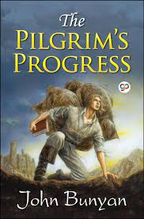
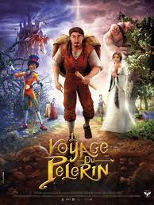
Notes:
Start here on November 20, 2022.

Slide 95
3. The Abolition of Man
The Pilgrim’s Regress deals with the rightful abolition of man, i.e., putting off the old man, the sinful self. But man’s increasing power over nature is not necessarily good (54).
Mankind’s power over nature—for example, the airplane, the radio (the word “wireless” has certainly changed its meaning, hasn’t it?), and the contraceptive (all of which can be withheld by some people to have power over others)

Slide 96
3. The Abolition of Man
Question (W23): Lewis argues that when someone uses an airplane, a wireless (i.e., radio), or a contraceptive, “it cannot strictly be said that … he is exercising his own proper or individual power over Nature.” Why not? Do you agree and, if so, do you agree equally strongly for all three examples?
Notes:
Ward’s Question 23, p. 200.

Slide 97
3. The Abolition of Man
This includes the power of this generation over future generations (56).
“In reality, of course, if any one age really attains, by eugenics and scientific education, the power to make its descendants what it pleases, all men who live after it are the patients of that power” (57). Especially the university professors.
If a future generation is the last generation, it has no power to extend to a future with no one in it.

Slide 98
3. The Abolition of Man—Education
“It must be remembered that in Mark’s mind hardly one rag of noble thought, either Christian or Pagan, had a secure lodging. His education had been neither scientific nor classical—merely “Modern.” The severities both of abstraction and of high human tradition had passed him by: and he had neither peasant shrewdness nor aristocratic honor to help him.…” (185).
Notes:
That Hideous Strength, 185.

Slide 99
3. The Abolition of Man—Education
“… He was a man of straw, a glib examinee in subjects that require no exact knowledge (he had always done well on Essays and General Papers) and the first hint of a real threat to his bodily life knocked him sprawling” (185).
Notes:
That Hideous Strength, 185.

Slide 100
3. The Abolition of Man
“Man’s conquest of Nature, if the dreams of some scientific planners are realized, means the rule of a few hundreds of men over billions upon billions of men. There neither is nor can be any simple increase of power on Man’s side. Each new power won by man is a power over man as well. Each advance leaves him weaker as well as stronger. In every victory, besides being the general who triumphs, he is also the prisoner who follows the triumphal car” (58).
The result is totalitarianism.
Notes:
Clotho—one of the three goddesses of Fate, who apportioned to each person his “thread of life” (59).

Slide 101
3. The Abolition of Man
“Hitherto the plans of educationalists have achieved very little of what they attempted …” (59f.) Is this true in the USA today?
“But the man-molders of the new age will be armed with the powers of an omnicompetent state …” Does this sound familiar?

Slide 102
3. The Abolition of Man
“Values are now mere phenomena. Judgments of value are to be produced in the pupil as part of the conditioning. Whatever Tao there is will be the product, not the motive, of education” (61).
Hence, values are subjective, determined by the Conditioners, a minority of people with the power of the State at their disposal.
The old liberalism didn’t care what others thought. The new liberalism uses the power of the State to demand conformity to its dictates.

Slide 103
Conditioning/Propaganda in THS
“Why you fool, it’s the educated reader who can be gulled. All our difficulty comes with the others. When did you meet a workman who believes the papers? He takes it for granted that they’re all propaganda and skips the leading articles. He buys his paper for the football results and the little paragraphs about girls falling out of windows and corpses found in Mayfair flats. He is our problem. We have to recondition him. But the educated public, the people who read the highbrow weeklies, don’t need reconditioning. They’re all right already. They’ll believe anything.”
Notes:
Fairy Hardcastle to Mark Studdock, as Studdock talks about knowing what his job is or leaving the N.I.C.E. Page 99f.

Slide 104
3. The Abolition of Man
“They are, if you like, men who have sacrificed their own share in traditional humanity in order to devote themselves to the task of deciding what ‘Humanity’ shall henceforth mean” (63).
Sic volo, sic jubeo = “as I will, so I command” (Juvenal). So, whatever I choose is right; I did it because I could.
“When all that says ‘it is good’ has been debunked, what says ‘I want’ remains” (65).

Slide 105
3. The Abolition of Man
“I am very doubtful whether history shows us one example of a man who, having stepped outside traditional morality and attained power, has used that power benevolently. I am inclined to think that the Conditioners will hate the conditioned” (66).
Notes:
Clinton on the deplorables.

Slide 106
History
It is good to criticize the past, but we also need to let the past criticize us. Lewis knew that people in each historical period have prejudices of which they are unaware. For example, if we should tear down statues because of the sins of those people who are recognized by the statues, what statues should remain? Who has such a personal record that they can’t be criticized?

Slide 107
3. The Abolition of Man
Definition of “nature” and “the natural” (68f.)
The opposite of “the Natural” is the Artificial, the Civil, the Human, the Spiritual, the Supernatural.
Nature is the spatial and temporal, the world of quantity rather than the world of quality, what knows no values versus what perceives values (69).
Rebecca West: “Perhaps the sin against the Holy Ghost is to deal with people as though they were things.”
Notes:
Theodore Roszak, “… treats quantities as objective knowledge and qualities as a matter of subjective preference.” Aeschliman, p. 50.

Slide 108
3. The Abolition of Man
“The stars lost their divinity as astronomy developed, and the Dying God has no place in chemical agriculture” (70).
“In our world,” said Eustace, “a star is a huge ball of flaming gas.”
“Even in your world, my son, that is not what a star is but only what it is made of. And in this world you have already met a star, for I think you have been with Coriakin.” (VDT)

Slide 109
3. The Abolition of Man
Kierkegaard was happy to let science deal with plants and animals and stars, but “to handle the spirit of man in such a fashion is blasphemy.”
Notes:
Aeschliman, p. 31 for the Kierkegaard note.

Slide 110
3. The Abolition of Man
In 2010, Anthony Cashmore published an article about human behavior and the criminal justice system. His points:
There is no such thing as free will.
“individuals cannot logically be held responsible for their behavior”
“as living systems, we are nothing more than a bag of chemicals”
He wanted to minimize retributive punishment.
Notes:
Anthony Cashmore, “The Lucretian swerve: The biological basis of human behavior and the criminal justice system.” Proceedings of the National Academy of Sciences. January 12, 2010. www.pnas.org/cgi/doi/10.1073/pnas0915161107. See also Ward, 171. Two-tiered justice based on personal preferences.

Slide 111
C. John Collins
What would Lewis say?
“Lewis would surely point out that Cashmore, in declaring our thoughts to be merely a biological phenomenon, has undercut anyone’s right to believe such a claim.”
That is, …
Cashmore’s thoughts are also merely a biological phenomenon and therefore no more valid than anyone else’s opinion or claim.
Notes:
C. John Collins, “A Peculiar Clarify,” The Magician’s Twin, 95.

Slide 112
Eugenics in Abolition, Part 3
“Something has to be overcome before we can cut up a dead man or a live animal in a dissecting room” (70).

Slide 113
Mere Physical Properties
“… the mere trousered ape who has never been able to conceive the Atlantic as anything more than so many million tons of cold salt water” (“Men Without Chests,” 9).

Slide 114
Professor Augustus Frost to Mark Studdock
“Before going on,” said Frost, “I must ask you to be strictly objective. Resentment and fear are both chemical phenomena. Our reactions to one another are chemical phenomena. Social relations are chemical relations. You must observe these feelings in yourself in an objective manner. Do not let them distract your attention from the facts.”
Notes:
THS, Chapter 12: “Wet and Windy Night,” page 255. Start here on January 15, 2023.

Slide 115
That Hideous Strength: Studdock and Cosser at Cure Hardy
They walked about that village for two hours and saw with their own eyes all the abuses and anachronisms they came to destroy. They saw the recalcitrant and backward laborer and heard his views on the weather….
Notes:
That Hideous Strength. New York: Macmillan, 1946, 87. They are writing an essay about getting rid of Cure Hardy to advance the cause of the N.I.C.E.

Slide 116
That Hideous Strength: Studdock and Cosser at Cure Hardy
… They met the wastefully supported pauper in the person of an old man shuffling across the courtyard of the almshouses to fill a kettle, and the elderly rentier (to make matters worse, she had a fat old dog with her) in earnest conversation with the postman….
Notes:
That Hideous Strength. New York: Macmillan, 1946, 87. They are writing an essay about getting rid of Cure Hardy to advance the cause of the N.I.C.E.

Slide 117
That Hideous Strength: Studdock and Cosser at Cure Hardy
… It made Mark feel as he were on a holiday, for it was only on holidays that he had ever wandered about an English village. For that reason he felt pleasure in it. It did not quite escape him that the face of the backward laborer was rather more interesting than Cosser’s and his voice a great deal more pleasing to the ear.
Notes:
That Hideous Strength. New York: Macmillan, 1946, 87. They are writing an essay about getting rid of Cure Hardy to advance the cause of the N.I.C.E.

Slide 118
The Gradual Incline
When asked to write a story about a disturbance before it happened . ..
“This was the first thing Mark had been asked to do which he himself, before he did it, clearly knew to be criminal” (Chapter 6, 130).
Has our society seen media figures defend violence?

Slide 119
That Hideous Strength: Studdock and Cosser at Cure Hardy
The resemblance between the elderly rentier and Aunt Gilly (When had he last thought of her? Good Lord, that took one back.) did make him understand how it was possible to like that kind of person. All this did not in the least influence his sociological convictions. Even if he had been free from Belbury and wholly unambitious, it could not have done so, for his education had had the curious effect of making things that he read and wrote more real to him than things he saw.
Notes:
That Hideous Strength. New York: Macmillan, 1946, 87.

Slide 120
That Hideous Strength: Studdock and Cosser at Cure Hardy
Statistics about agricultural laborers were the substance; any real ditcher, ploughman, or farmer’s boy, was the shadow. Though he had never noticed it himself, he had a great reluctance, in his work, ever to use such words as “man” or “woman.” He preferred to write about “vocational groups,” “elements,” “classes” and “populations”: for, in his own way, he believed as firmly as any mystic in the superior reality of the things that are not seen.
Notes:
That Hideous Strength. New York: Macmillan, 1946, 87.

Slide 121
3. The Abolition of Man
Examples?
Most transgenderism, the abandonment of traditional marriage, the move to abolish the right to private property, atheism, two-tiered justice, the devaluing of life in the womb or in old age, and the use of fetal cells to produce a vaccine.
Getting rid of all traditional values.

Slide 122
3. The Abolition of Man
P. 71, Question (W25): In Lewis’s view, it is not the greatest scientists but “little scientists and little unscientific followers of science” who are most sure that an object stripped of its qualitative properties and reduced to mere quantity is wholly real. Why are “qualitative properties” so important to him? Do you share his view?
Notes:
Question 25 in Ward, p. 200. Kreeft calls it reductionism.

Slide 123
3. The Abolition of Man
P. 72, Question (W26): “If man chooses to treat himself as raw material, raw material he will be.” Do you see evidence of this approach to humanity either in your own attitudes and actions or in the attitudes and actions of other people? Specify.
Notes:
Question 26 in Ward, p. 201.

Slide 124
3. The Abolition of Man
P. 73: In Lewis’s view, subjectivism undermines “the very idea of a rule which is not tyranny or an obedience which is not slavery.” Questions (W14): Why does he say this? Do you agree? Is subjectivism compatible with democracy?
P. 73: “many a mild-eyed scientist in pince-nez …” An echo of Professor Frost in THS.
P. 75: Lewis denies that this lecture is an attack on science. Question (W27): “Nothing I can say will prevent some people from describing this lecture as an attack on science.” Is The Abolition of Man an attack on science?
Notes:
Questions 14 and 27 in Ward, p. 200. Page 76: “from science herself might come the cure.”

Slide 125
Language
Rowan Williams, “… for Lewis, the abuse of language is one of the things which would tell you immediately that you couldn’t trust someone …”
Lewis: “Once we killed bad men: now we liquidate unsocial elements” (74).
What examples of the abuse of language do you see in our world today?
Notes:
The accusation of racism for every disagreement, the use of “anti-abortion” instead of “pro-life” or vice versa, etc.

Slide 126
But first, classify four things (Kreeft).
Put them in two categories.
Religion, science, magic, and technology
Lewis puts religion and science together, while most would put religion and magic together.
The issue: conforming the mind to objective reality rather than the other way around.
Notes:
Kreeft, C. S. Lewis for the Third Millennium, p. 136. Abolition, p. 76.

Slide 127
3. The Abolition of Man
Question (W24): “There is something which unites magic and applied science” (77). Why does Lewis say this? Do you agree?
Lewis: “The serious magical endeavor and the serious scientific endeavor are twins: one was sickly and died, the other strong and throve. But they were twins. They were born of the same impulse” (76).
A “Magician’s bargain” or the “Magician’s twin” (76), since both tried to control nature, to subdue reality to the wishes of men (77). Faustus wants gold, guns, and girls.
Notes:
Question 24 in Ward, p. 200. Page 77: “For magic and applied science alike the problem is how to subdue reality to the wishes of men.”

Slide 128
3. The Abolition of Man
That is, Faustus wants wealth, power, and unbridled lust.
“The whole point of seeing through something is to see something through it” (81).

Slide 129
3. The Abolition of Man
Question (W28): What does Lewis mean by “regenerate science” (79)?
Question (W29): “Dulce et decorum est … Nazi rulers … Quislings … men of Vichy.” How much does the war-time context affect Lewis’s argument? Does this weaken or strengthen it?
Notes:
Questions 28 and 29 in Ward, p. 201.

Slide 130
Appendix: Illustrations of the Tao
Question (W30): Is the Tao best understood as objective goodness in general or as moral laws in particular (e.g., those outlined in the appendix)?
Question (W9): Does Lewis ignore or downplay the differences between moral traditions?
Question (W9): If so, does it matter?
Notes:
Questions 9 and 30 in Ward, p. 201.

Slide 131
Appendix: Illustrations of the Tao
Question (W31): Many of the traditions Lewis cites in the appendix are theistic. Does this undermine his claim that he is not making an “indirect argument for Theism”?
Question (W32): If the different duties listed in the appendix were to conflict in a given situation (e.g., the laws of general and special beneficence), how would you decide what to do?
Question (W33): Why do you think Lewis finishes his appendix with the quotation from John’s Gospel?
Notes:
Ward’s Questions 31, 32, and 33 on p. 201.

Slide 132
For Further Reading
Michael Aeschliman, The Restitution of Man: C. S. Lewis and the Case against Scientism. Grand Rapids: Eerdmans, 1983.
John G. West, ed. The Magician’s Twin: C. S. Lewis on Science, Scientism, and Society. Seattle: Discovery Institute Press, 2012.
Peter Kreeft, C. S. Lewis for the Third Millennium. San Francisco: Ignatius Press, 1994.

Slide 133
The Goodness of Goodness and the Badness of Badness
According to Peter Kreeft, Lewis refutes at least twenty moral heresies.
Subjectivism, Emotivism, Positivism, Cultural-relativism or conventionalism, Historicism, Utilitarianism, Instinctualism, Hedonism, Egotism, Pragmatism, Optimistic humanism, Cynicism, Pop-psychobattle, Moral phlistinism, Rationalism, Calvinism, Secularism, Pantheism, Moralism, and Nietzscheanism.
Notes:
C. S. Lewis for the Third Millennium, 68f.

Slide 134
The Goodness of Goodness and the Badness of Badness
Subjectivism: the subjectivity of goodness and badness
Emotivism (one of subjectivism’s little brothers): the reduction of goodness and badness to emotions
Positivism (another of subjectivism’s little brothers): the idea that man posits values with his will, invents goodness and badness

Slide 135
The Goodness of Goodness and the Badness of Badness
Cultural-relativism or conventionalism: the relativity of goodness and badness to place, or culture
Historicism: the relativity of goodness and badness to time
Utilitarianism: the reduction of goodness to utility, or efficiency
Notes:
On Historicism: Aragorn … “Good and evil have not changed since yesteryear, nor are they one thing among Elves and Dwarves and another among Men. It is a man’s part to discern them, as much in the Golden Wood as in his own house.” The Lord of the Rings.

Slide 136
The Goodness of Goodness and the Badness of Badness
Instinctualism: the reduction of goodness to biological instinct
Hedonism: the reduction of goodness to pleasure
Egotism: the reduction of goodness to enlightened selfishness

Slide 137
The Goodness of Goodness and the Badness of Badness
Pragmatism: the weakness of goodness and the power of badness
Optimistic humanism: the denial of the existence of human badness
Cynicism: the denial of the existence of human goodness

Slide 138
The Goodness of Goodness and the Badness of Badness
Pop-psychobattle: the niceness of goodness and the nastiness of badness
Moral phlistinism: the dullness of goodness and the beauty of badness
Rationalism: the simplicity and plainness of goodness

Slide 139
The Goodness of Goodness and the Badness of Badness
Calvinism: the reduction of goodness to arbitrary divine decree
Secularism: the reduction of goodness to the merely horizontal (human)
Pantheism: the identity of goodness and badness

Slide 140
The Goodness of Goodness and the Badness of Badness
Moralism: the idolization of moral goodness as ultimate
Nietzscheanism: the goodness of badness and the badness of goodness, the “transvaluation of all values”

