Slide 1
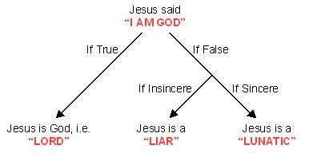
“The Shocking Alternative”

Slide 3
Testimonies
Stephen Arterburn, author of more than thirty books, including Every Man’s Battle: “Showed me that most of what I had been taught about what a Christian is and is not was not true.”
Steve Brown, author of Approaching God, seminary professor
Bryan Chapell, president of Covenant Seminary, St. Louis: “Lewis’s thoughtful and sensitive defense of Christianity resonated with the faith needs of my teen years.”

Slide 4
Testimonies
Lyle Dorsett, editor of The Essential C. S. Lewis: “Was instrumental in my conversion to faith in Jesus Christ as Savior and Lord.”
Ted W. Engstrom, president emeritus of World Vision: “This is a basic treatise on the Christian faith, which is wonderfully profound in its simplicity.”
Gordon D. Fee, professor of New Testament, Regent College: “Helped me realize that a burning heart did not necessarily mean one had to have a pumpkin for a head.”

Slide 5
Testimonies
George Gallup, Jr. pollster: “Brought me a heart-stopping awareness, when I was a student at Princeton, that Christianity is a religion of the head as well as the heart, and that our hope is not in finding ourselves, but in losing ourselves—in God.”
John Guest, pastor of Christ Church at Grove Farm: “Lewis’s clear thinking about the relativism he saw advancing, and his giftedness at making relativism look ‘silly,’ helped me challenge such silliness—and thereby make the gospel all the more relevant.”

Slide 6
Testimonies
Peter Kreeft, Boston College philosopher: “The reader emerges with not only knowledge, but wisdom.”
Woodrow Kroll, president of Back to the Bible: “Lewis makes sense when he states the case for Christianity. It was compelling the first time I read it; it remains compelling today.”
Kevin Leman, author of Sex Begins in the Kitchen and The New Birth Order Book: “After reading this book, I realized what God’s grace means.”

Slide 7
Testimonies
Alister McGrath, professor of historical theology, Oxford University
Rebecca Manley Pippert, author of Out of the Salt Shaker: “In Lewis I found myself face-to-face with an intellect so disciplined, so lucid, so relentlessly logical, that all my intellectual pride at not being a ‘mindless believer’ was quickly squelched.”
Cornelius Plantinga Jr., president of Calvin Theological Seminary: “Who else so wonderfully combines sharp thinking, soaring theological imagination, and noble simplicity?”

Slide 8
Testimonies
Leland Ryken, editor of The Christian Imagination: “Helped to codify my thinking about Christian belief and practice during my college years.”
All testimonies from Indelible Ink: 22 Prominent Christian Leaders Discuss the Books that Shape Their Faith. Scott Larsen, senior editor.

Slide 9
“The Shocking Alternative”
Mere Christianity
Book II: What Christians Believe, Chapter 3

Slide 10
Nicol cross
The Principal of Manchester College at Oxford University, Nicol Cross, a Unitarian, didn’t like the logic of Lewis in one of his talks.
Cross called himself a Unitarian—a creed sometimes defined as “one God, no devil, and twenty shillings in the pound.”
Cross wanted to believe that Jesus was a good man, but nothing more.

Slide 11
Nicol cross
He said at a meeting of the Socratic Club on November 11, 1946 that “he must allude to the ‘vulgar nonsense’ that ‘a man who said the things that Jesus said, and was not God would be either a lunatic or a devil.’”
He said that this represented such a simplification of the possibilities as only a naïve person could perpetrate, who combined a triple ignorance of New Testament criticism, of psychology, and of elementary logic.
Oh, really?

Slide 12
Lewis on the bbc
He was quoting Lewis’s BBC address, entitled “The Shocking Alternative,” first delivered on Feb. 1, 1942, an address that later became Chapter Three of Book Two in Mere Christianity. Elton Trueblood, professor of philosophy and chaplain at both Stanford University and Earlham College, had a much different and more accurate perspective on this most powerful chapter:

Slide 13
Elton trueblood
“In reading Lewis I could not escape the conclusion that the popular view of Christ as being a Teacher, and only a Teacher, has within it a self-contradiction that cannot be resolved. I saw, in short, that conventional liberalism cannot survive rigorous and rational analysis.” (Elton Trueblood, While It Is Day: An Autobiography, 99)
Read “only a Teacher” as “a good man, but nothing else.”

Slide 14
outline
There is a Prince of this World, an evil power.
An analogy on Free Will from the home.
God created us with Free Will.
God thought it worth the risk.
The better the creature the better if it goes right, but also the worse if it goes wrong.
The Dark Power went wrong by wanting to be in the center, wanting to be God, which is what our first sin was.
God made us to run on Himself, which is why we will never be happy without God.

Slide 15
outline
People and civilizations have a flaw.
God did three things to solve this problem:
Conscience
Good dreams
The Jews
One of the Jews talks as if He were God; He claims to forgive sins.
Jesus “behaved is if He was the party chiefly concerned.”
If Jesus were just a man, He wouldn’t act this way.
He is Lord, liar, or lunatic.

Slide 16
Jesus forgives
We can all understand how a man forgives offences against himself. You tread on my toe and I forgive you, you steal my money and I forgive you. But what should we make of a man, himself unrobbed and untrodden on, who announced that he forgave you for treading on other men’s toes and stealing other men’s money? Asinine fatuity is the kindest description we should give of his conduct. Yet this is what Jesus did.

Slide 17
Jesus forgives
He told people that their sins were forgiven, and never waited to consult all the other people whom their sins had undoubtedly injured. He unhesitatingly behaved as if He was the party chiefly concerned, the person chiefly offended in all offences. This makes sense only if He really was the God whose laws are broken and whose love is wounded in every sin.

Slide 18
Lewis, the master of logic
Educated in the medieval Trivium, which is …
Grammar
Logic
Rhetoric
Logic is considered to be “the enquiry into the principles of valid thought” or “the study of the principles of valid thinking.” (Prof. H. A. Hodges)
It is the foundation of philosophy.

Slide 19
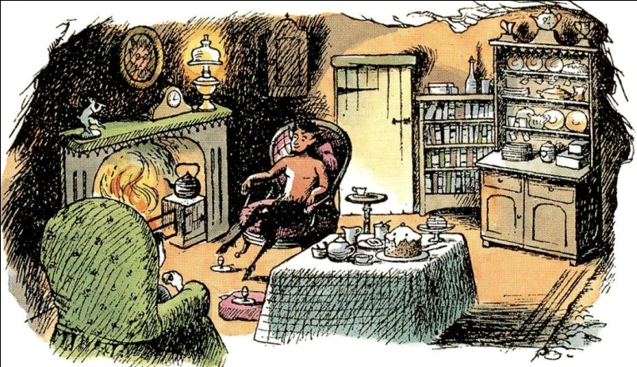
Lucy in The Lion, the Witch…
The context of this story in The Lion, the Witch and the Wardrobe.
The three options for Lucy.
“Logic!” said the Professor half to himself. “Why don’t they teach logic at these schools? There are only three possibilities.”

Slide 20
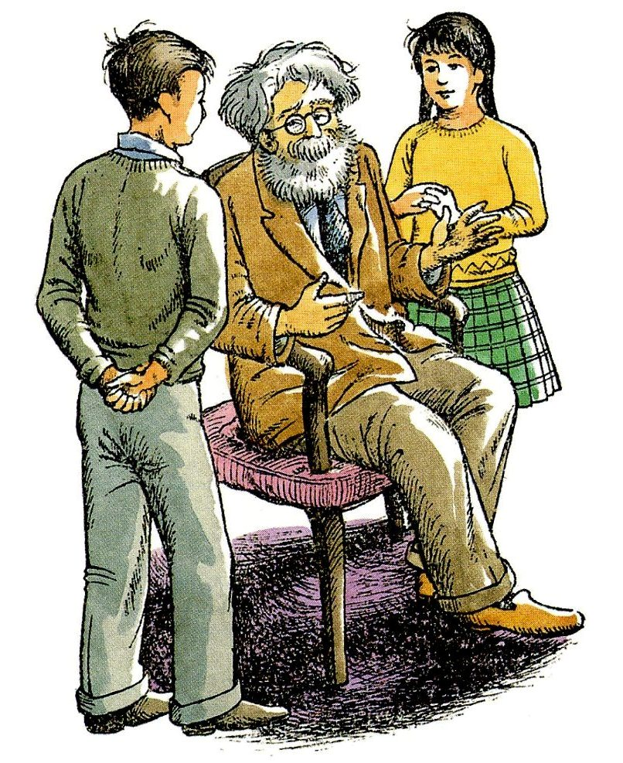
Professor Kirke
“Either your sister is telling lies, or she is mad, or she is telling the truth. You know she doesn’t tell lies and it is obvious that she is not mad. For the moment then and unless any further evidence turns up, we must assume that she is telling the truth.”

Slide 21
Lord, Liar, or lunatic
I am trying here to prevent anyone saying the really foolish thing that people often say about Him: “I’m ready to accept Jesus as a great moral teacher, but I don’t accept His claim to be God.” That is the one thing we must not say. A man who was merely a man and said the sort of things Jesus said would not be a great moral teacher. He would either be a lunatic—on a level with the man who says he is a poached egg—or else he would be the Devil of Hell.

Slide 22
Lord, Liar, or lunatic
You must make your choice. Either this man was, and is, the Son of God: or else a madman or something worse. You can shut Him up for a fool, you can spit at Him and kill Him as a demon; or you can fall at His feet and call Him Lord and God. But let us not come with any patronizing nonsense about His being a great human teacher [a good man]. He has not left that open to us. He did not intend to.

Slide 23
Discussion Questions

